Slide 1
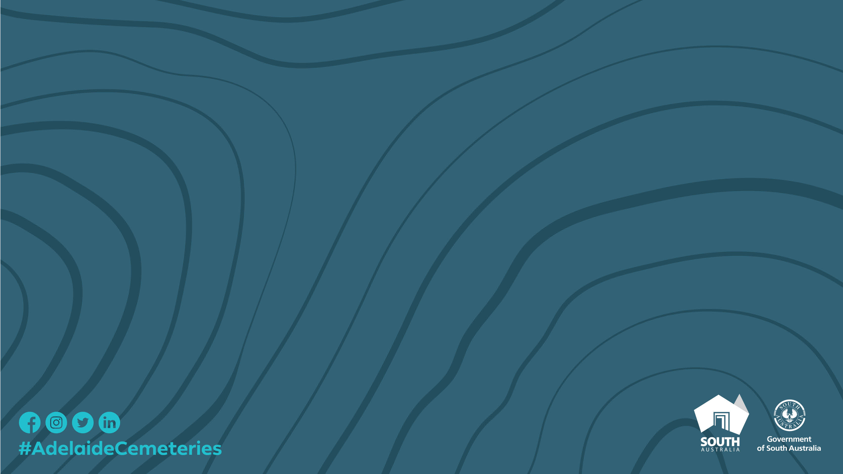

Nurture Nature
How cemeteries and crematoria can achieve positive and sustainable environmental outcomes
Paula Pothoven
Environment & Project Manager

Slide 2
Today
Paula Pothoven, Environment & Project Manager
History of Cemeteries and the Environment
Making sense of Sustainability
Adelaide Cemeteries & its Environmental Journey
What Next?

Slide 3
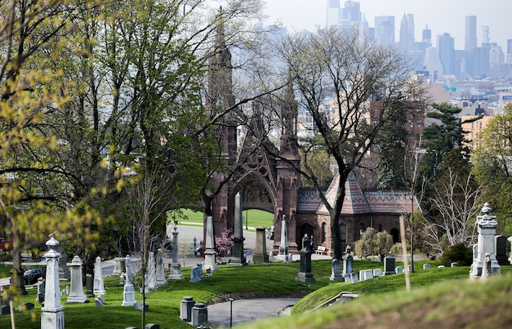
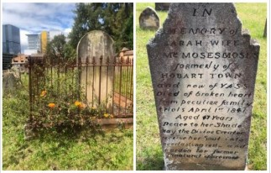
Cemeteries first Urban Parks
Cemeteries were the inspiration for many of today’s parks
Spacious & sanitary space for the dead
Tourist attractions - admission was free, guided tours, urban oases
WTC Promenade
Green Wood cemetery, NY – USA has 7,000 trees of more than 700 different species, making it a haven for biodiversity in the concrete jungle.
St Johns Cemetery, built 1790 - Parramatta, Sydney, NSW

Slide 4
The Importance of Cemeteries
Biological Diversity – diverse species, ecosystems or biological communities, rare or endangered elements or distinctive species
Geodiversity – unusual hydrological systems, unique fossils or landforms
Scientific – landscape may contribute to broader scientific understanding
Aesthetic – inspirational design, symbolic, sounds & smells
Natural Heritage Value – indigenous vegetation – may be an important biological or geological resource

Slide 5
Cemeteries in SA
Over 700 cemeteries in South Australia
Reflect the attitudes of the time
A history of people
Valued by community
Significant to all societies & cultures

Slide 6
Why Cemeteries are a surprising source of Life
Smithfield Memorial Park
  # Trees : 5000+
  # Species Trees : 47
  # Plant / Shrub Species : 60
  # Species Fauna : 5
  # Species Insects : 12
  # Species Avian : 38
Cheltenham Cemetery
  # Trees : 80
  # Species Trees : 11
  # Plant / Shrub Species : 25
  # Species Fauna : 3
  # Species Insects : 10
  # Species Avian : 6
West Terrace Cemetery
  # Trees : 690
  # Species Trees : 37
  # Plant / Shrub Species : 38
  # Species Fauna : 6
  # Species Insects : 14
  # Species Avian : 24
Enfield Memorial Park
  # Trees : 2000+
  # Species Trees : 250
  # Plant / Shrub Species : 150
  # Species Fauna : 3
  # Species Insects : 12
  # Species Avian : 13
many species are yet to be identified and our
teams continue to add to our registers as species are identified

Slide 7
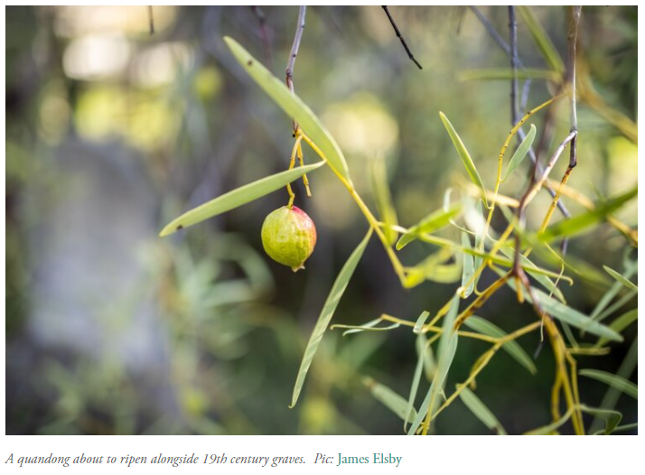
West Terrace Remnant Vegetation
Australia’s oldest metropolitan cemetery still operating
Rare native quandong grove
100-year-old Olive trees
Native vegetation laws prevent visitors from sampling the produce.
Ref: WTC Conservation Management Plan

Slide 8
Regulatory Context
What is Sustainability?
“development that meets the needs of the present without compromising the ability of future generations to meet their own needs”
Federal Government
SA Government
The Environment Protection Act 1993 or EP Act provides the regulatory framework to protect South Australia's (SA) environment, including land, air and water.
Environmental Protection Policies & Regulations
Department of Environment & Water
Local Councils & regulators such as the EPA

Slide 9
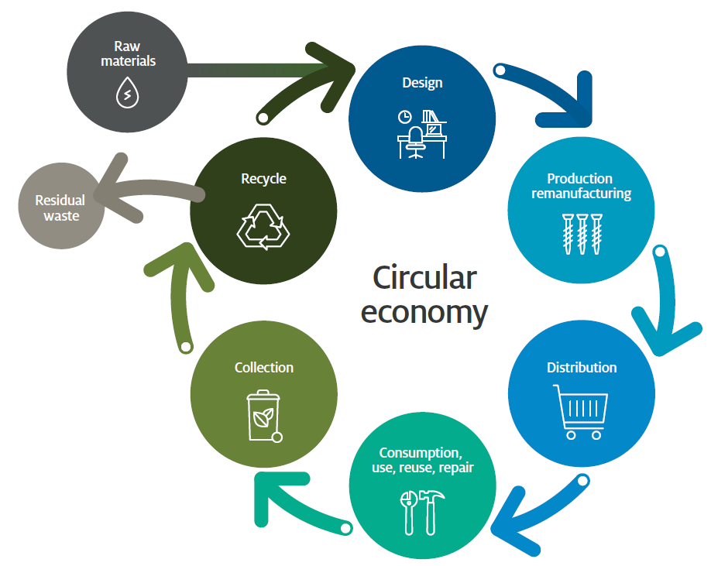
Sustainability in Cemeteries
What is it & how do we achieve it?
Measure & Monitor
Emissions – Scope 1, 2 & 3
Considering the Whole of Life Costs when purchasing
we are a sustainable cemetery, which sustains, and is sustained, by nature

Slide 10
Adelaide Cemeteries ISO:14001 Accreditation
Journey commenced in 2016
Accredited in June 2020
What is it?
Environmental Management System (EMS)
Why have it?
How has it benefited the Adelaide Cemeteries?

Slide 11
Sustainability at the Adelaide Cemeteries
Full abatement system on new cremators to capture emissions
Five Year agreement with Trees for Life
Adelaide High School & Willos Men's Shed
QR Codes on Collateral
Shift to Compostable versus biodegradable
Smart Water Monitoring & Species Selection
Electric Vehicle Charging & expansion of electric fleet

Slide 12
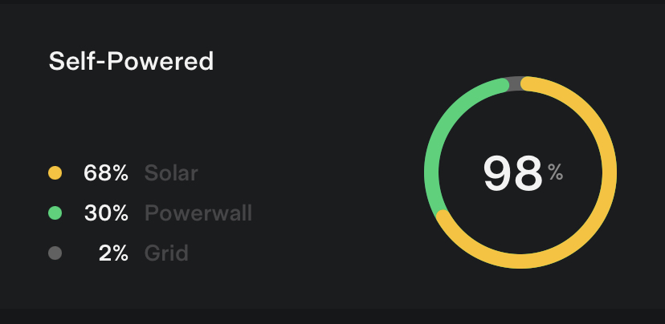
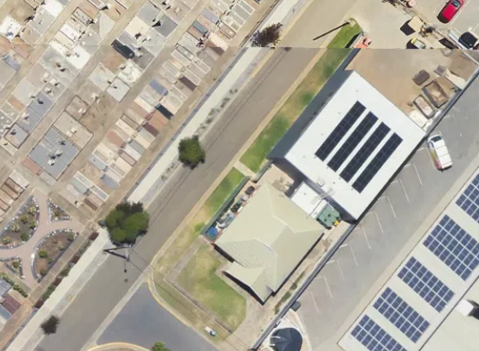
Sustainability at the Adelaide Cemeteries
New Solar System and Tesla Battery : Cheltenham
Expand Solar System : Enfield
New Solar System and Tesla Battery : Smithfield
Aerial View Cheltenham Solar System

Slide 13
Sustainability at the Adelaide Cemeteries
Recycling of plastic coffin handles (prior to cremation)
Milk Carton Recycling
Phasing out all balloons
Evolution towards a plastic free environment
Grave Re-Use & Recycling of Monuments
Conservation of Monuments
Natural burials
Milk Carton Recycling / YCA Regency Park

Slide 14
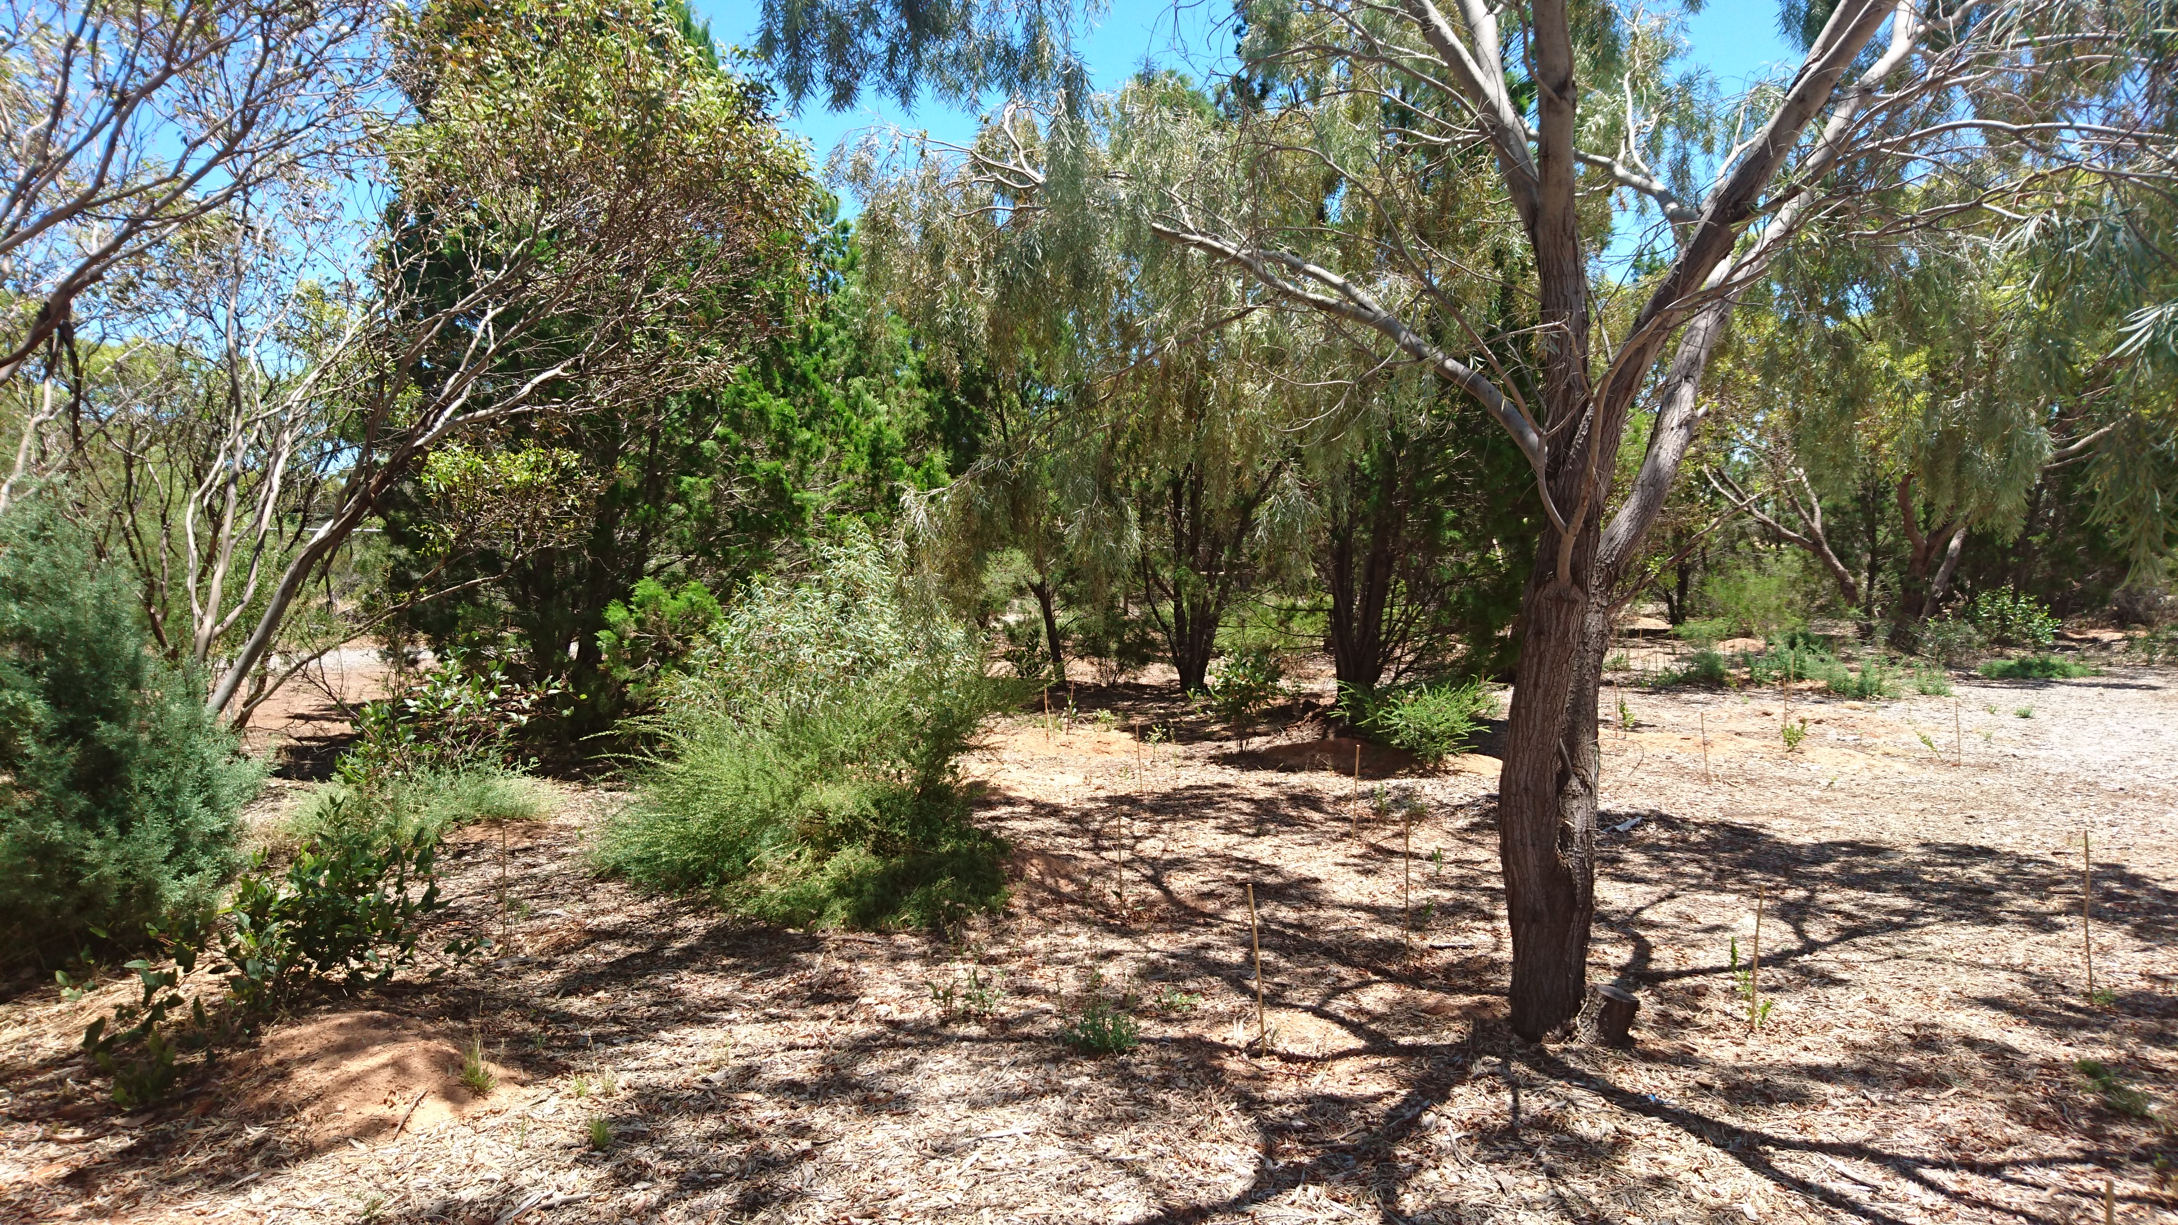
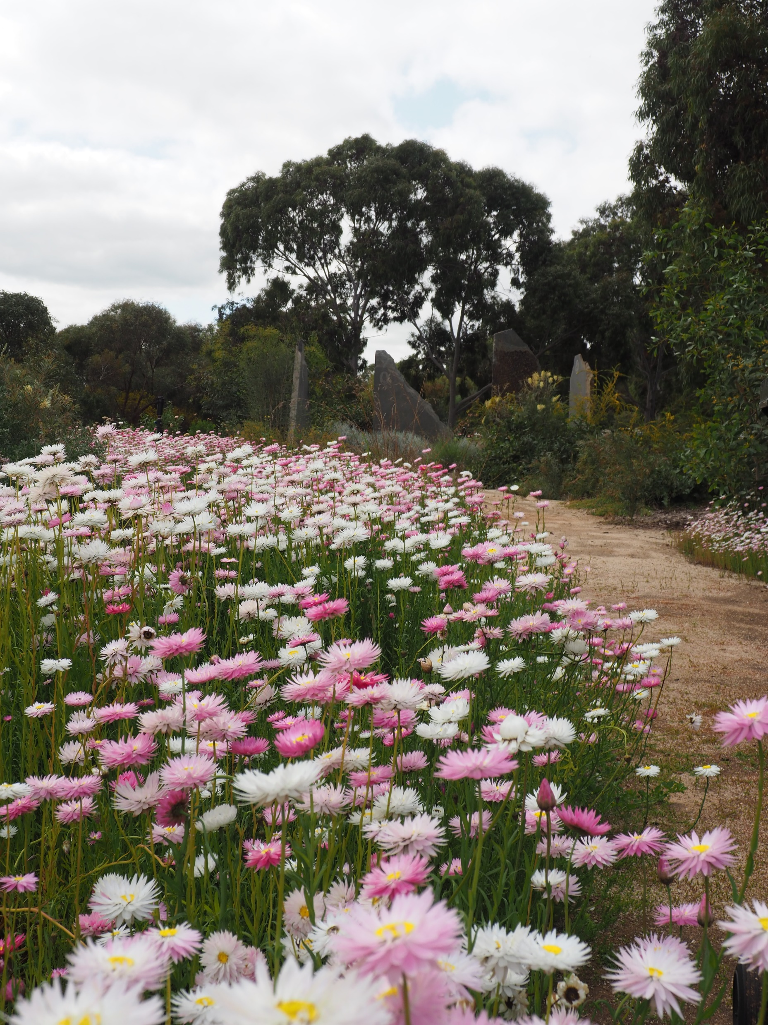
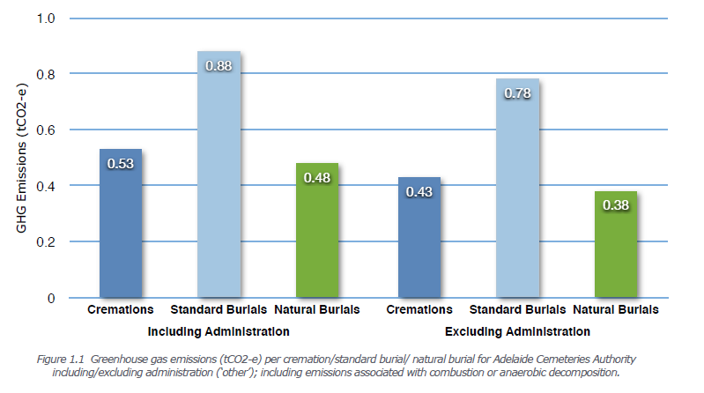
Natural
Burials
Wirra Wonga
Enfield Memorial Park
Pilyu Yarta
Smithfield Memorial Park
Ref: A Comparison of GHG Emissions due to Burial & Cremations
Chandler, Dr Helen; Cirtog, Dr Adina & Ross, Dr David (2013)

Slide 15
What Next?
Superficial “greening” won't pass muster
Increasing regulatory environment
Increasing expectations of consumers & stakeholders
Increasing costs for utilities – particularly power & water
Resilience - its Good for Business

Slide 16
What Next?
Increase in Natural Burials
Sea or Air Burials
Cryomation
Resomation
Regulatory requirement to rate Products & Services
Natural forms of memorialisation

Slide 17
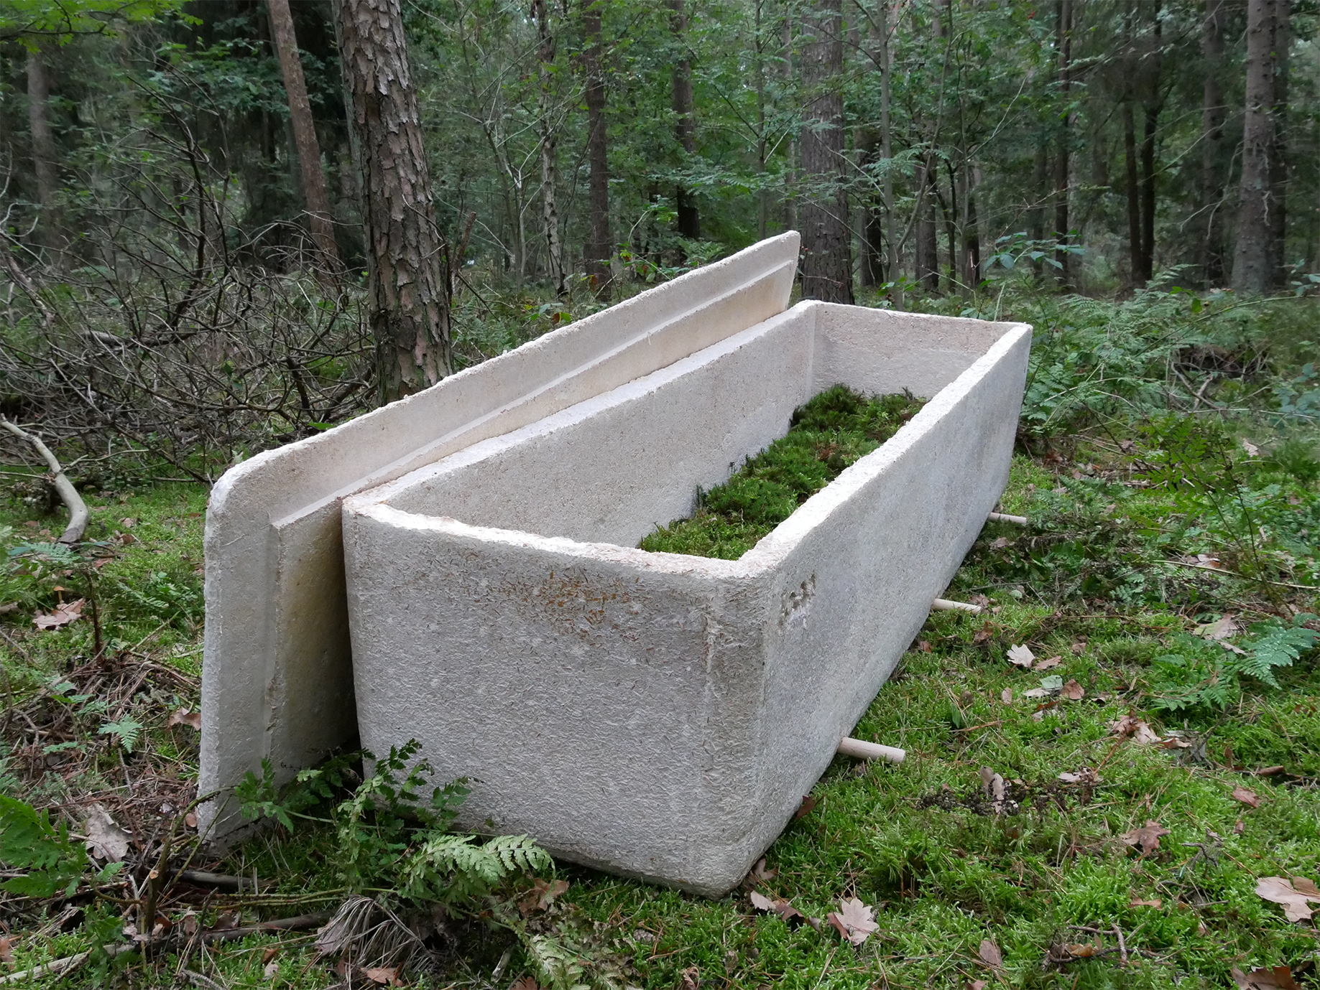
Mycelium (Mushroom Coffin)

Slide 18
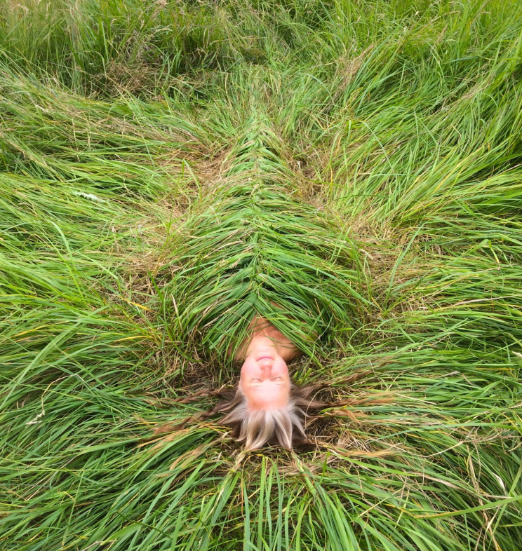
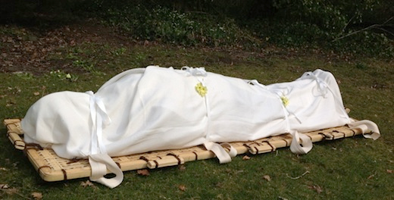
Shroud Burial (Compostable Materials)
No Shroud

Slide 19
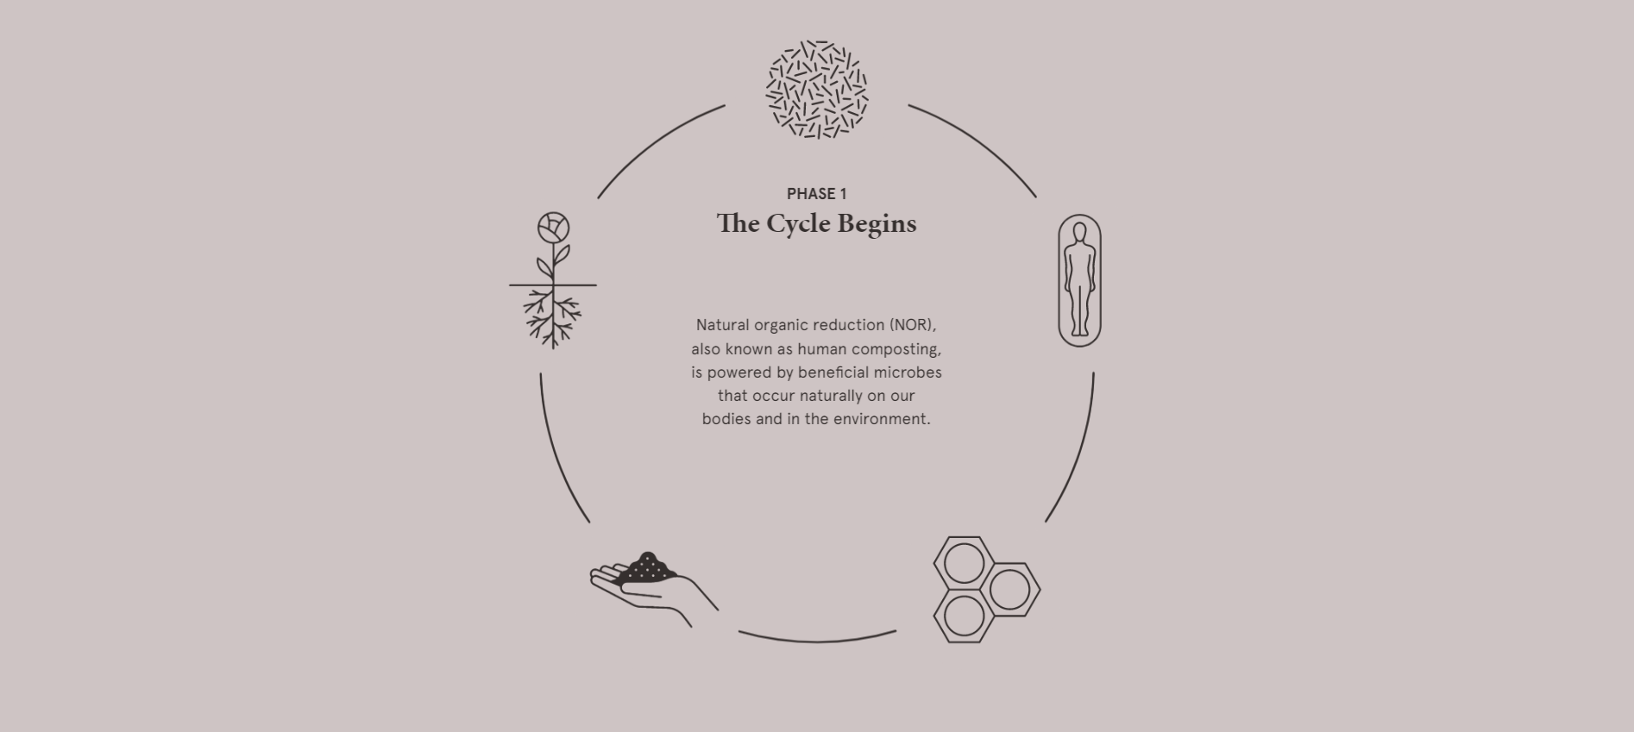
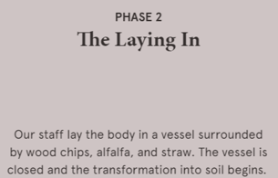
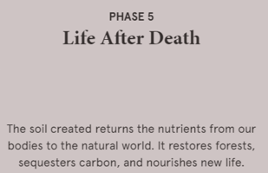
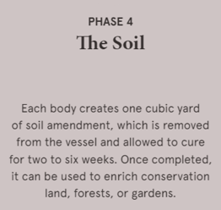
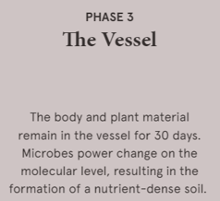
Recompose
Human Composting
(ecological death care)
https://recompose.life/our-model/
https://recompose.life/our-model/

Slide 20

Questions?
Thank You
Special Thanks for the Contributions by our Team
Peter Sobotta, Project Officer, Horticulture
Rikki King, Smithfield Memorial Park Team Leader
Tahnee Thomas, Environmental Sustainability Coordinator
Michael Robertson, Chief Executive Officer

