Slide 2
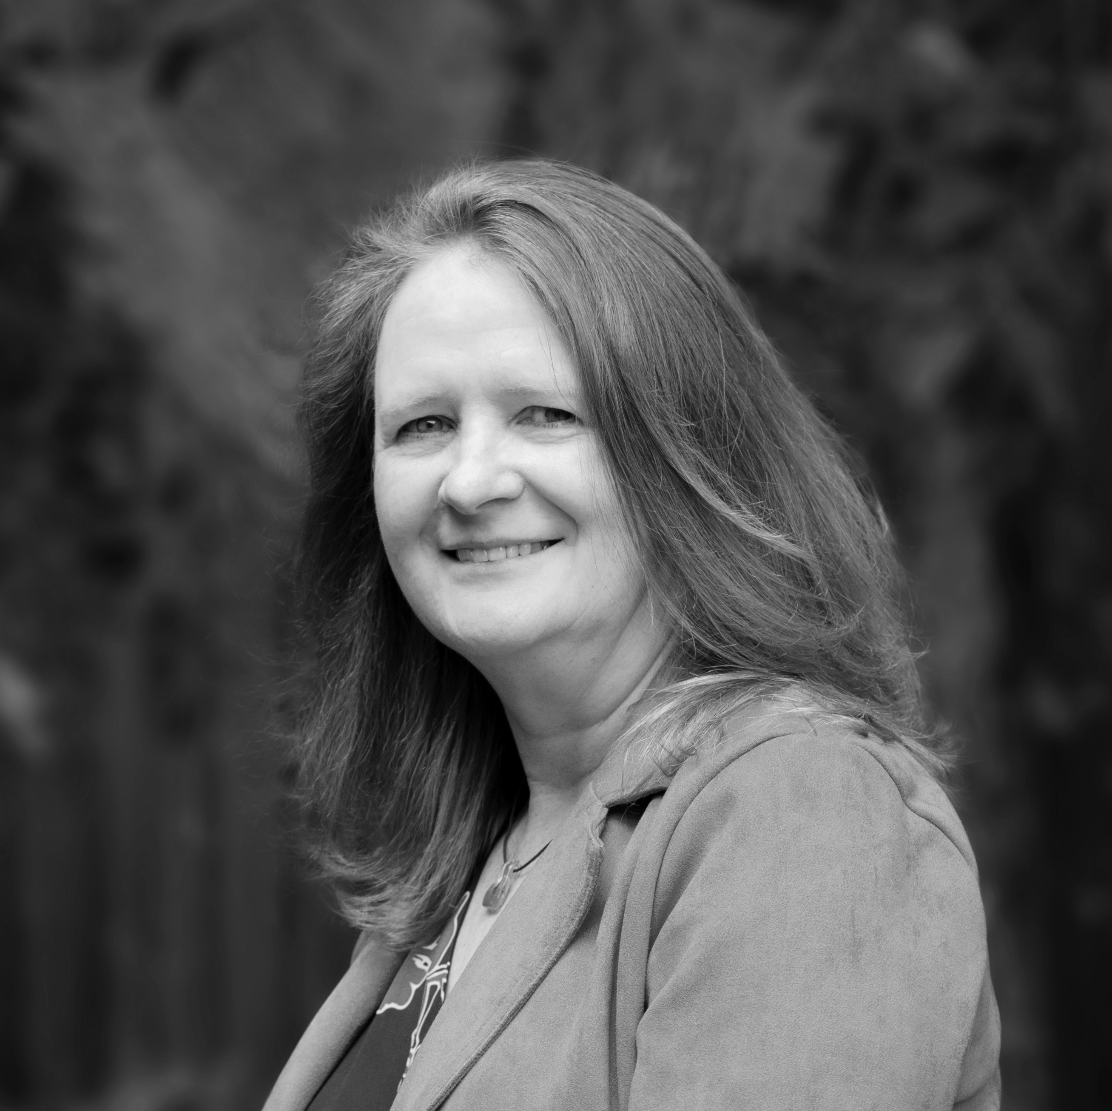
Claire Shelvey
Cofounder of OpusXenta

Slide 3
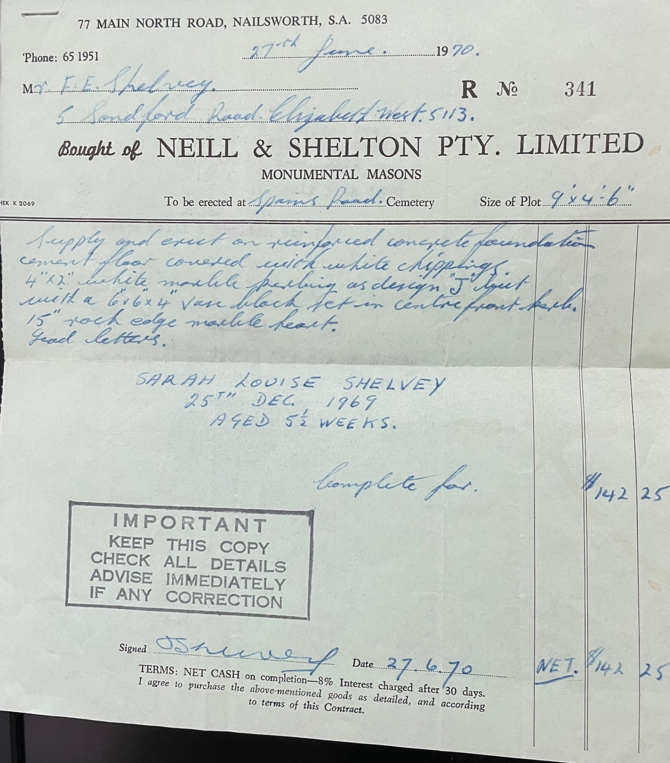
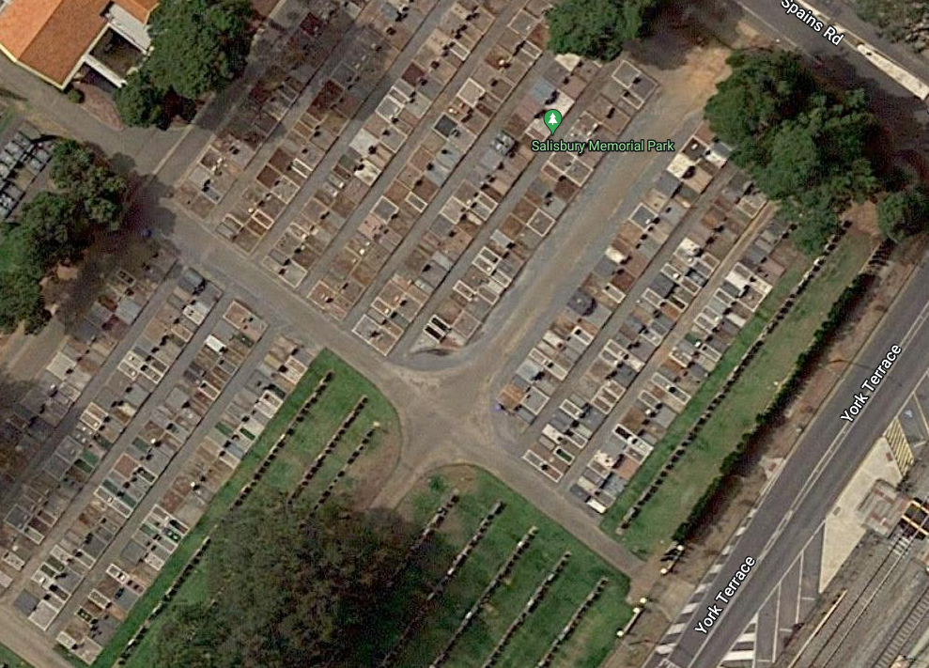
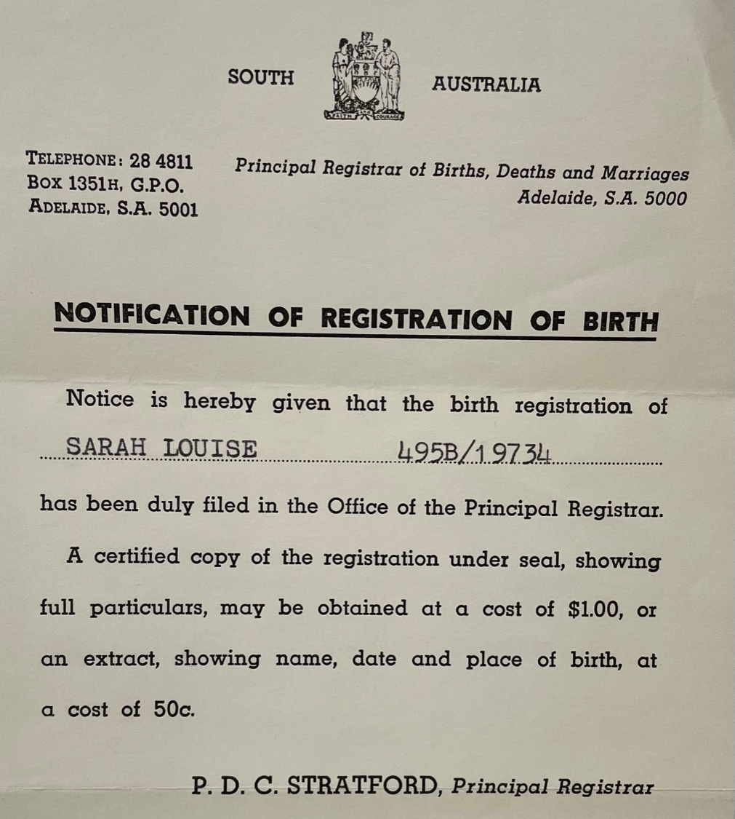
From personal experience …

Slide 4
A Year in Review
2023

Slide 5
Welcome to the OpusXenta Family

Slide 6
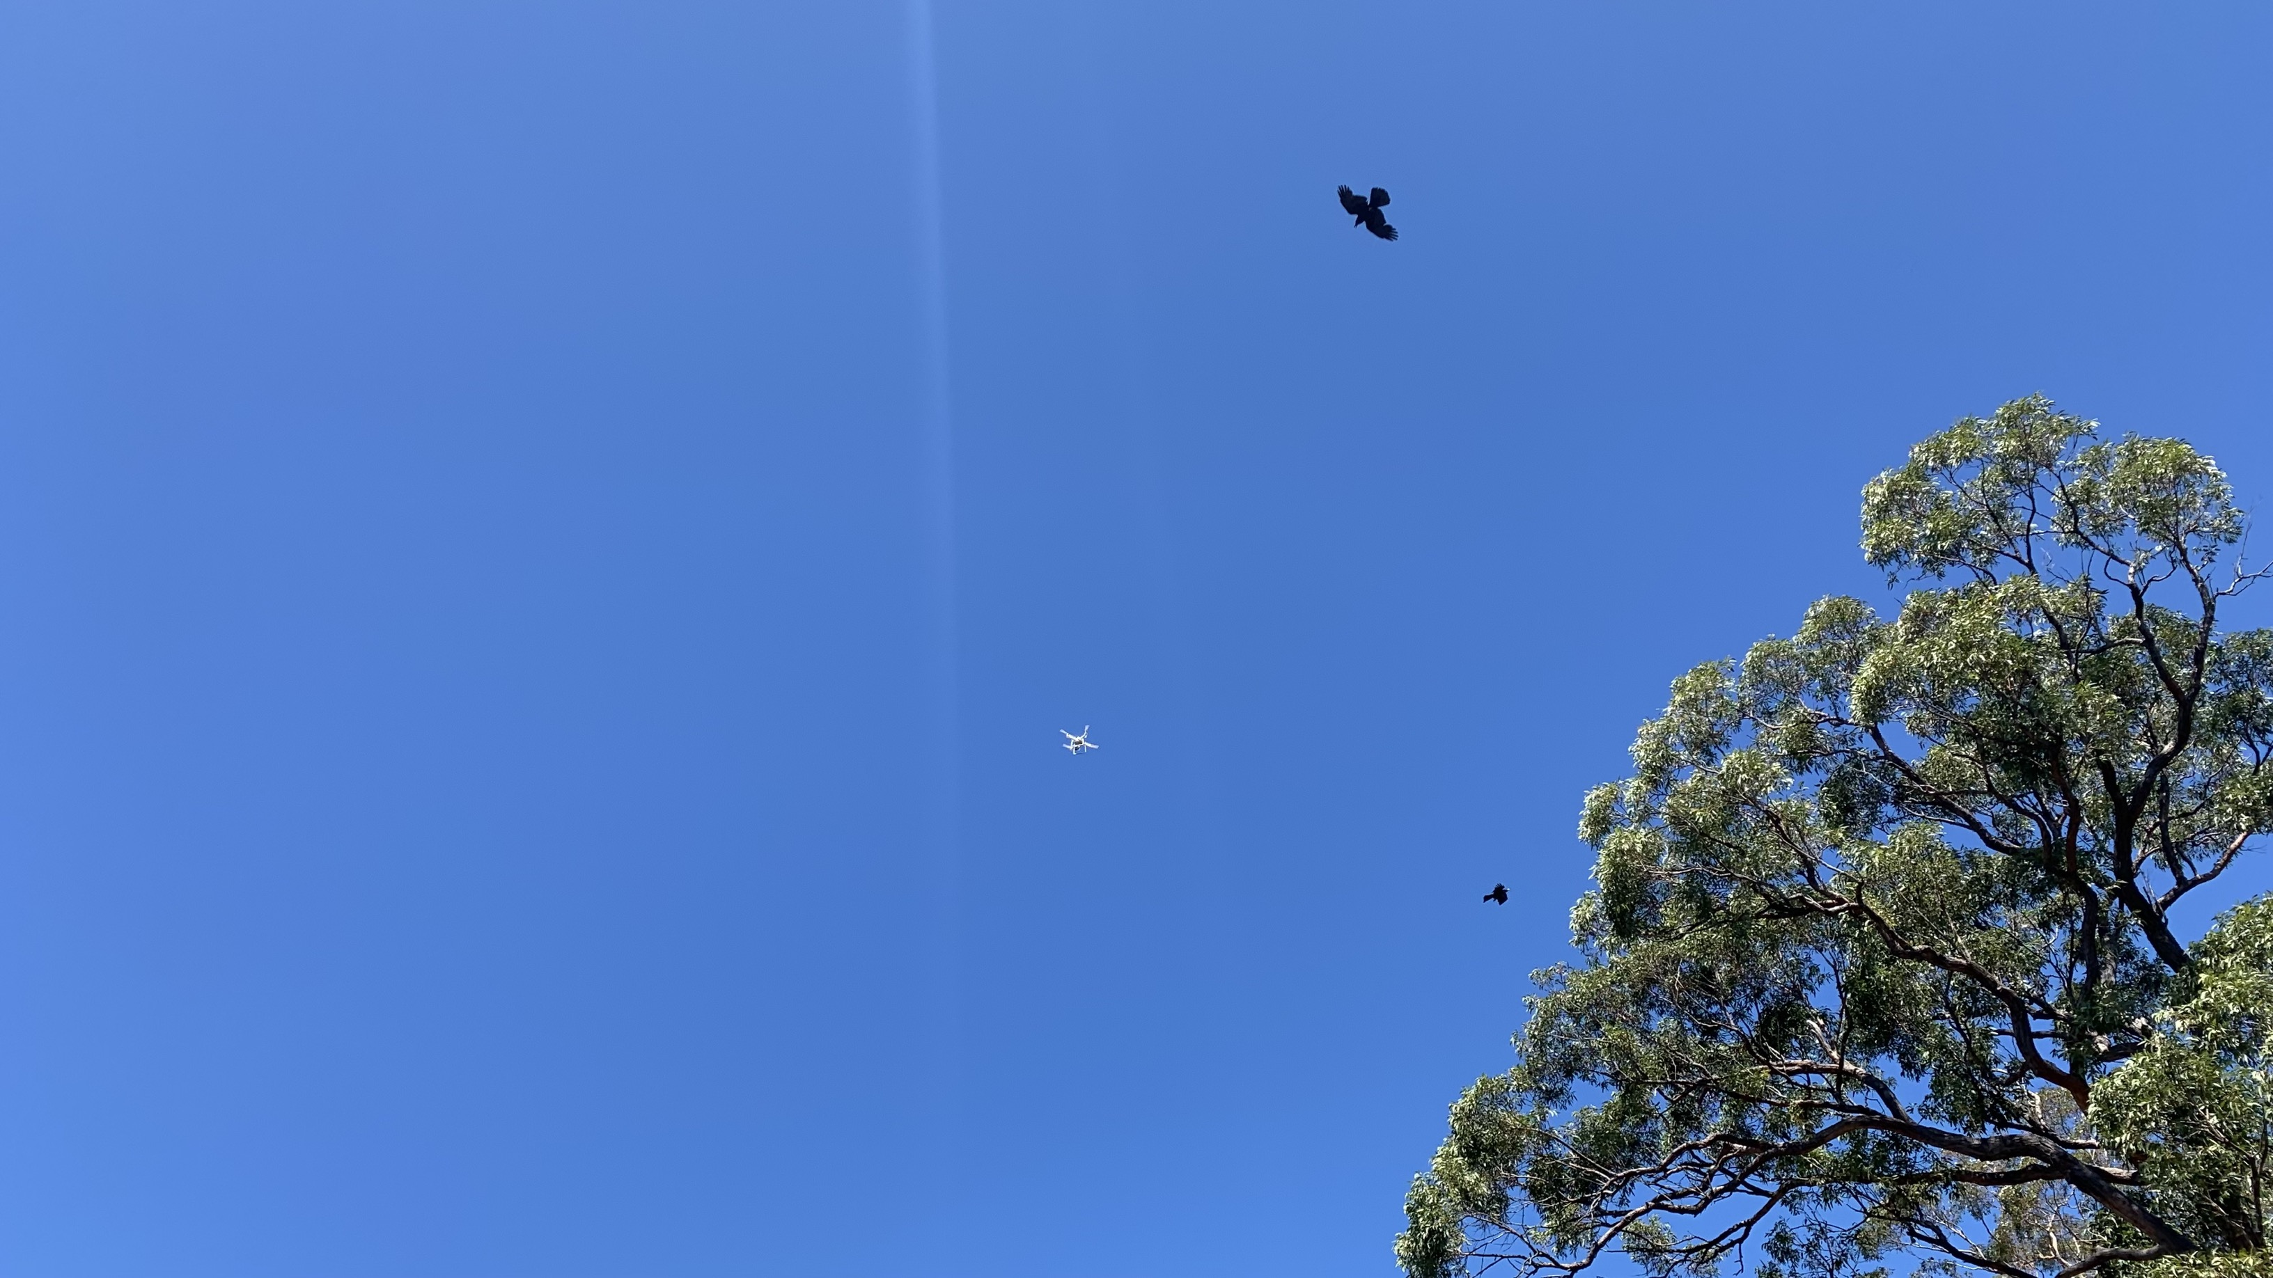
Flying the Drone
Cost-effective, High-resolution Cemetery Maps

Slide 7
Introduced Integrated Payments and Donations

Slide 8
Released MarketMakr

Slide 9
Launched Flower Programs and Floral Store

Slide 10
Enhanced Funeral Home Capabilities

Slide 11
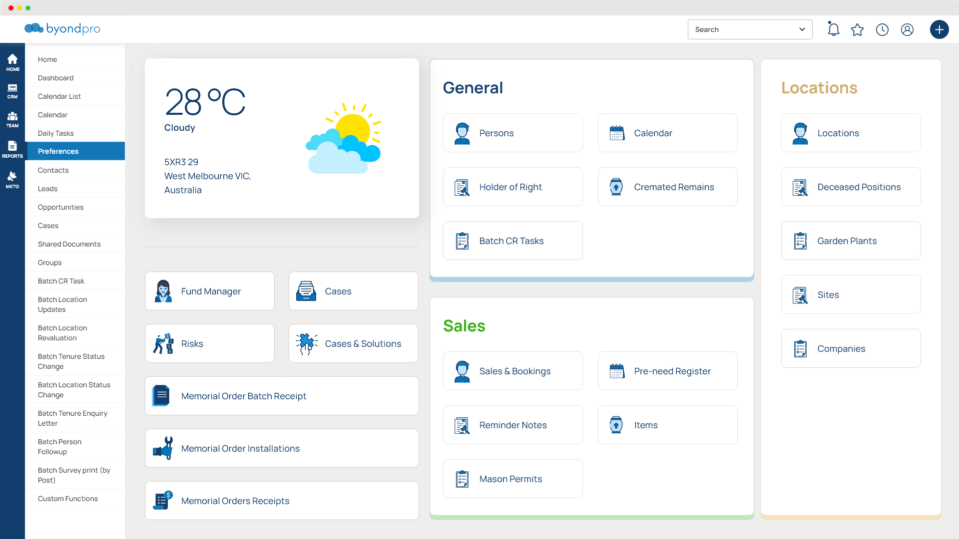
New Look

Slide 12
Thank You
opusxenta.com
claires@opusxenta.com

