Slide 2
Phoenix Foundry
Est: 1983

Slide 3
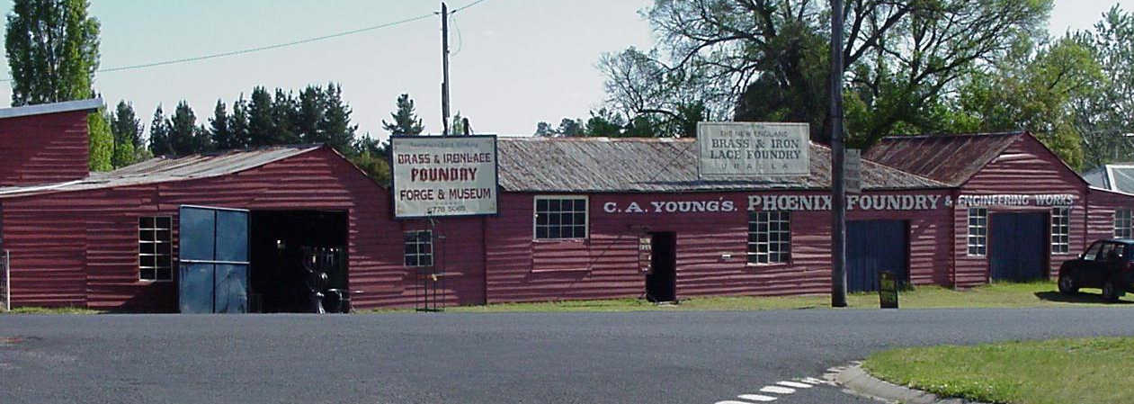
Our Journey
FOUNDRY COMMENCED OPERATIONS IN 1872
ORIGINALLY NAMED NEW ENGLAND BRASS & IRON LACE FOUNDRY
THE FOUNDRY WAS A NON-SPECIFIC JOBBING FOUNDRY
THE BUILDINGS ARE STILL STANDING AND MAINTAINED IN URALLA
WITH MANY ORIGINAL PATTERNS STILL IN STORAGE

Slide 4
Our Journey
THE BEGINNING 1982
THE ORIGINAL SHAREHOLDERS
CHARLIE RUDD & HENRY RAYMOND
ONE AN IDEAS MAN ~ THE OTHER AN ENGINEER
WERE APPROACHED BY A LOCAL FUNERAL DIRECTOR TO REOPEN THE RECENTLY VACATED FOUNDRY AND RE PURPOSE THE FACILITY AS A SPECIALIZED PRODUCER OF BRONZE PLAQUES & MEMORIAL PRODUCTS

Slide 5
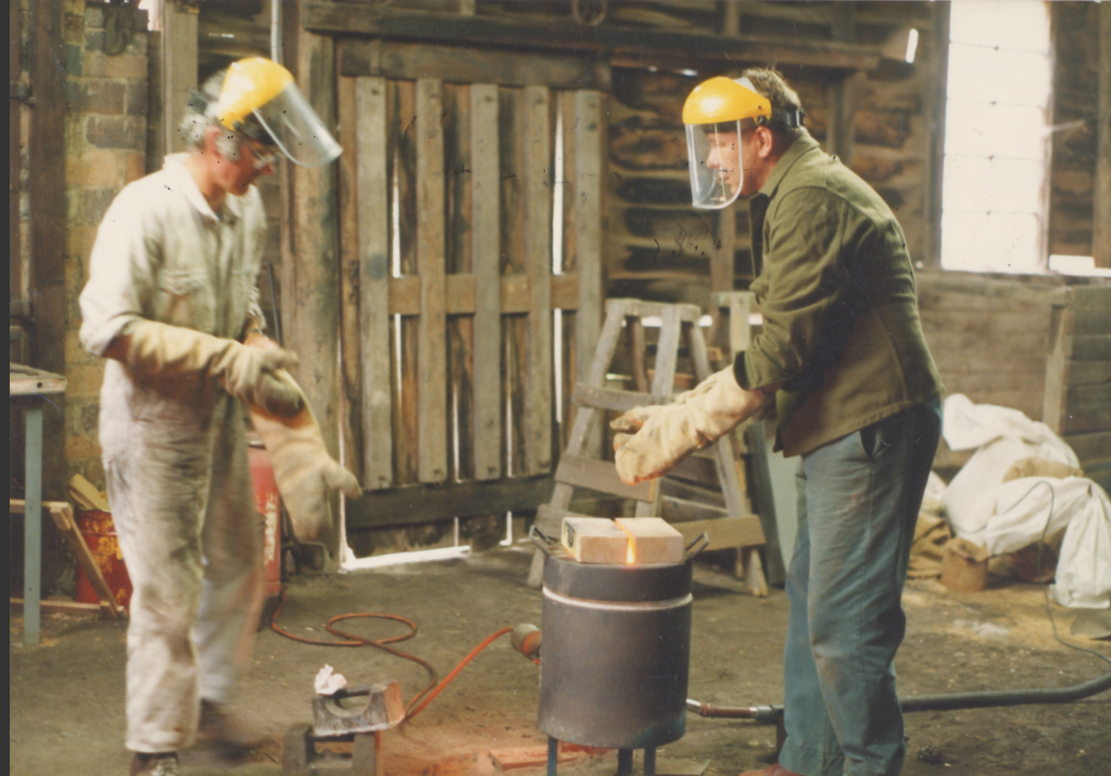
CHARLIE & HENRY FELT THIS WOULD BE A GOOD BUSINESS VENTURE FOR THEMSELVES AND THE LOCAL COMMUNITY
AFTER 12 MONTHS RESEARCH AND PLANNING AND HELP FROM SOME LOCAL BUSINESS PEOPLE THEY WENT ON THE JOURNEY OF CASTING THEIR FIRST PLAQUE

Slide 6
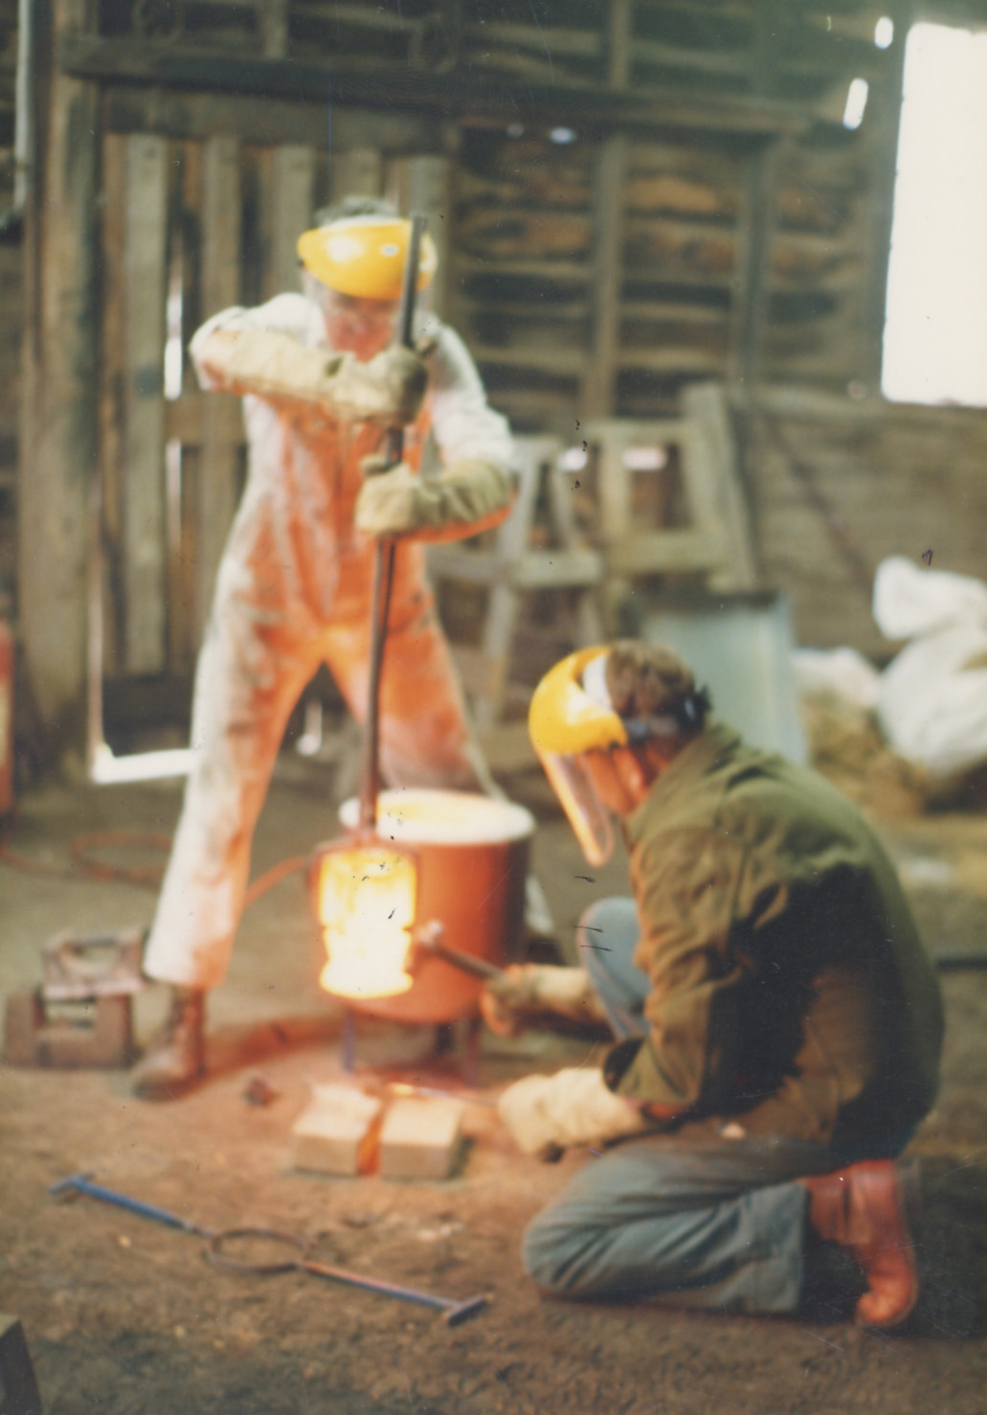
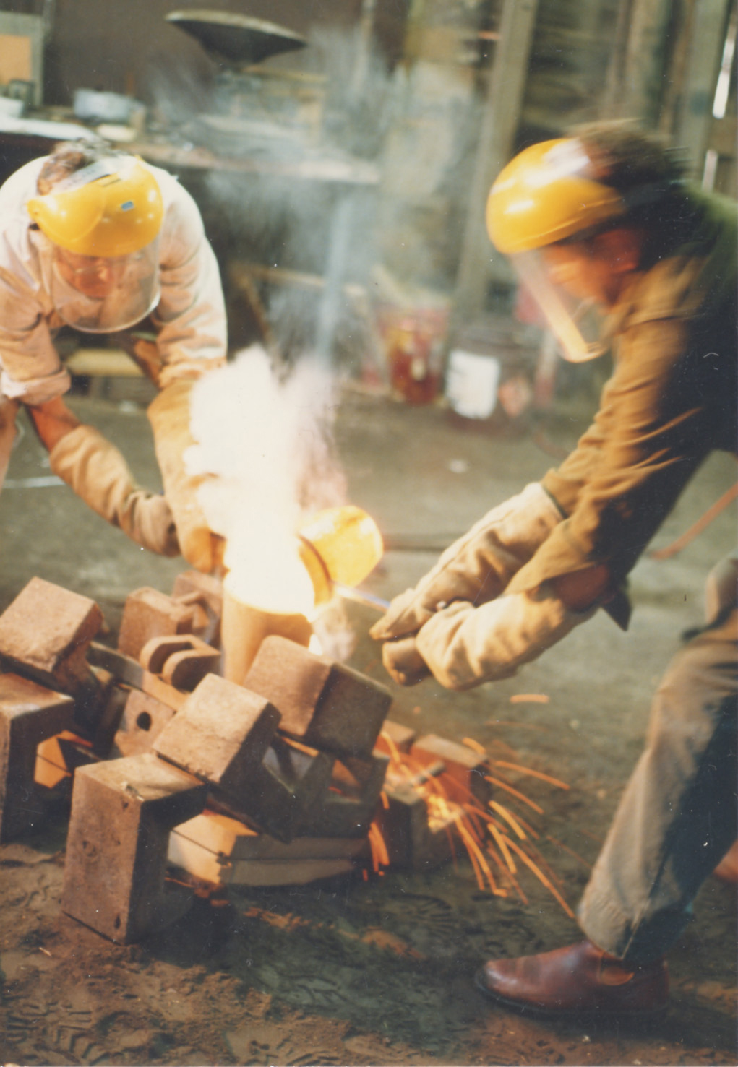
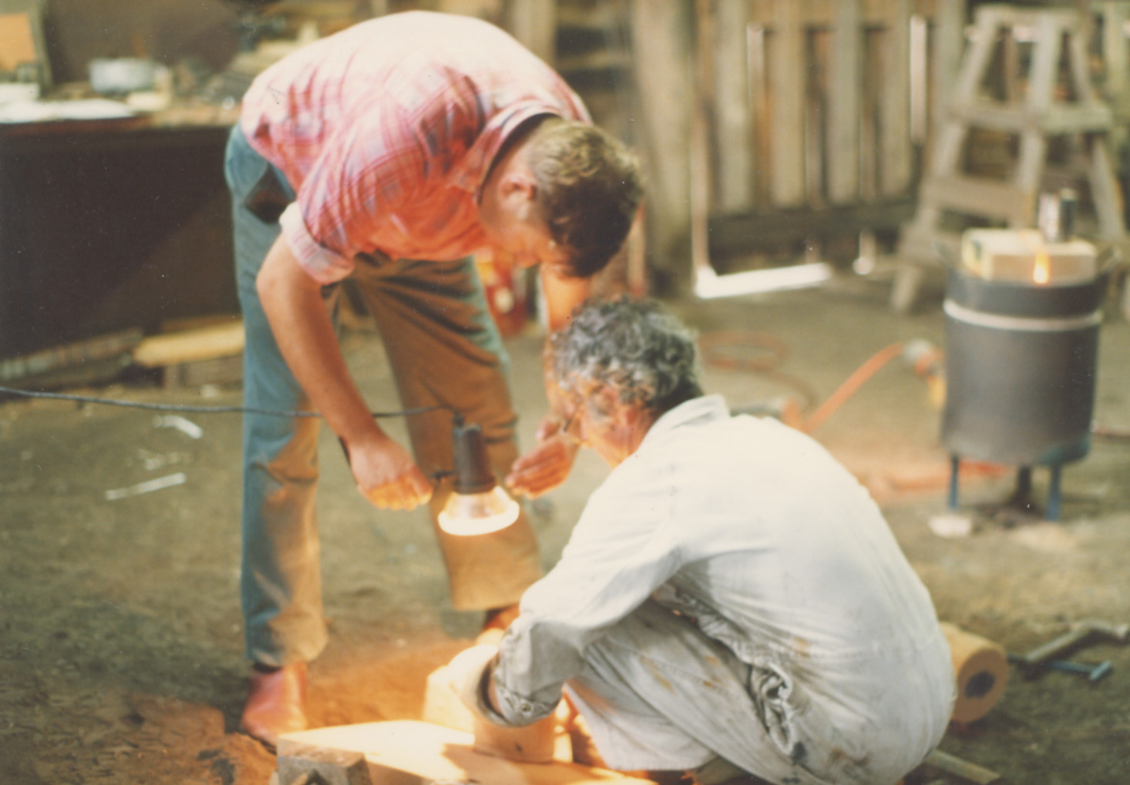
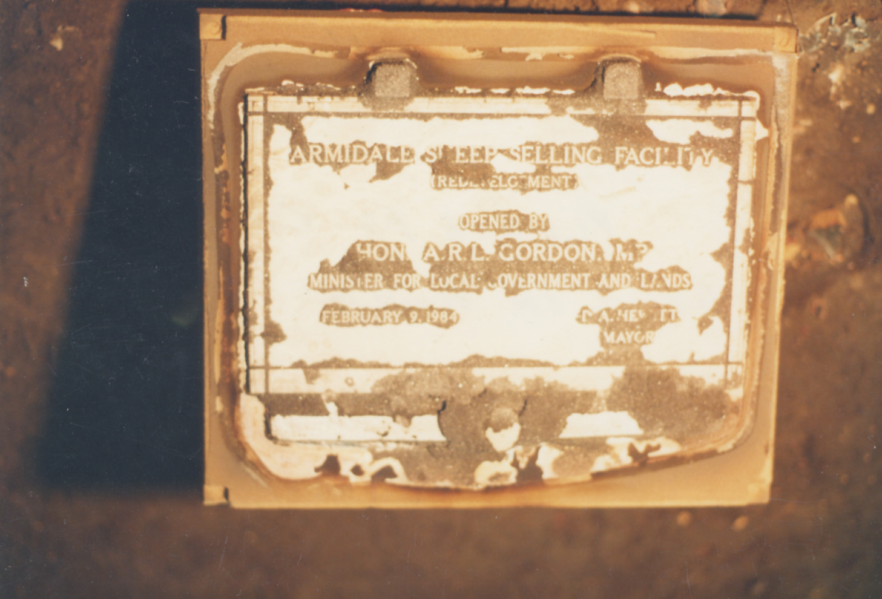
Our Journey
1983
OUR FIRST PLAQUE WAS MANUFACTURED IN 1983 FOR ARMIDALE REGIONAL COUNCIL
FOR THEIR SHEEP SELLING FACILITY

Slide 7
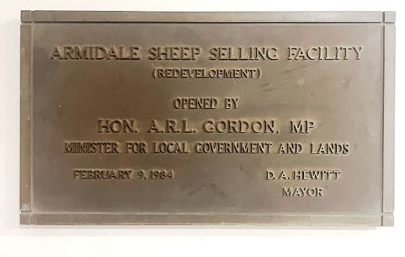
Our Journey
THE ORIGINAL PLAQUE BELOW IS NOW PROUDLY ON DISPLAY IN THE PHOENIX BOARDROOM, AFTER IT WAS RETURNED BY ARMIDALE COUNCIL AND REPLACED WITH NEW PLAQUE AT PHOENIX’S REQUEST.

Slide 8
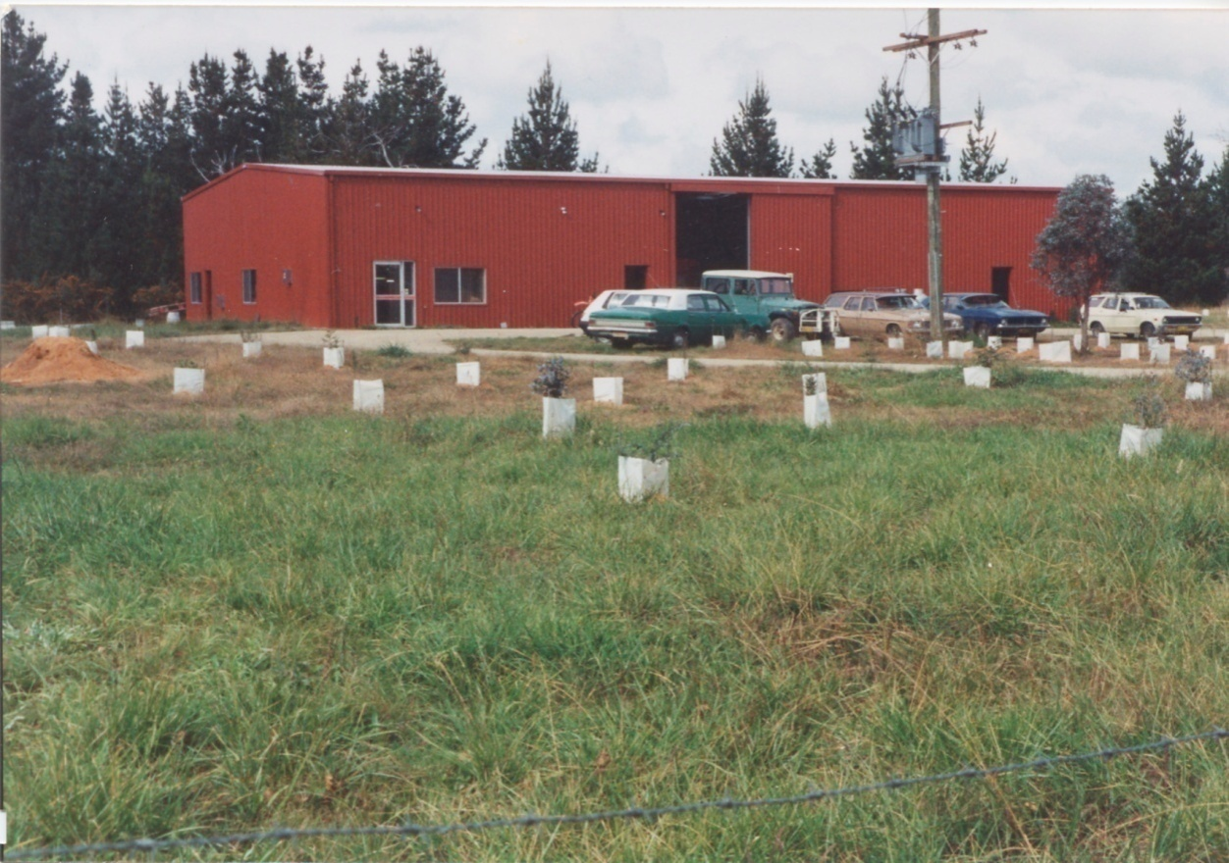
Our Journey
1988 BUSINESS WAS GROWING
THE NEW PHOENIX HAD OUTGROWN THE ORIGINAL PREMISES AND RELOCATED TO THE CURRENT LOCATION IN DUKE ST URALLA

Slide 9
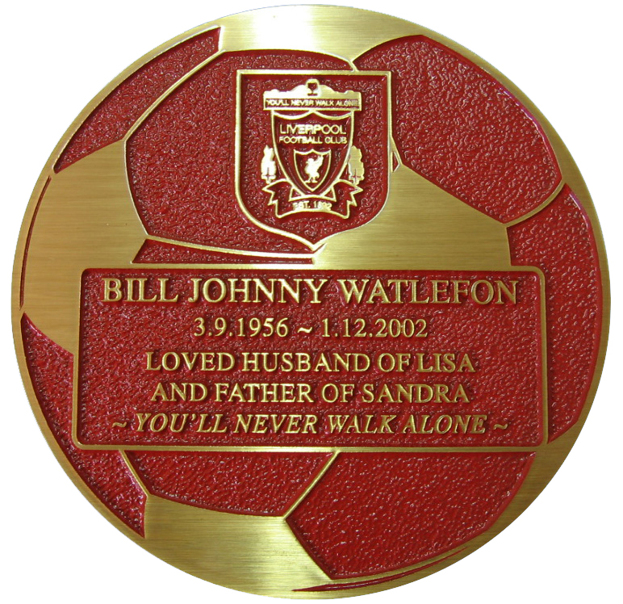
Our Journey
2001
PHOENIX HAD BECOME A RECOGNIZED BRAND THROUGHOUT AUSTRALIA
AND BEGAN EXPLORING OPPORTUNITIES FOR ADDITONAL GROWTH.
ENTERED THE UK MARKET- EXPORTING PLAQUES MANUFACTURED IN URALLA TO THE UK.

Slide 10
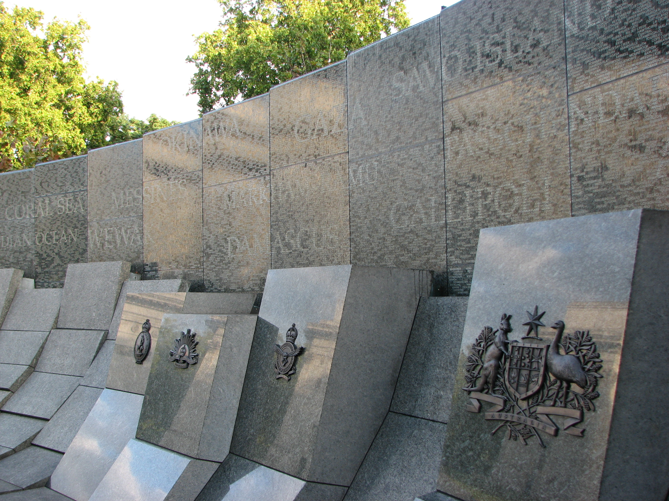
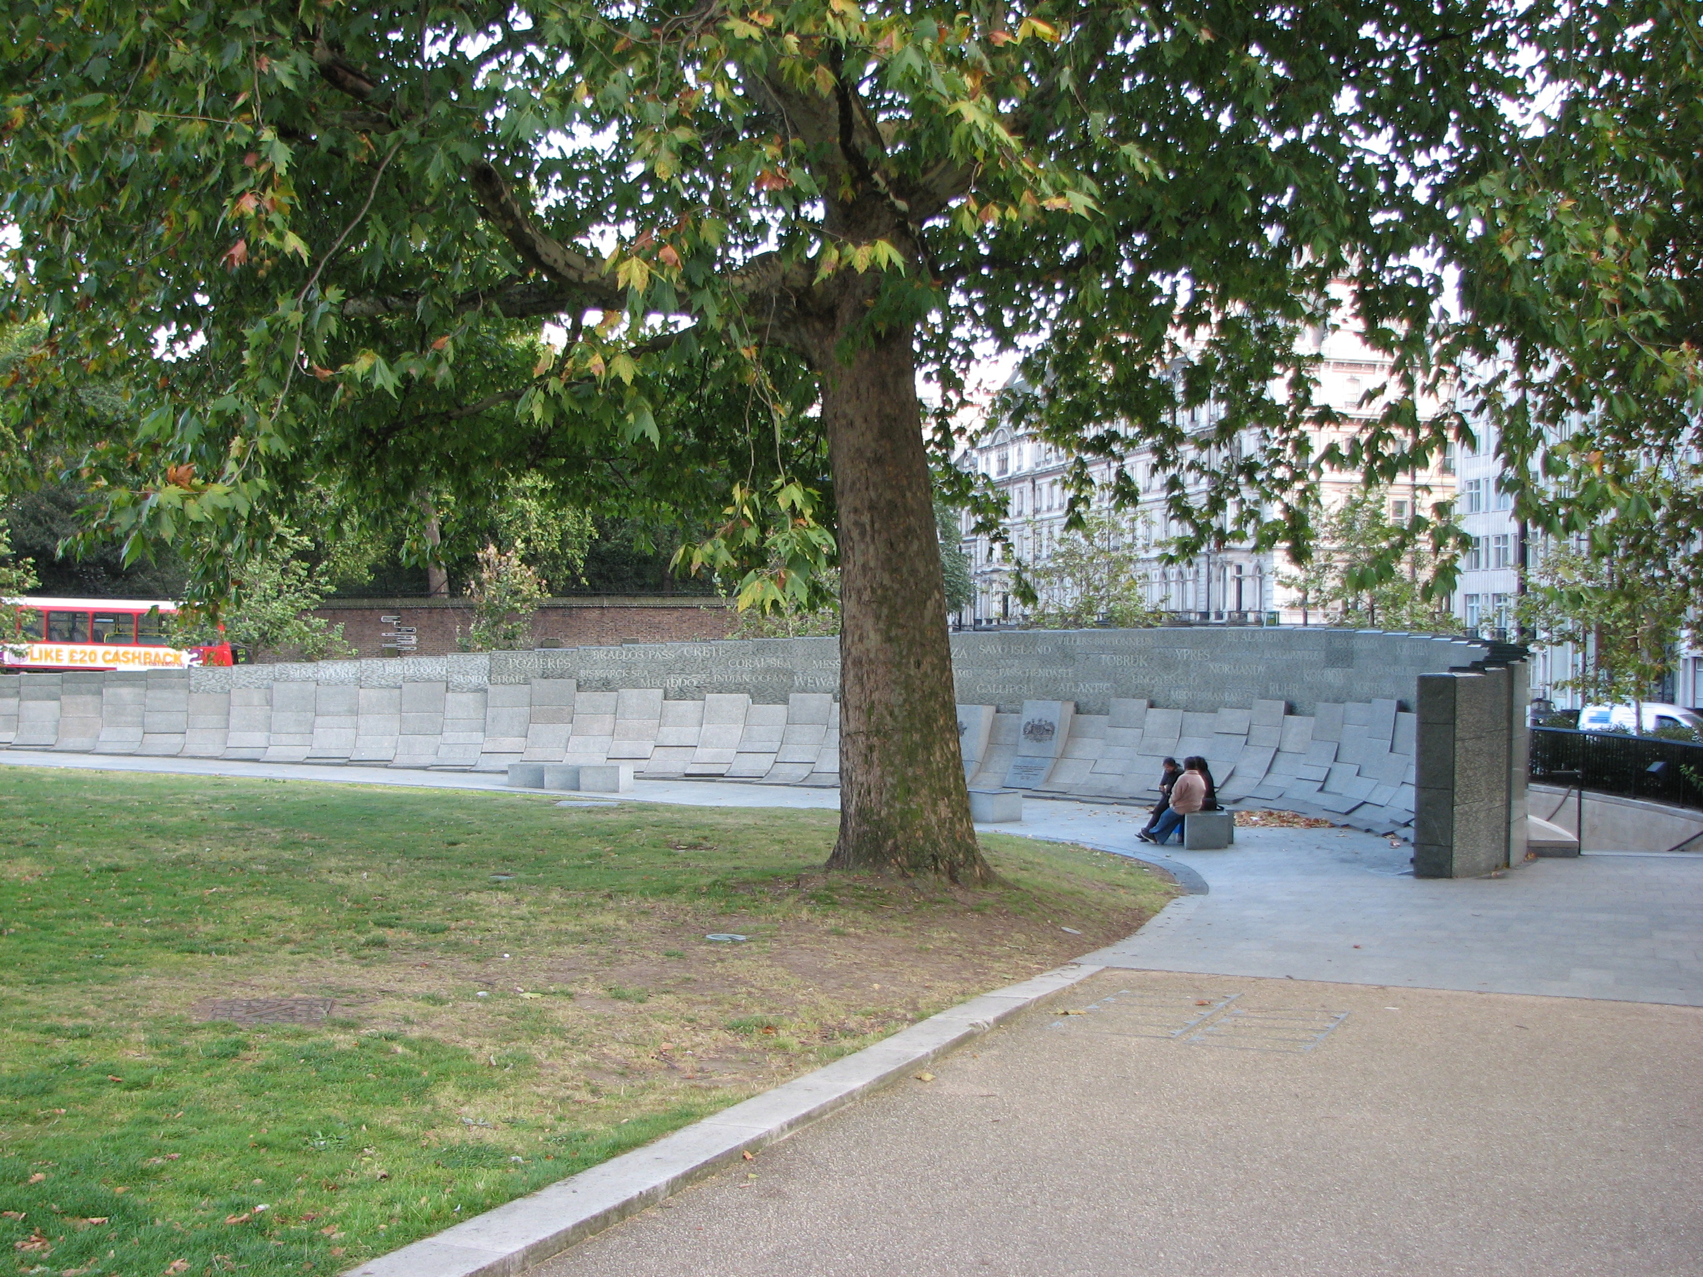
Our Journey
2003
PHOENIX SELECTED TO MANUFACTURE ALL BRONZE COMPONENTS FOR THE AUSTRALIA WAR MEMORIAL IN LONDON.
LOCATED ON HYDE PARK CORNER
OPENED BY HER MAJESTY QUEEN ELIZABETH II, & PRIME MINISTER JOHN HOWARD ON 11TH NOV 2003.

Slide 11
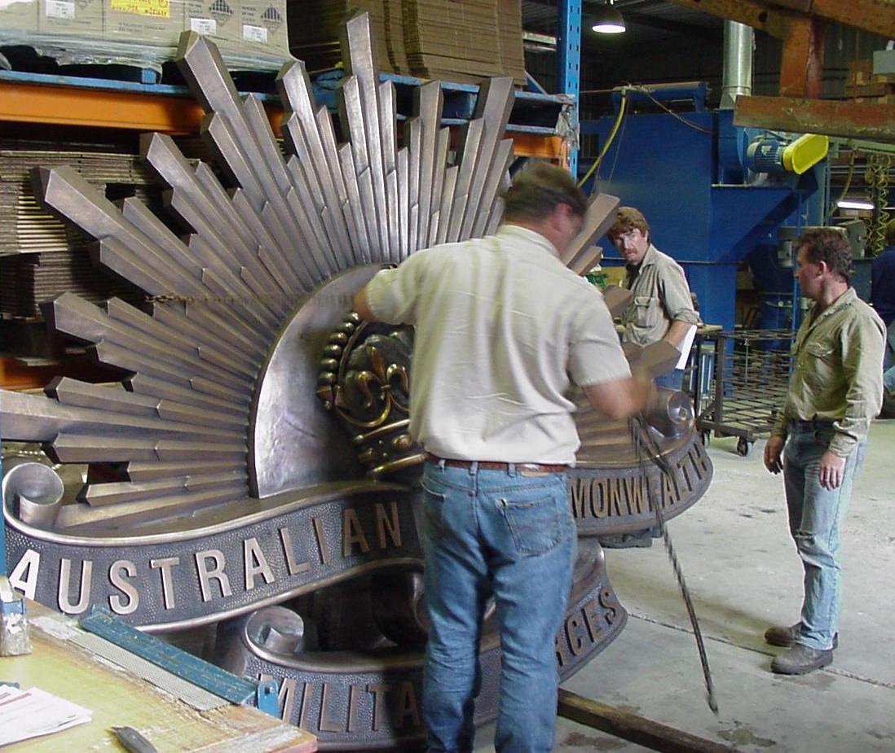
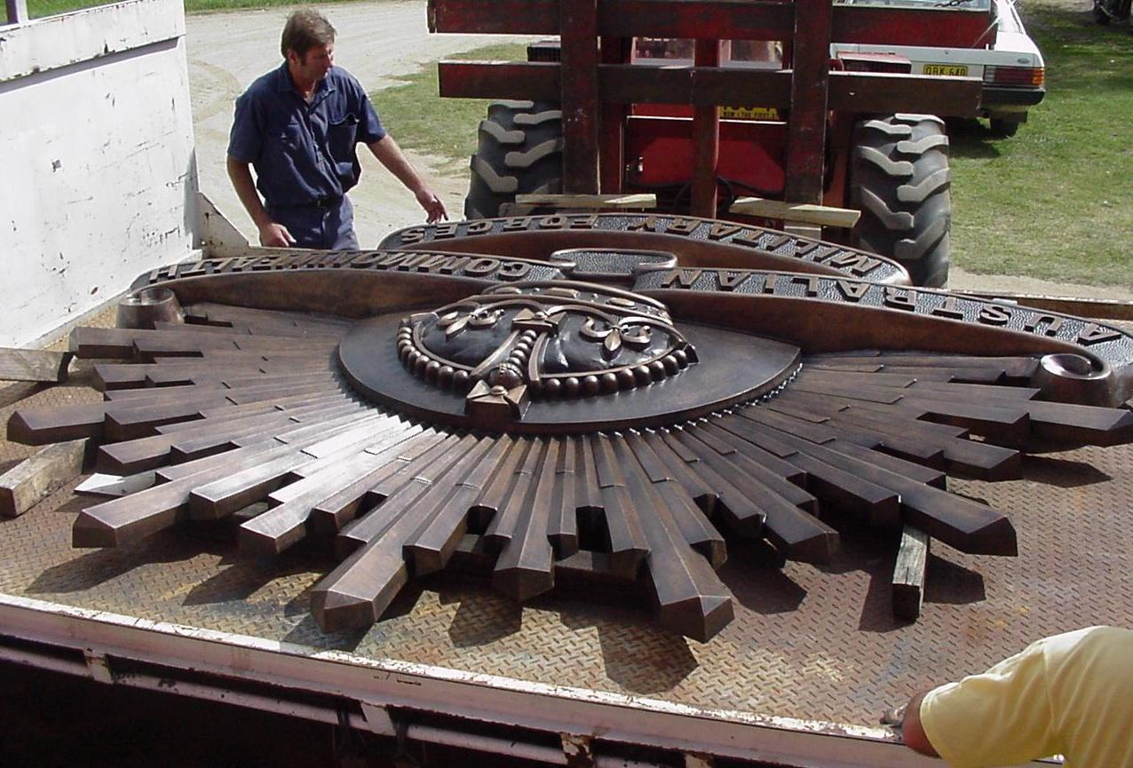
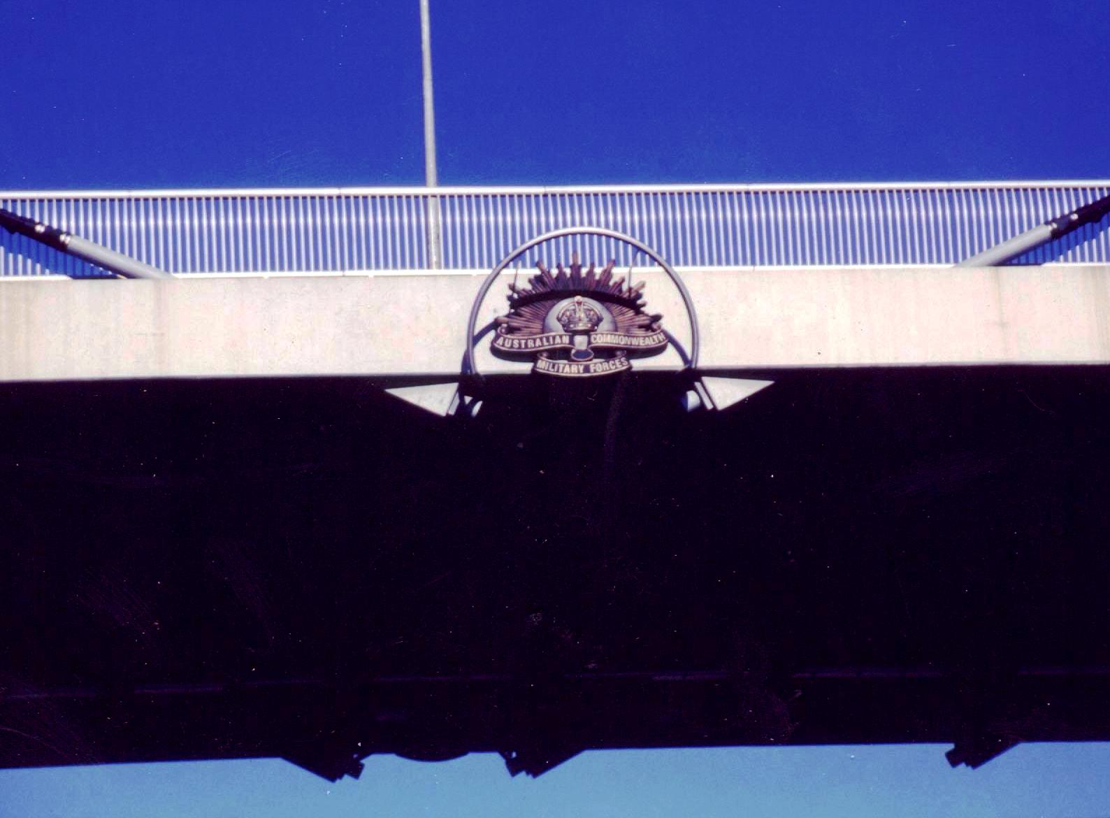
Our Journey
ANZAC
BRIDGE
MEMORIAL

Slide 12
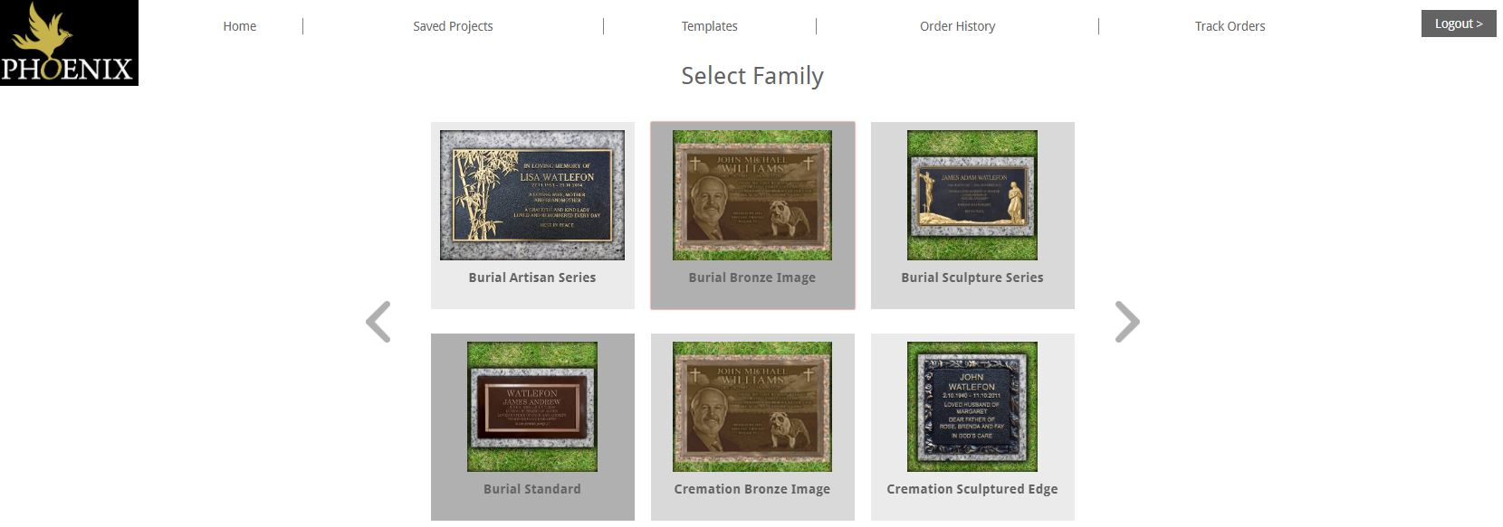
Our Journey
2003
DESIGN ORDER & TRACKING SYSTEM “DOTS” 2003
EXPORT MARKET REGIONS AND TIME ZONES WITHIN AUSTRALIA PROVIDED THE CHALLENGE OF EFFICIENTLY NEGOTIATING TIME DIFFERENCES .
TO HELP SERVICE THE MARKET PHOENIX CONSULTED WITH CUSTOMERS & SOFTWARE DEVELOPERS TO CREATE OUR INDUSTRY LEADING MEMORIAL DESIGN SOFTWARE WHICH INCORPORATES AN INTERGRATED MANUFACTUREING & FREIGHT TRACKING PORTAL

Slide 13
Our Journey
FOR EASE OF USE AND ACCESS THE SYSTEM WAS INTERNET BASED
REQUIRING NO PROGRAM OR SOFTWARE DOWNLOAD THAT COULD
CAUSE CONFLICT WITH CUSTOMER SYSTEMS. THIS WAS A KEY
DEVELOPMENT CONSIDERATION.
THE SOFTWARE CAN ALSO BE UTILIZED IN AN OFFLINE ENVIRONMENT
THE “DOTS” DESIGN / ORDER TRACKING SYSTEMS HAVE ALLOWED CUSTOMERS TO DEAL SEAMLESSLY WITH PHOENIX & ASSISTED IN STREAMLINING CUSTOMER INTERACTIONS IN AUSTRALIA AND AROUND THE WORLD
THIS IN TURN HAS ALLOWED CEMETERIES TO PROVIDE A SUPERIOR SERVICE TO THEIR CUSTOMERS DUE TO THE EFFICIENCY OF THE PORTAL BOTH IN IMMEDIATE MEMORIAL DESIGN AND TRACKING, WHICH UPDATES MANUFACTURING KEY MILESTONES, AND DELIVERY TRACKING

Slide 14
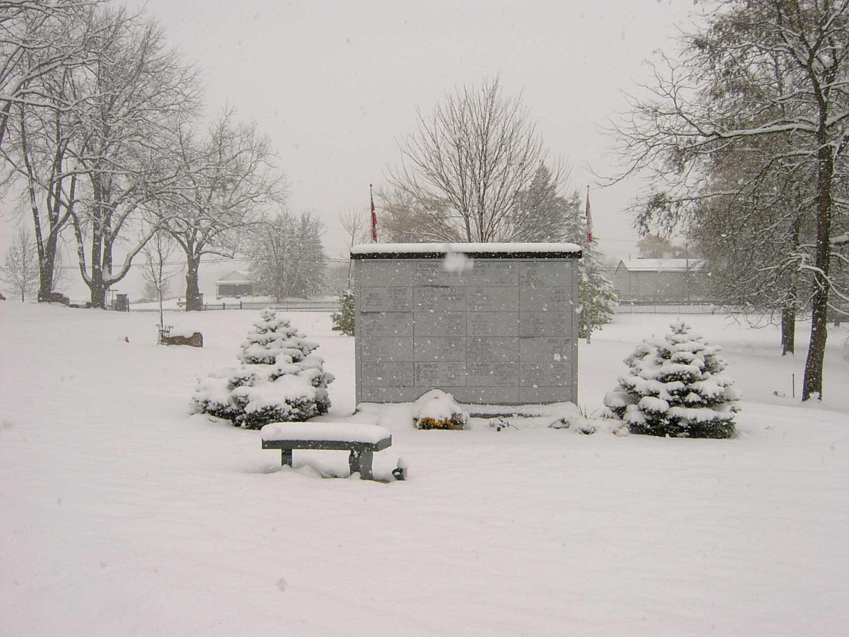
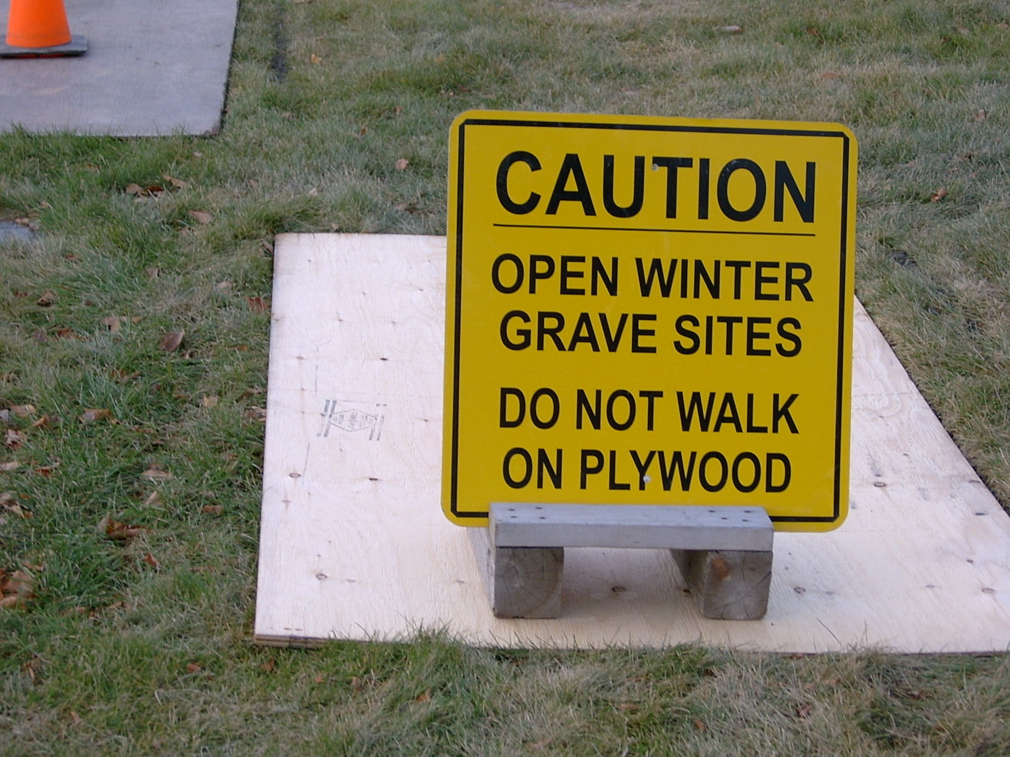
Our Journey
2006
FURTHER EXPANSION OCCURRED ENTERING THE NORTH AMERICAN MARKET.
PHOENX QUICKLY ESTABLISHED ITSELF AS A PREFFERED SUPPLIER OF CHOICE IN MANY CANADIAN LOCATIONS DUE TO PRODUCT QUALITY, CONSISTANT TIMELY SERVICE, & SPEEDY DELIVERY.

Slide 15
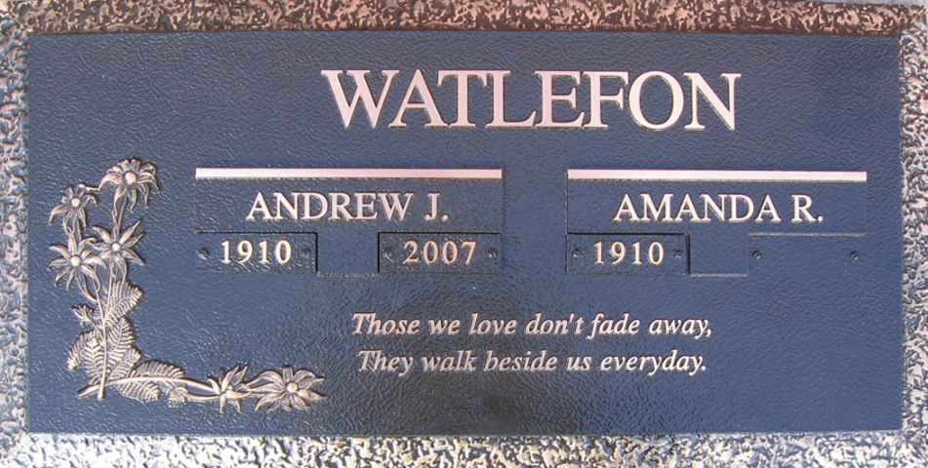
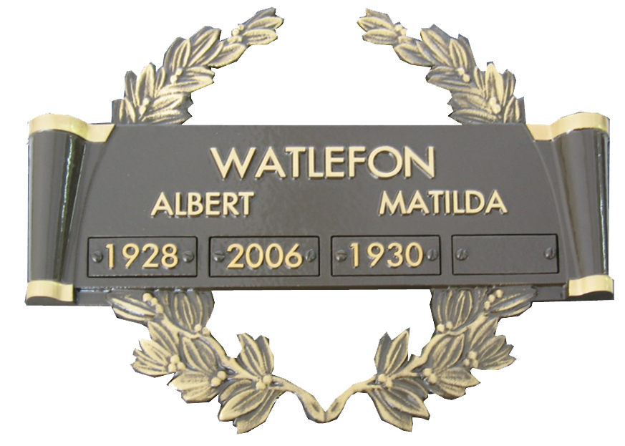
Our Journey
PHOENIX HAD TO ADAPT TO THE “NORTH AMERICAN” STYLE PLAQUES WHERE PRE-SALE MEMORIALS ARE POPULAR.
THIS REQUIRED US TO DEVELOP A BASE AND DATE TAB SYSTEM AS ABOVE.

Slide 16
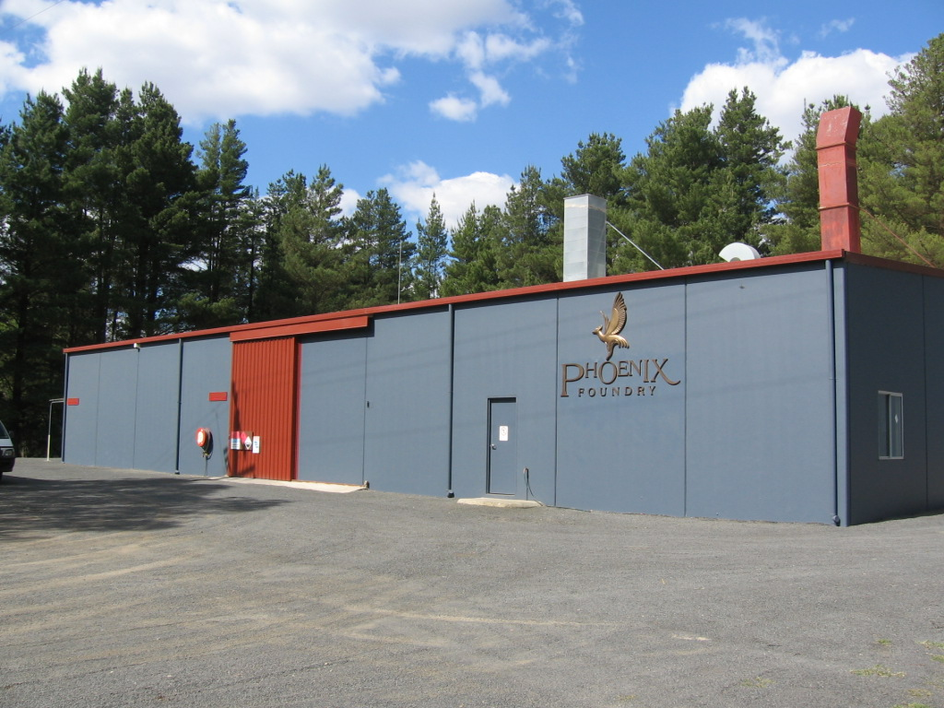
Our Journey
2008
DOMESTIC & INTERNATIONAL SUCCESS HAD PHOENIX QUICKLY OUTGROW OUR PREMISES AGAIN.
THE CURRENT SITE WAS EXPANDED TO ACCOMMODATE THE INCREASED GROWTH IN 2008.

Slide 17
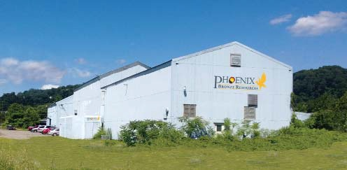
Our Journey
2014
PHOENIX EXPANDED FURTHER WITH A JOINT VENTURE FACILITY IN PITTSBURG USA TO ASSIST SERVICE THE NORTH AMERICAN SIDE OF THE BUSINESS.
UNFORTUNATLEY THE JV WAS NOT SUCCESSFUL WITH PHOENIX NOT HAVING SUFFICIENT CONTROL OVER THE END PRODUCT AND SERVICE LEVELS, SO WE WITHDREW FROM THE PARTNERSHIP IN 2017.

Slide 18
Our Journey
CLIENT DOTS
INTRODUCED & OPERATIONAL PRIOR TO THE COVID PANDEMIC
BECAME A SIGNIFICANT POINT OF FOCUS FOR PHOENIX AND MANY
CUSTOMERS TO CONDUCT MEMORIALIAZATION DURING THIS PERIOD
CLIENT DOTS IS FULLY INTERGRATED AND INTERACTS SEAMLESSLY WITH
THE CEMETERY INHOUSE / ONLINE STANDARD DOTS SYSTEM
QUICKLY - SIMPLY - & SECURELY ALLOWS CEMETERIES
ASSIGN A SPECIFC TEMPLATE, WITH OPTIONAL SET DESIGN PARAMETERS
VIA A USER NAME & PASSWORD TO THEIR CUSTOMER.

Slide 19
Our Journey
CUSTOMERS CAN THEN COMPLETE THE MEMORIAL DESIGN AT HOME AND ALSO SHARE WITH RELATIVES AT OTHER LOCATIONS USING THEIR LOG IN
FOR THE HOME CUSTOMER, ASSITANCE IS PROVIDED WITH BOTH A WRITTEN MANUAL AND A SERIES OF HOW TO VIDEOS MADE AVAILABLE ONCE A TEMPLATE HAS BEEN ASSIGNED BY THE CEMETERY.
WHEN COMPLETED THE DESIGN IS RETURNED TO THE CEMETERY ONLINE FOR REVIEW AND APPROVAL, THEN WITH THE CLICK OF A BUTTON IS FORWARDED TO PHOENIX STRAIGHT INTO PRODUCTION
WITH TODAYS CHANGING TRENDS ON HOW CUSTOMERS AND MANY
BUSINESSES WISH TO CONDUCT BUSINESS. THIS A VALUABLE TOOL
PROVIDING THE CUSTOMER FLEXIBILTY OF CHOICE AND ASSISTING IN
A REDUCTION OF TIME & COST FOR THE CEMETERY.

Slide 20
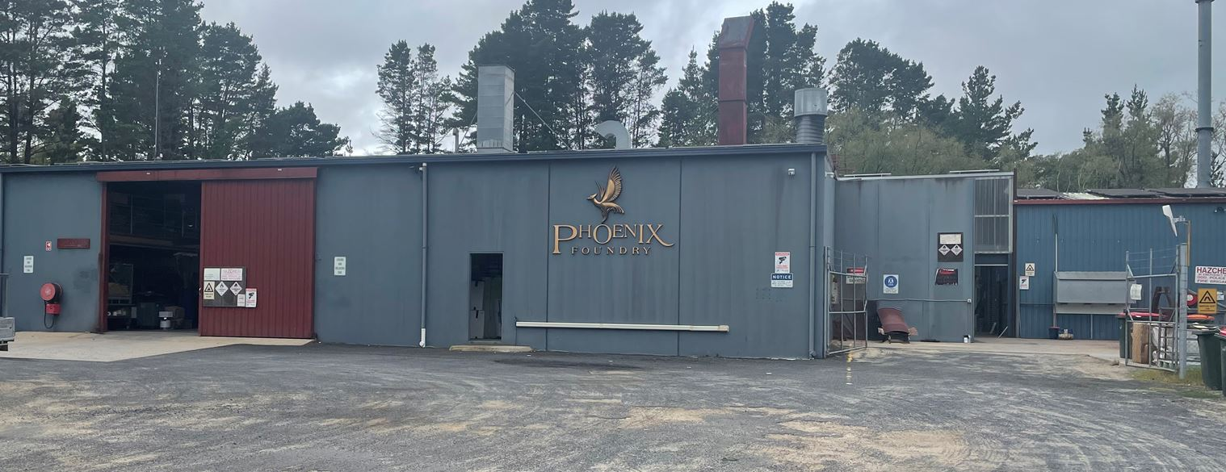
Our Journey
PHOENIX HAS RECENTLY MADE ADDITIONAL FACTORY EXTENSIONS TO ASSIST PRODUCTION,
ADDING AN ADDITIONAL INDIVIDUAL POURING SHED WITH EXTENSIONS TO OUR MOULDING AND PATTERN MAKING AREAS.
THESE CHANGES HAVE HELPED FUTURE PROOF PHOENIX WITH A SIGNIFICANT INCREASE IN ADDITONAL CAPACITY.

Slide 21
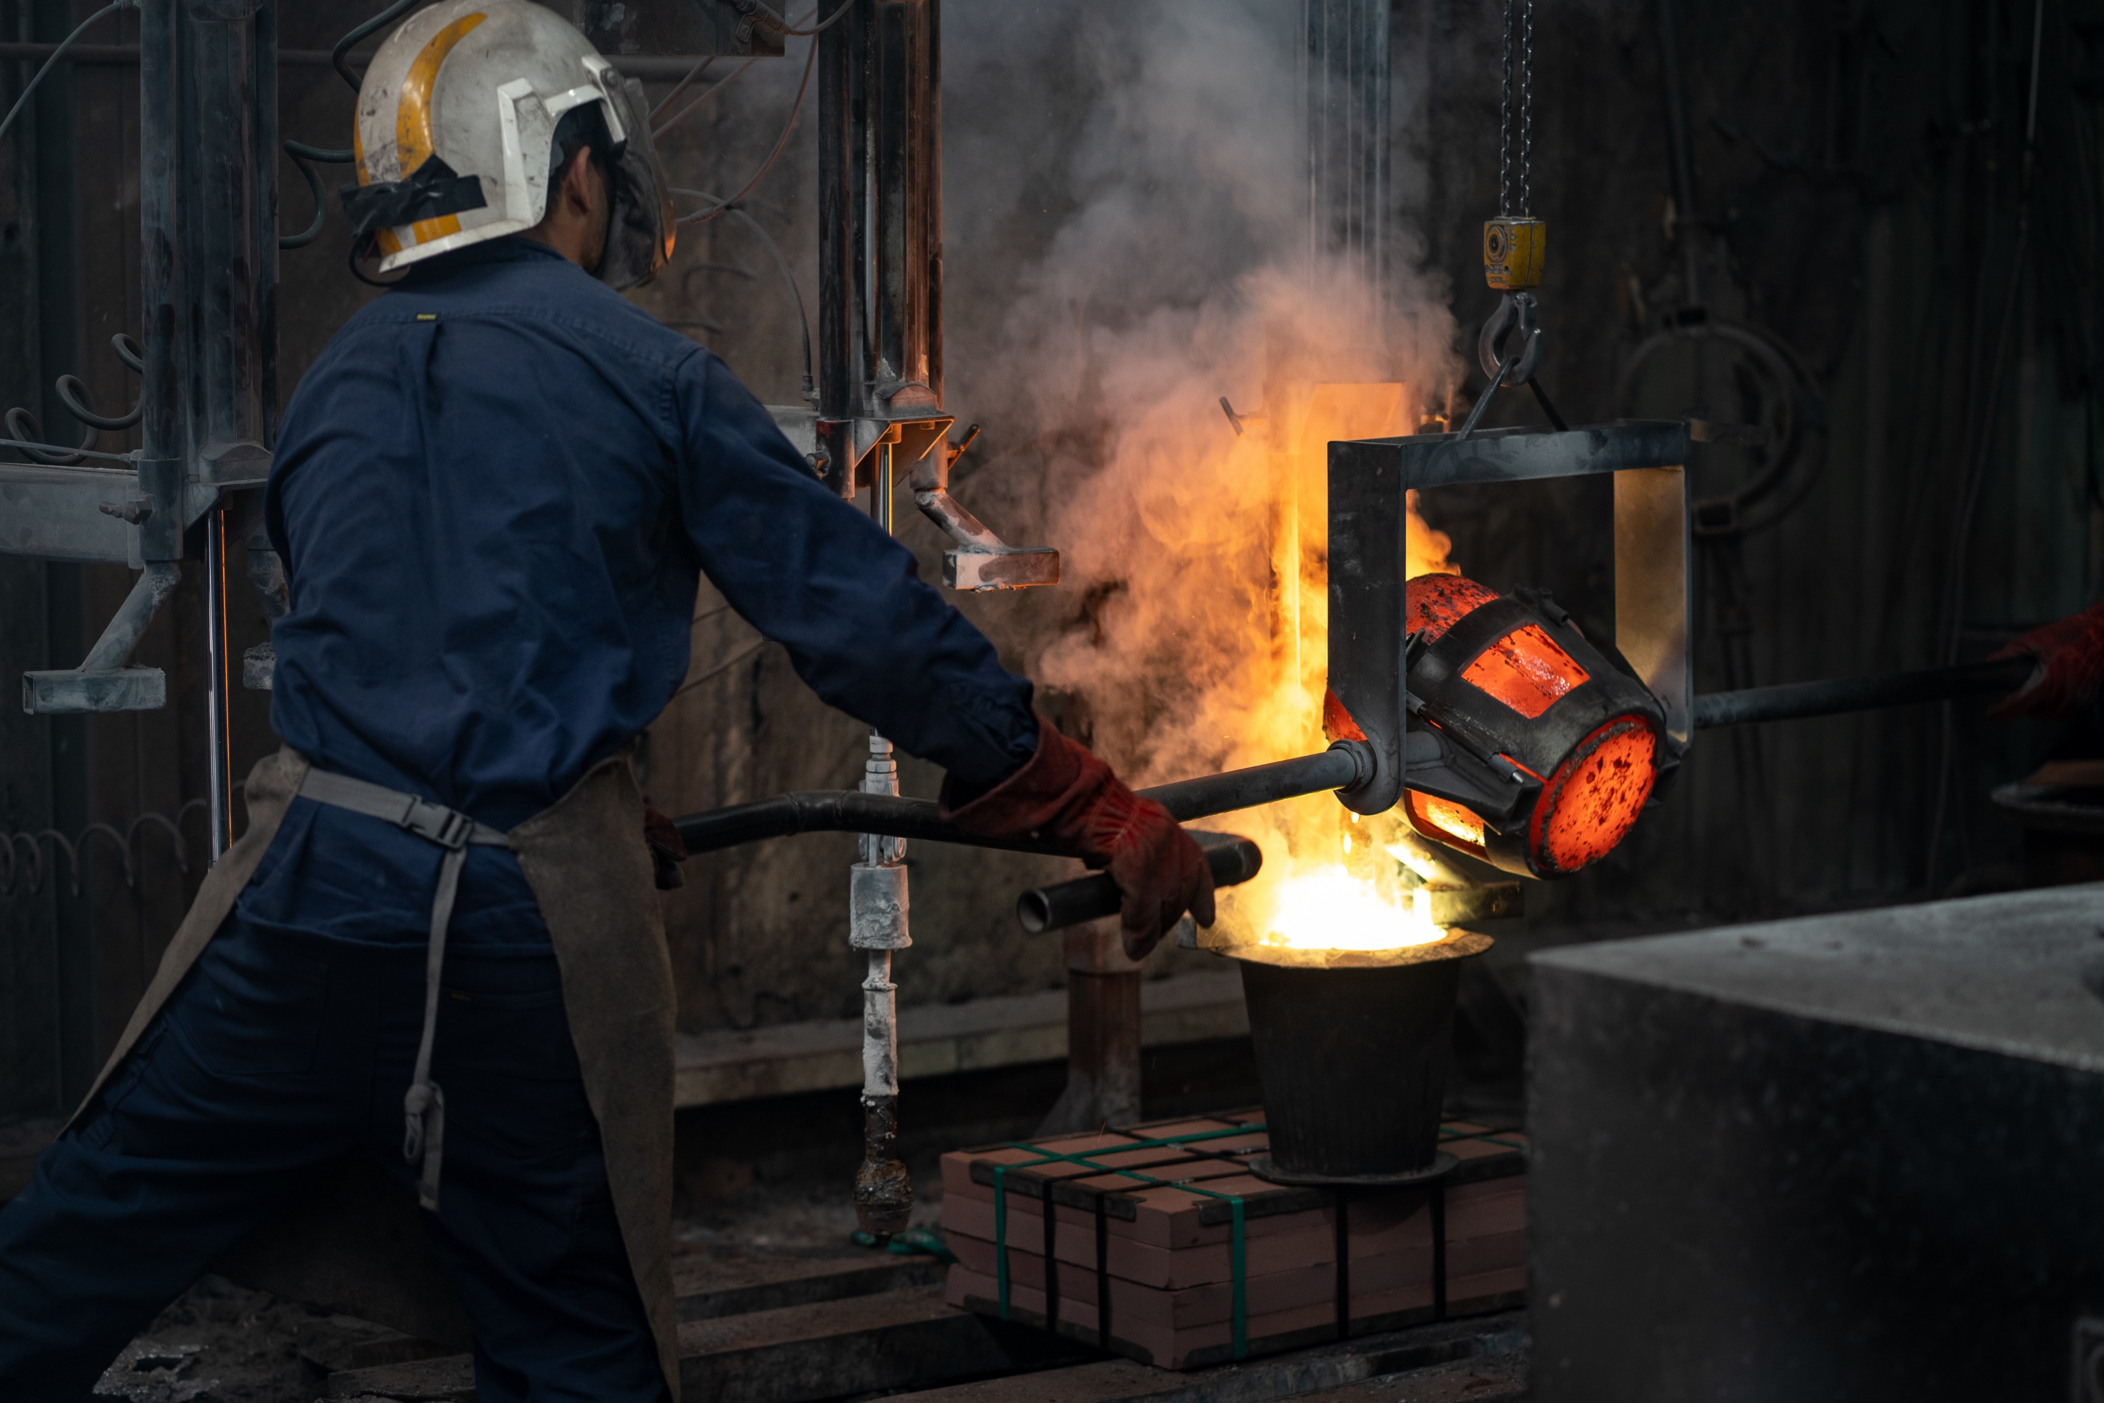
Final Thoughts
PHOENIX IS PROUD TO BE BUCKING THE TREND OF MANY MANUFACTURING COMPANIES IN AUSTRALIA.
OUR JOURNEY HAS SHOWN WE CAN COMPLETE DOMESTICALLY AGAINST FOREIGN OWNED COMPANIES,UNLIKE MANY LARGER BRANDS THAT WE UNFORTUNATELY NO LONGER SEE MANUFACTURING IN AUSTRALIA
IN MANY INSTANCES WE HAVE BEEN SHOWN TO PROVIDE A MORE TIMELY AND RELIABLE SERVICE DUE TO OUR LOCAL CONTROLS AND INTERACTIONS
KEEPING THE BUSINESS AND JOBS IN AUSTRALIA IS OUR SHAREHOLDERS FOCUS.

Slide 22
Our Journey
PRODUCTION UPDATE
DOTS UPDATE

Slide 23
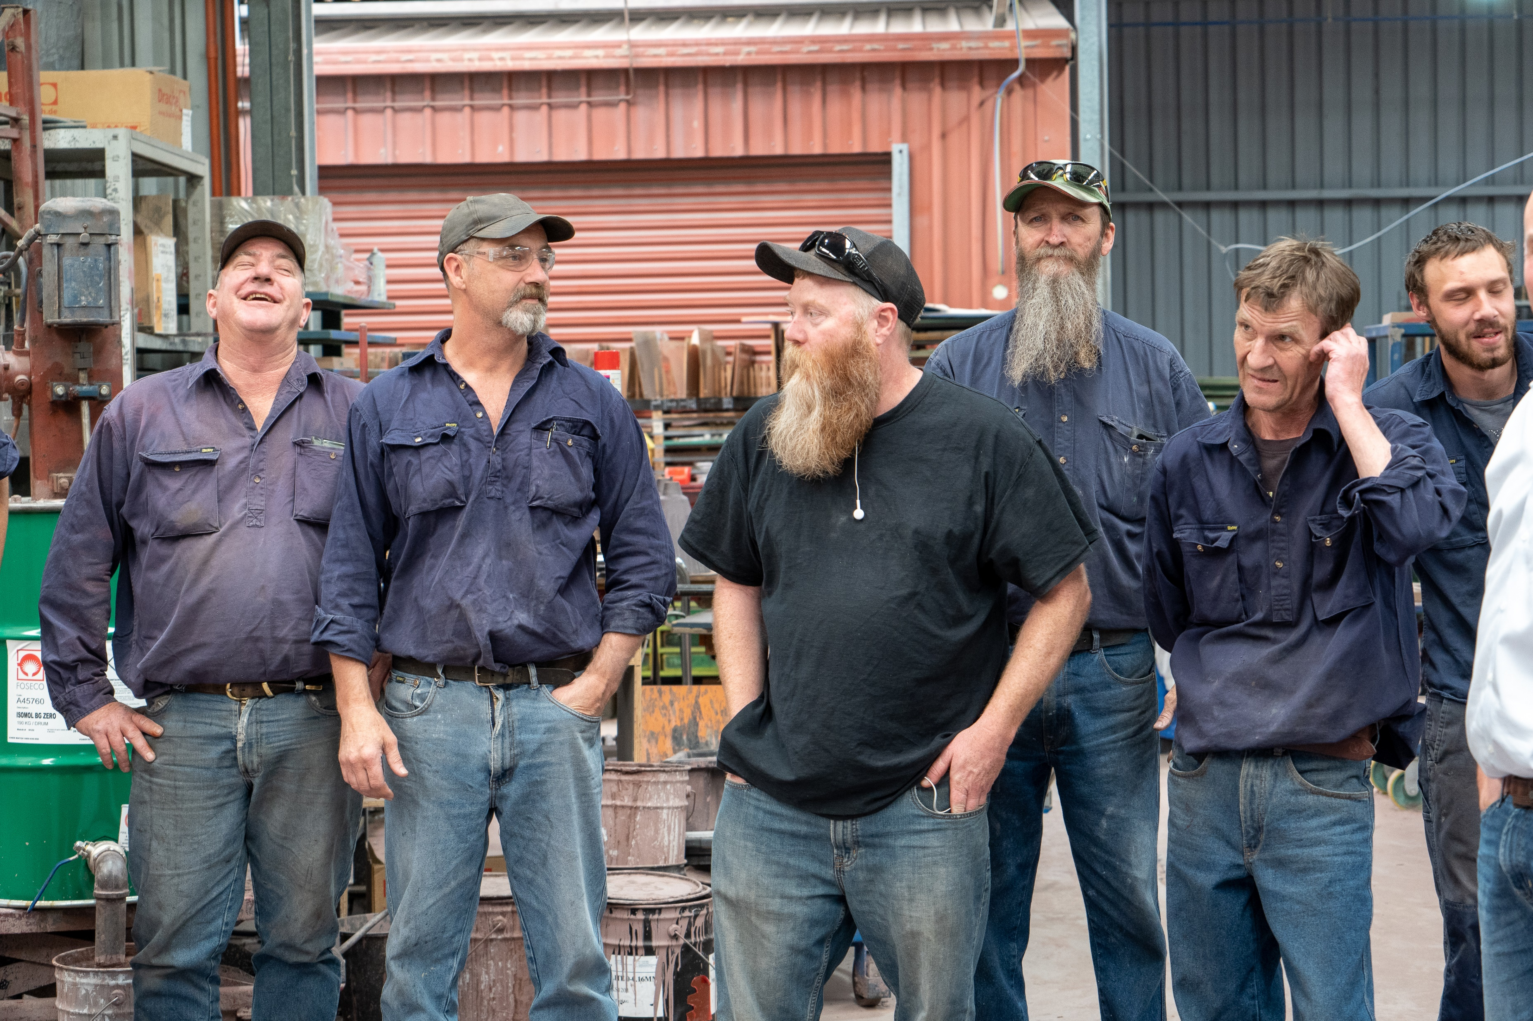
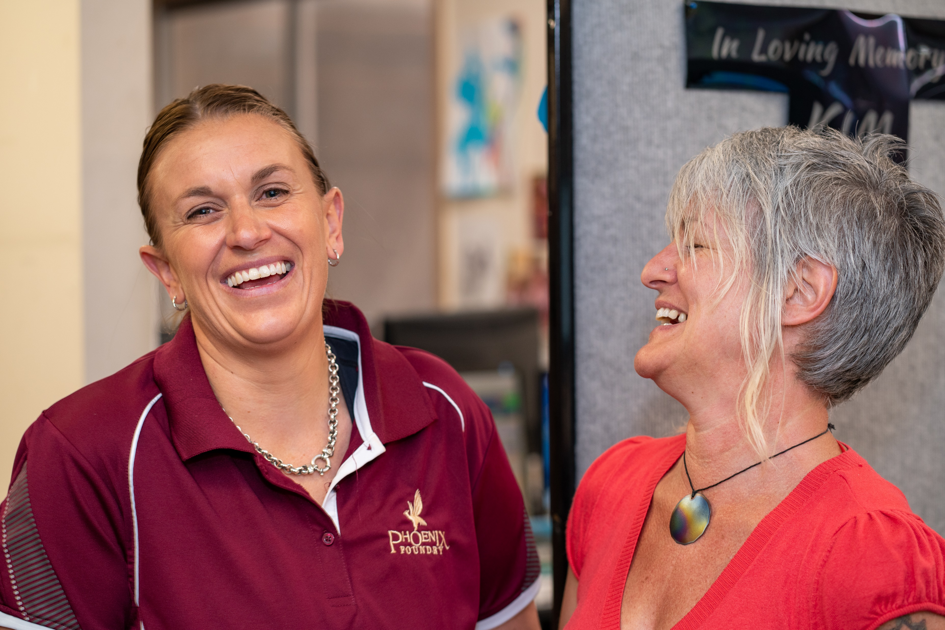
Final Thoughts
THANK YOU TO ALL WHO HAVE BEEN PART OF OUR 40 YEARS
WE LOOK FORWARD TO CONTINUING OUR FRIENDLY, PERSONAL SERVICE WITH THE PROFESSION IN THE FUTURE
WE PRIDE OURSELVES ON OUR COUNTRY MENTALITY, SO IF YOU ARE IN THE NEED OF A QUALITY PRODUCT COUPLED WITH EXCELLENT SERVICE LEVEL PLEASE CALL US,
OR EMAIL orders@phoenixfoundry.com.au

