Slide 1
StandBy – Support After Suicide
Tracey Wanganeen
Coordinator, StandBy Country SA
an initiative funded by the Australian Government
Notes:
Welcome and thank you for taking some time out of your day to listen to this presentation
My name is ………… introduction

Slide 2

Notes:
I would like to start off with an acknowledgement to country
StandBy acknowledges the traditional custodians of the land on which we work and live (I live and work on ______________ land)
Our staff recognise the Aboriginal and Torres Strait Islander community and their continuing connection to land and water.
We pay respects to elders, past, present and future

Slide 3


StandBy recognises and pays respect to those with a lived experience of suicide and we honour their wisdom, bravery and insight.
We also acknowledge and remember the lives that have ended due to suicide and encourage everyone to care for themselves and others.
Notes:
We would also like to
Recognise and pay respect to those with a lived experience of suicide and we honour their wisdom, bravery and insight.
We also acknowledge and remember the lives that have ended due to suicide and encourage everyone to care for themselves and other
We know talking about suicide can be difficult and if you need any support after this presentation please reach out to myself, or someone else you feel safe to have a chat with. We encourage you all to take some time today to do some self-care but we will touch more on this later in the presentation.

Slide 4
Governance and Structure

Slide 5

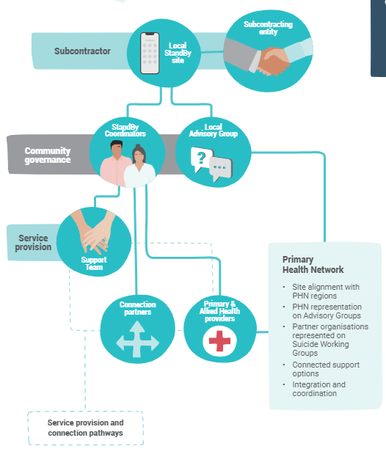
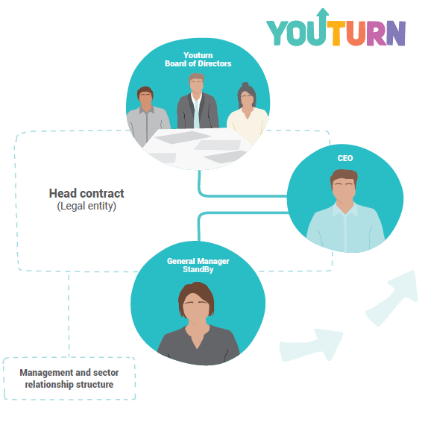
Standby Governance & Partner Organisations
Standby National Structure
StandBy is a service brand of Youturn Limited.
Youturn is only referenced for legal, financial, and ethical responsibility, for example
‘Youturn Limited, trading as StandBy Support After Suicide’
Based on PHN regions
Notes:
Youturn is a not-for-profit organisation supporting people across Southern Queensland from our sites in Tewantin, Maroochydore, Toowoomba, Gympie, Caboolture and Bundaberg
StandBy engages partner organisations to operate StandBy in specified Primary Health Network (PHN) regions under a suggested operating and funding allocation model.
StandBy SA Country site has a professional support team spread throughout South Australia country who are available to respond anytime – anywhere to the needs of those bereaved by suicide. Our support team have a range of skills and specific suicide bereavement training & suicide prevention training.
Examples of team members
Support Sessions are conducted in pairs as this allows for the ‘story’ to be shared and to utilise each other’s experience and expertise as every ‘story’ is unique
A Peer debrief is done immediately following the session (debrief card provided to assist in this process);
Team members then debrief with the site team leader or coordinator and communicate details of the session for the team leader or Coordinator to follow-up
External supervision is mandatory after 3 support sessions but available after any support session as requested by team members.
StandBy uses a formal external supervision model to support staff to maintain their wellbeing, avoid burn out and minimise the effects of vicarious traumatisation.
These practices are consistent with those recommended for bereaved clients, and such practices also value team members and enables ongoing sustainable skilled staffing levels.
The use of an external supervisor enables containment of supervision needs as well as regular impartial practice reviews.
Due to the uniqueness of the suicide postvention field, it is important to engage a Supervisor who understands suicide, its impacts on the bereaved and the potential impacts of working in the suicide field.
These practices are in line with recommendations from “An examination of wellbeing and resilience among StandBy Coordinator, team leader and support team workers” in May 2015 (Maple et al, 2017)
- That stated - StandBy staff require ongoing support to ensure effective debriefing and reflection through internal and external supervision. Both types of supervision need to be structured and scheduled at regular intervals and evaluated consistently, to ensure matters are addressed within and between members of the crisis support team.
Note : Staff Wellbeing after Suicide or Traumatic Loss
Working in the suicide field may impact significantly greatly if bereaved by suicide. In the event a StandBy staff member is impacted by suicide or another traumatic loss, the Partner Organisation is obliged to advise the relevant National StandBy Partnership
Coordinator. In such a situation, the National StandBy Team will discuss with and support the
Partner Organisation with issues including:
• Contingency plans to sustain service delivery
• Providing direct support for affected StandBy staff members

Slide 6


Standby Partner Orgs
Notes:
In South Australia the partnering organisation is Anglicare SA and has been since July 2021.
Previously its was Uniting communities and Centacare Catholic Country SA

Slide 7
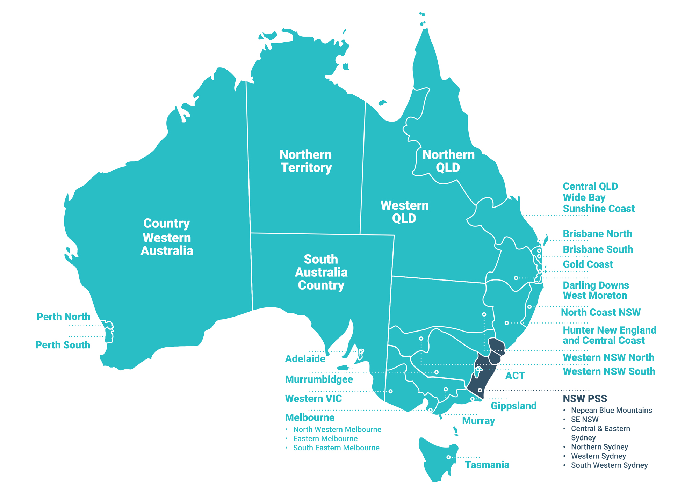
Current StandBy Expansion
Notes:
StandBy is funded by the Commonwealth Government. Access to equitable postvention bereavement services, regardless of where people live in Australia was identified as a priority in the National suicide prevention implementation strategy 2020 – 2025.
StandBy National provides support across the all of Australia
Note: Teal colour is where StandBy currently operates
Dark Blue is where the Postvention Support Service operates in partnership with Jesuit Social Services, NSW Department of Health, Roses in The Ocean and StandBy National.
We are dedicated to supporting people and communities affected by suicide
Our sites are accessible 24/7 via their StandBy response phone
We provide initial face to face support and refer people for ongoing support
We also provide
Community education
Professional development training

Slide 8
What is suicide?
Suicide is a reaction to overwhelming feelings of loneliness, worthlessness, helplessness, hopelessness and sometimes depression
Suicide occurs when a person’s pain exceeds their resources to cope
Kerkhof & Diekstra 1995
Notes:
Suicide is not always about dying or about understanding the finality of death
Rather, as the final sentence states,
suicide occurs when a person’s psychological suffering exceeds their resources to cope
Many suicide survivors have reported that they did not actually want to die – they just didn’t want to live with the pain they were experiencing

Slide 9

What is Postvention
All interventions that attempt to reduce negative consequences that may impact on the bereaved
What do postvention activities aim to do?
Ease the trauma and related affects of the suicide loss
Encourage resilience and coping
Minimise the risk of suicide ideation or suicidality
Prevent the onset of adverse grief reactions and complications
Notes:
Postvention is the term applied to interventions AFTER a suicide and attempt to reduce negative consequences that may impact on the bereaved
Postvention Objectives
Ease the trauma and related affects of the suicide loss
Encourage resilience and coping
Minimise the risk of suicide ideation or suicidality
Prevent the onset of adverse grief reactions and complications

Slide 10
Who do we support?

Slide 11
Who do we support?
StandBy supports anyone bereaved or impacted by suicide including:
Individuals, families, friends, witnesses
schools, workplaces, sporting, community groups
first responders and service providers
There is no time limit on how long ago the suicide may have occurred, as to when people can seek support.
Notes:
We support anyone who is bereaved or impacted by suicide, and these is no time limit. What that means is the suicide may have been recent of it could have been several years ago, it doesn’t matter. Because everyone grieves differently, support can be needed at different times.
Sometimes we may have contact with a bereaved person, but it is sometimes too soon, or they are not ready for support straight away, so we always offer to call at a later time that suits to check in and see if support is needed.
This can sometimes happen especially if it’s a recent death and the person may already have a lot on their plate with lots of visitors, family gatherings and trying to sort out funeral arrangements. Often the support is needed when things become more quieter, and others start going back to their normal life routines, visits start to reduce, and the casseroles stop coming.
Bereaved: a person or persons that experience grief and loss of a family, friend or close contact. While this is a broad term to describe all people affected by grief and loss after a death, for the purpose of StandBy communications, the term ‘bereaved’ is explicitly used to describe those who are ‘bereaved by suicide’. Suicide bereavement is complex in nature and while the grief experienced can be similar to other sudden losses, there may be additional emotional and physical responses attributed to the intentional nature of the death, the potential trauma experienced as well as possible implications resulting from stigma that may be associated with death by suicide. Evidence suggests that those who are bereaved by suicide are at higher risk of suicidal thoughts and behaviours due to their trauma and loss.
Impacted: a person or persons that are directly or indirectly affected by a suicide or suicide attempt. This may be due to (but not limited to) witnessing a suicide, being the first to respond, being in the vicinity of a suicide, played a role in the search for missing persons, exposed to graphic detail regarding a suicide and personally identifying with the deceased person/s. An impacted individual does not have to know the deceased to be impacted. Those impacted can experience emotional and physical responses attributed to the intentional nature of the death, the potential trauma experienced as well as possible implications resulting from stigma that may be associated with death by suicide. The impact can be both long and short term.

Slide 12
How do we support?
Immediate tailored response to people bereaved by suicide via a locally based 24/7 crisis number.
People receive face-to-face or telephone support and connection through coordinated local support services matched to their needs, including psychological first aid.
Follow up calls are continued for up to 24 months from initial contact.
Provide free tailored community workshops and education programs to increase awareness of suicide and suicide bereavement to help enable communities to support one another.

Slide 13


Suicide deaths in 2020
3139
234
Remember every one death by suicide is too many!
Notes:
In 2020 ABS data indicates a total of 3,139 suicide deaths in Australia – 2,384 male 755 female. A decrease from the previous year.
Now translates to 8.6 people per day
Suicide rates are consistently more than double the road toll
In 2019 SA were impacted by 234 suicide deaths – a decrease from the previous year
2019 SA lost 251 people to suicide, an increase from the previous year which was 212

Slide 14
Why do we support?
Every suicide death, there are at least 135 people who are impacted (Cerel, Brown, Maple, Bush, Van de Venne, Moore & Flaherty)
People who are impacted, are at increased risk of suicidal thoughts and suicidal behaviours
Bereavement support is a vital step in keeping community members safe and well after a suicide death.
This period of support is termed POSTVENTION
Notes:
Remember every one death by suicide is too many!
Considering in 2020 we lost 3139 people to suicide nationally and if you think about for every life loss there are 135 who are impacted, that adds up to over 400,000 people impacted and potentially needing support.
We also know that if you are impacted by suicide, you are at greater risk of suicidal ideation and this is why suicide postvention is also suicide prevention!

Slide 15

Notes:
If the video above doesn’t work, here is the youtube link: https://www.youtube.com/watch?v=ibcs36_bHh0
PLEASE NOTE: some of the data in this video has been updated in the latest Science of Knowing evaluation/research paper 2021

Slide 16
How do people connect with this service?

Slide 17

Referrals
How do people connect with our service
Self referral
Referral by organisations, services, community
members – no referral forms – only verbal
consent needed.
Call our 1300 727 247 crisis number
Send an email or send a text message
Anyway, that works
Notes:
Referrals can come from anyone. There are no forms to fill in. We simply need the consent of the bereaved to make contact
i.e. If you call me to advise someone is bereaved, I can’t just contact them, but if you know them you can give them our number or get their consent to pass on for me to call them
There is now an agreement with SA Police that when a bereaved family is contacted by them, one of the South Australian postvention services (StandBy, LBS & Thirrili) will be offered and with their consent SAPol will pass on details for us to contact them directly. An officer may offer to call the appropriate service and make the initial connection on their behalf, always with the families consent.
Can take referrals from police officers, Criminal Investigations Branch (CIB) officers and Victim Contact Officers (VCO) on a family’s behalf.
This is often helpful for people who have just lost someone to suicide as they may feel overwhelmed and unable to cope with simple daily living activities like making a phone call.
The service can then contact the family and make a time to visit, whether that be in the next couple of days, weeks or whenever they are ready.
Our services work collaboratively to support anyone within the ripple effect of a suicide, for example a suicide may occur in Mount Gambier or Port Lincoln, however, there may be close relatives living within the Adelaide metropolitan area that also need supporting.

Slide 18

How can you help connect?
Activities that can help promote the service in a community:
Providing StandBy resources
Displaying Helpseeking information
Speaking with your local StandBy site
Notes:
We have a range of resources we can share with you and we encourage you to share them with your networks and communities.

Slide 19
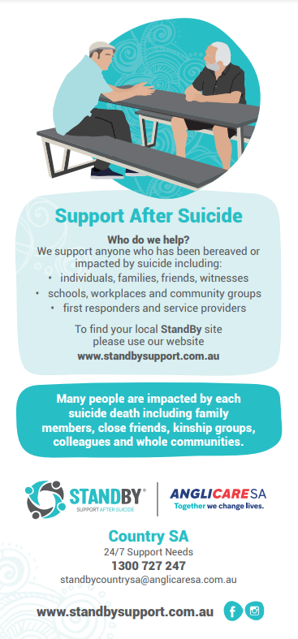
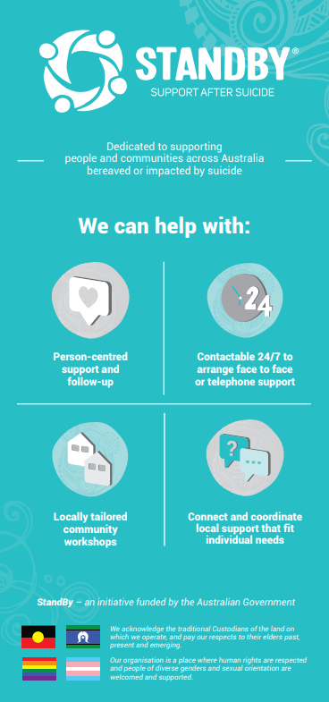
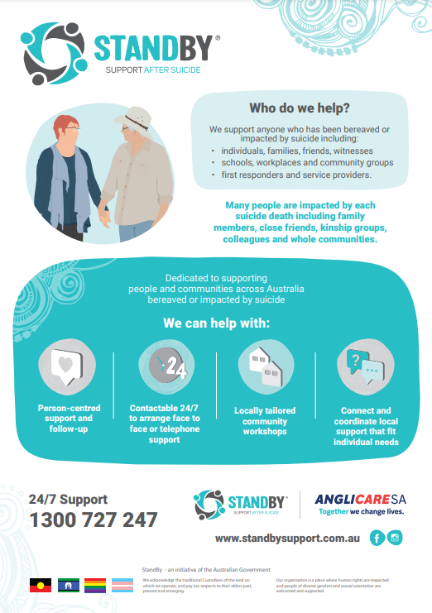
Resources
DL Flyer Posters
Please let us know if you would like any hard or electronic copies sent
Notes:
Both available in hard and soft copies

Slide 20
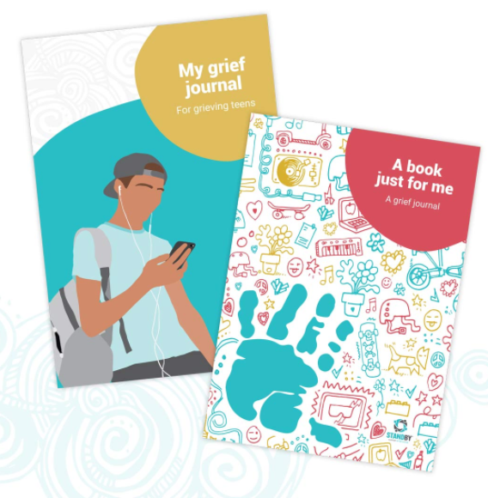
Resources
To support young people
“A book just for me – a grief journal” for children under 12
“My grief journal – For grieving teens”
“Accompanying notes” – a helpful resource for
carers who are supporting a bereaved child
Plus, many more: www.standbysupport.com.au/resources
Notes:
Both available to download via our national website

Slide 21
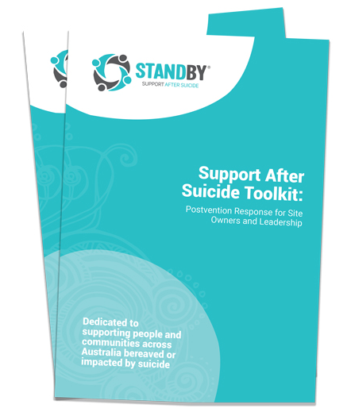
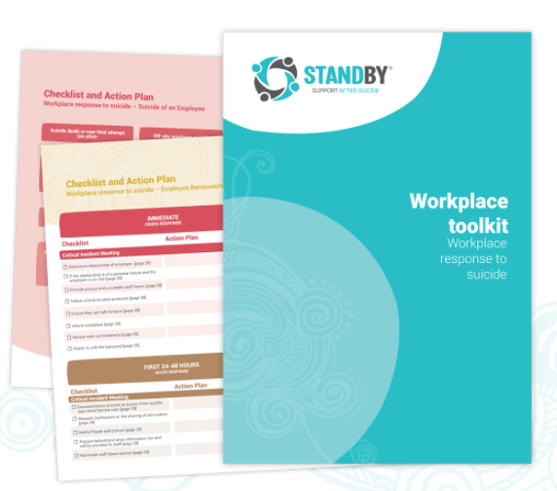
Resources
Toolkit: Workplace Toolkit
Workplace response and support
following a suicide of an employee
Includes Action Plans
Suicide of an employee
Bereaved Employee
Toolkit: Postvention Response for Site Owners
and Leadership
Guide leadership from immediate response
through different postvention activities
Notes:
Also available via national website.

Slide 22
Before we finish up

Slide 23
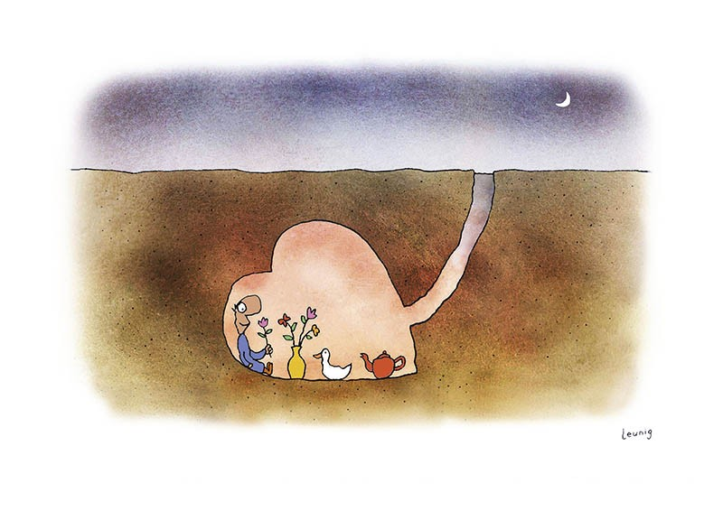
Your Self-Care
What do you do to continually nourish yourself?
Notes:
Talking about suicide can be difficult as we all have our own experiences and can be impacted differently, this is why it is very important to make sure you do something for you self-care, not just today but everyday.
Self care is more than a bubble bath or massage on occasion. True self care is practising the activities that bring joy into our life on a regular basis.
What do you do?

Slide 24
Questions?
Notes:
Hand out resource, flyers, business cards etc or forward information electronically.

