Slide 1


Digital Business
Systems in Death
Care Services
Notes:
introductions

Slide 2
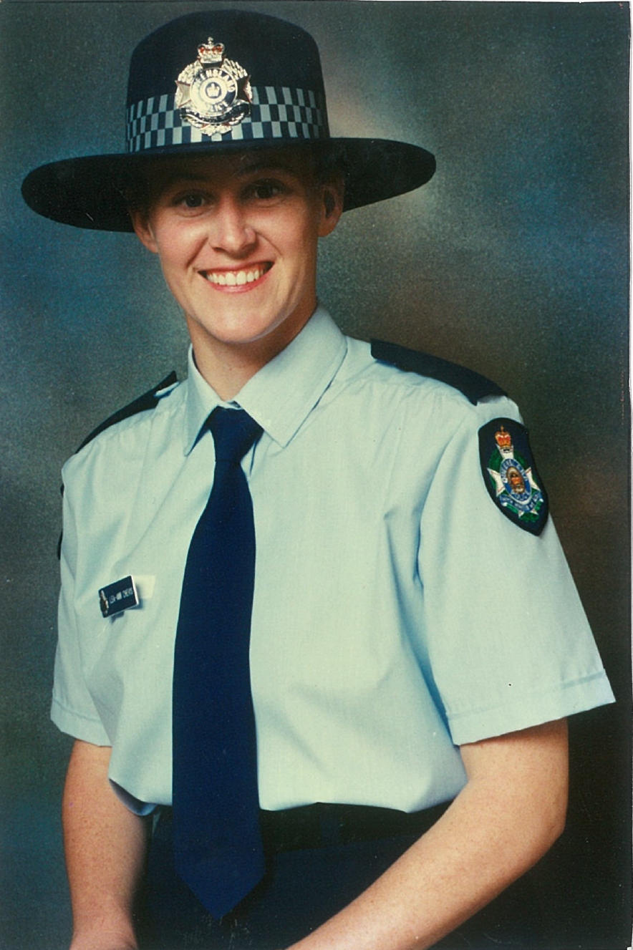

Slide 3
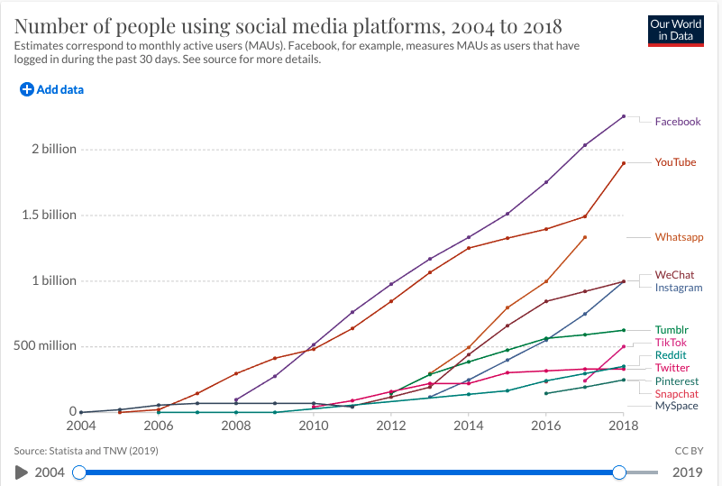

Slide 4
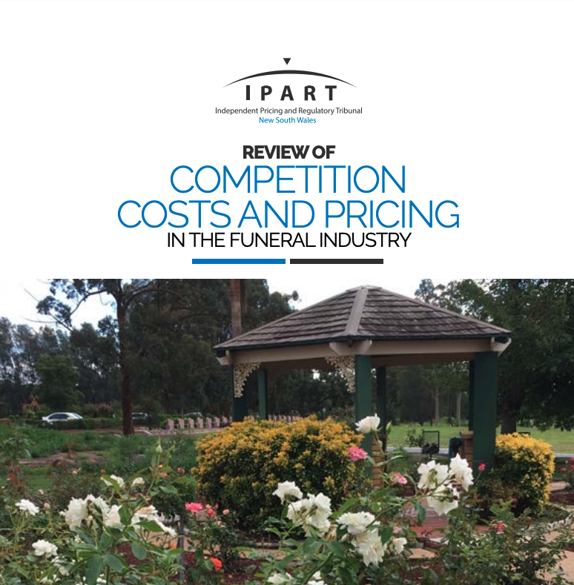

Slide 5


With powerful operational and customer service solutions
Fully integrated cemetery, crematorium and funeral home operating software
Multi-location, multi-lingual, multi-currency,
multi-jurisdictional – truly global solution
Caters to all size operations
A truly end-to-end solution
Key product features:
CRM
Invoicing
Deceased records
Marketing automation
Cemetery mapping
Document management
Financial management
Cremated remains management
OH&S
Also creates new revenue opportunities for our customers
Grounds & services management
Mason permits
Pre-Need
Workflows/
Escalations
Document & image management
Maintenance
Data
Genealogy
Perpetual maintenance
Inventory management
Escalations
Horticulture management
Cemetery tourism
Mapping
Memorialisation
Flower drives
Fintech
Multi-media
Notes:
.

Slide 6







And a digital presence
B2B2C
Funeral Directors
Crematoria
B2B marketplace
B2C coming
Simplifies the transactions
Improves efficiency
Reduces costs
Creates new sales channels
Caters to changing consumer demands
Cemeteries
Death Care
Consumers
Masons
Suppliers
Notes:
.

Slide 7
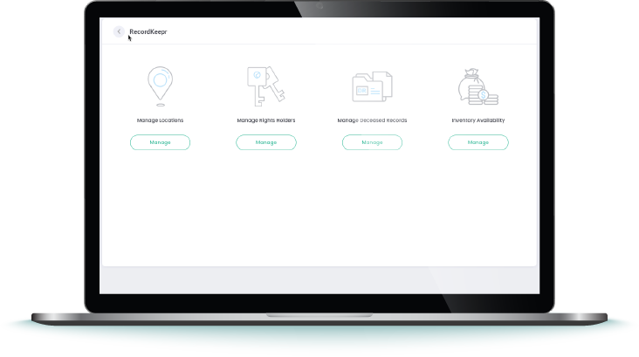
Now every cemetery can be digital
RecordKeepr (formerly OpusXc)
Small and historical cemeteries
Locations
Deceased
Rights Holders
Document Storage
Mapping
Deceased Search
Points of Interest

Slide 8
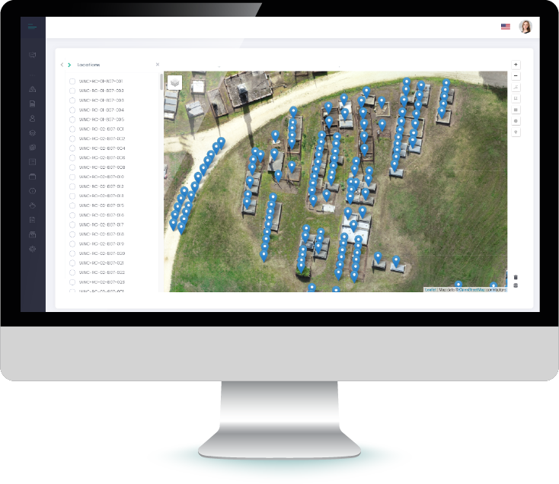
Mapping Made Easy
Mapping Tool
No surveying required
Fly the drone (or not)
Add location codes
Draw the polygon
Automatically collects. the GPS
Add to byondpro, Google Earth …
Low-cost mapping resource pool

Slide 9
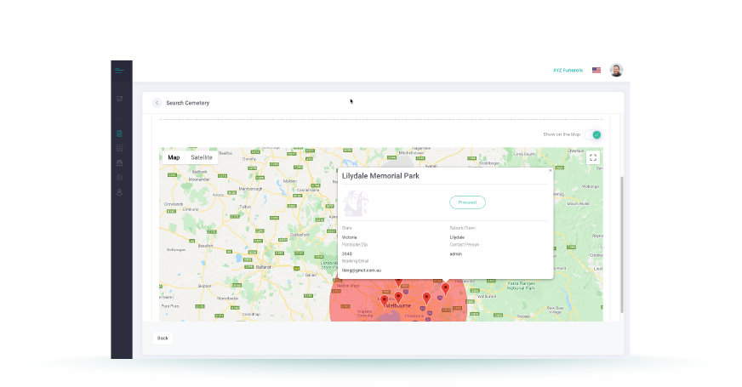
Simplify Bookings
Online Bookings
Calendars online
Book 24/7
Improved service to the families
Frees up family consultants
Simple no-service bookings
Easy information collection

Slide 10
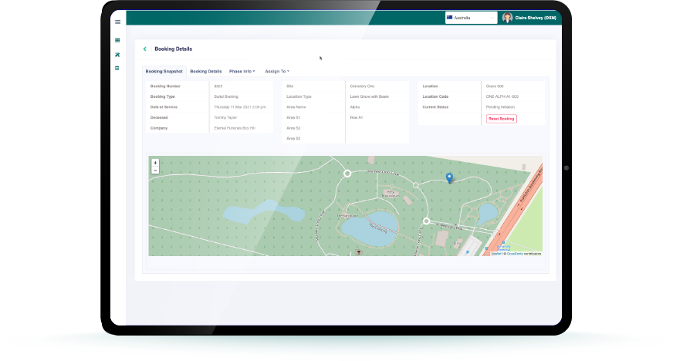
Efficient Grounds Management
New Grounds and Service Manager
Auto update to/from booking
Job and team assignments
Any mobile device
Know what is needed in the grounds
Manage alerts
Tracked workflows

Slide 11
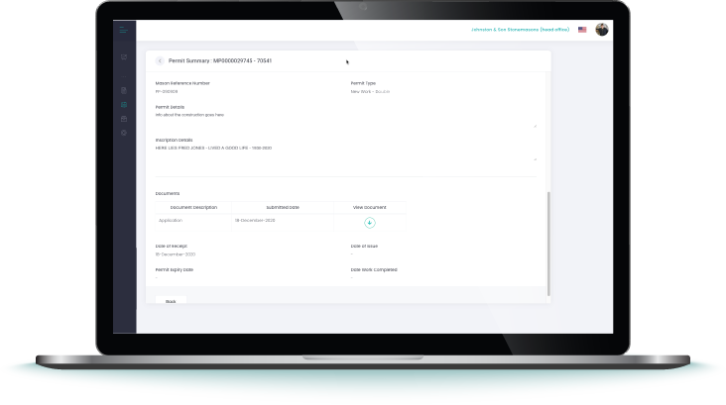
Streamlined Monument Permits
Mason Permits
Simplified for the mason
Submit permits 24/7
Upload documents
Approval process managed

Slide 12








Builds new revenue streams for the industry
Reduces
operational costs
Caters for every part of the business
A solution
like no other.
The only platform that provides
a comprehensive operational solution and that connects the whole industry into a digital marketplace.
Delivers a better customer experience
Allows consumers to find, review and purchase online
Enables a digital transformation
Improves compliance management
Simplifies transactions between trading partners

Slide 13
Thank you.
Contact Information
Australia : 1300 994 853
E: sales@opusxenta.com
W: opusxenta.com

