Slide 1
Changes in Legislation to the Surrender of Interment Rights
2022 CCASA Information Forum

Slide 2
WARNING
WARNING
This presentation features maths calculations and
refers to the Act & Regulations
75% of students are good at maths……….
I belong to the other 10%

Slide 3
There are two documents that you need to be aware of
Burial and Cremation Act 2013
Burial and Cremation Regulations 2014

Slide 4
Burial and Cremation Act 2013
34—Surrender of interment rights
(1) The holder of an interment right may surrender the interment right to the relevant authority that issued it.
(2) On the surrender of an unexercised interment right, the relevant authority must give the former holder of the interment right a refund equal to the current fee payable for an interment right of the same kind, less a reasonable fee—
(a) for administration and maintenance costs; and
(b) for costs involved in the establishment of the cemetery or natural burial ground, determined in accordance with the regulations.

Slide 5
Burial and Cremation Act 2013
Continued
(3) On the surrender of an unexercised interment right, that interment right is discharged.
(4) In this section— unexercised interment right means a current interment right under which—
(a) human remains are yet to be interred; and
(b) a memorial is yet to be erected.

Slide 6
The Act advises you must refund if the Interment right holder meets the previous requirements. So how much do you have to refund?

Slide 7
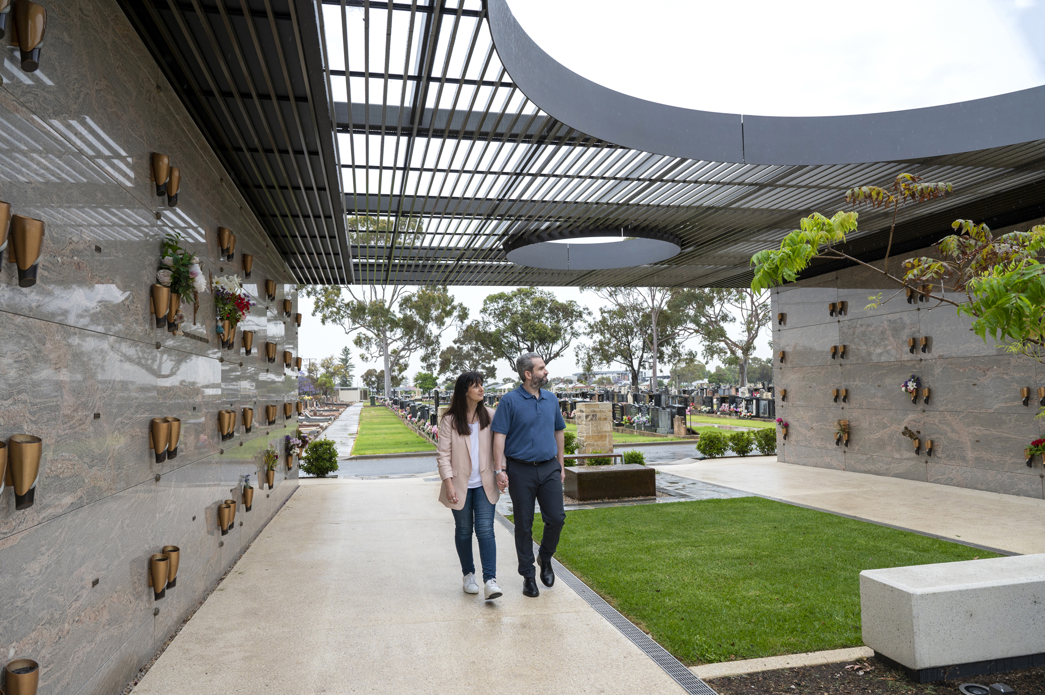
Burial and Cremation Regulations 2014
31—Surrender of interment rights (section 34 of Act)
The fee that may be deducted by a relevant authority from a refund under section 34(2) of the Act on the surrender of an interment right is an amount to be determined in accordance with Schedule 1.

Slide 8
Burial and Cremation Regulations 2014
1—Determination of fee that may be deducted from refunds
The fee that may be deducted by a relevant authority from a refund under section 34
(2) of the Act on the surrender of an interment right issued for a specified term is an amount to be determined in accordance with the following formula: A –((B÷C) ×D)

Slide 9
Burial and Cremation Regulations 2014
Where—
A is the current fee payable for an interment right of the same kind
B is 75% of the current fee payable for an interment right of the same kind
C is the number of years for which the interment right was issued
D is the number of full years in the unexpired portion of the period for which the interment right was issued (but if the number of full years in the unexpired portion of the period for which the interment right was issued is more than 30 years, the unexpired portion of that period must be taken to be 30 years).

Slide 10
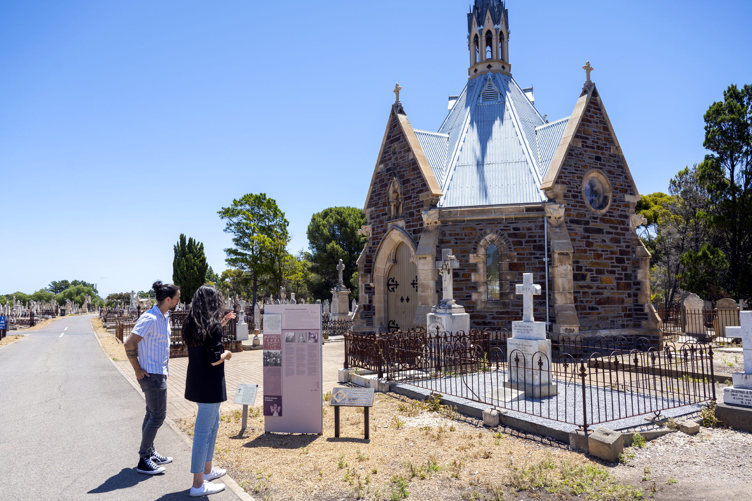
Burial and Cremation Regulations 2014
Example with 25 years remaining
A –((B÷C) ×D)
$7500-((5625 ÷50)x 25)
=$2812 to be refunded
Example with 40 years remaining
A –((B÷C) ×D)
$7500-((5625 ÷50)x 30) This is capped at 30 years as per the new act
=$3375 to be refunded

Slide 11
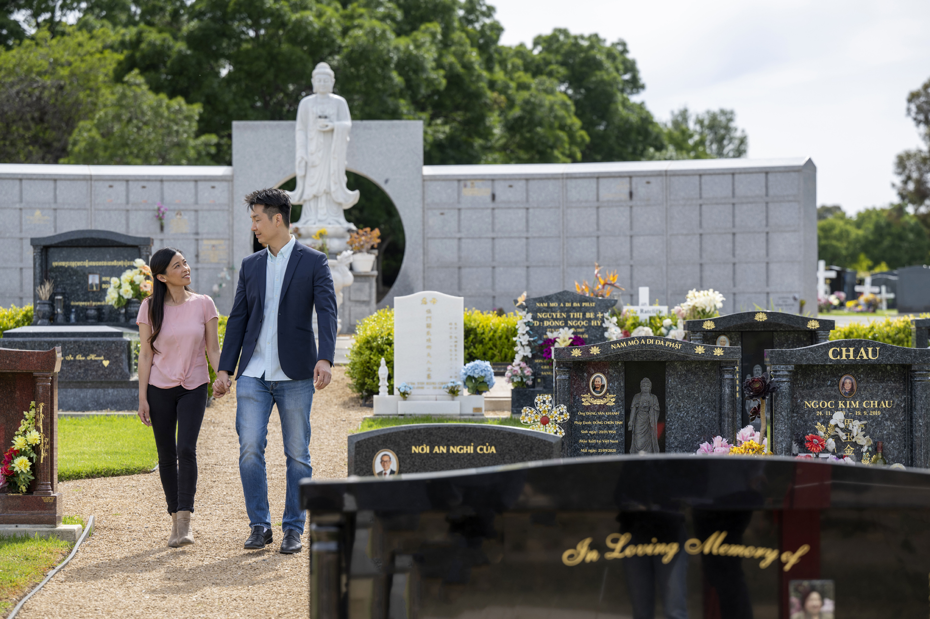
Burial and Cremation Regulations 2014
New table for Surrender of Interment Rights for Perpetuity
1 year = 25%
5 years 33.97%
10 years 45.17%
20 years 67.59%
25 years 78.79%
30 years 90%

Slide 12
Questions
Michael Robertson
P: 8139 7400
E: enquiries@aca.sa.gov.au

