Slide 1
LGA's statewide cemetery database
John Mundy
How to get involved

Slide 2
Web solutions
LGA Squiz platform
53 councils
Statewide databases: employment, events, points of interest AND graves

Slide 3
Cemetery search
28 participating councils
Over 200,000 records
Search all councils

Slide 4
Participating councils
Alexandrina
Barunga West
Berri Barmera
Clare & Gilbert Valleys
Cleve
Coober Pedy
Copper Coast
Elliston
Goyder
Grant
Kimba
Kingston
Mid Murray
Mount Gambier
Naracoorte Lucindale
Northern Areas
Onkaparinga
Orroroo Carrieton
Port Lincoln
Port Pirie Regional
Renmark Paringa
Robe
Salisbury
Southern Mallee
Walkerville
Wattle Range Council Whyalla
Wudinna
Yankalilla

Slide 5
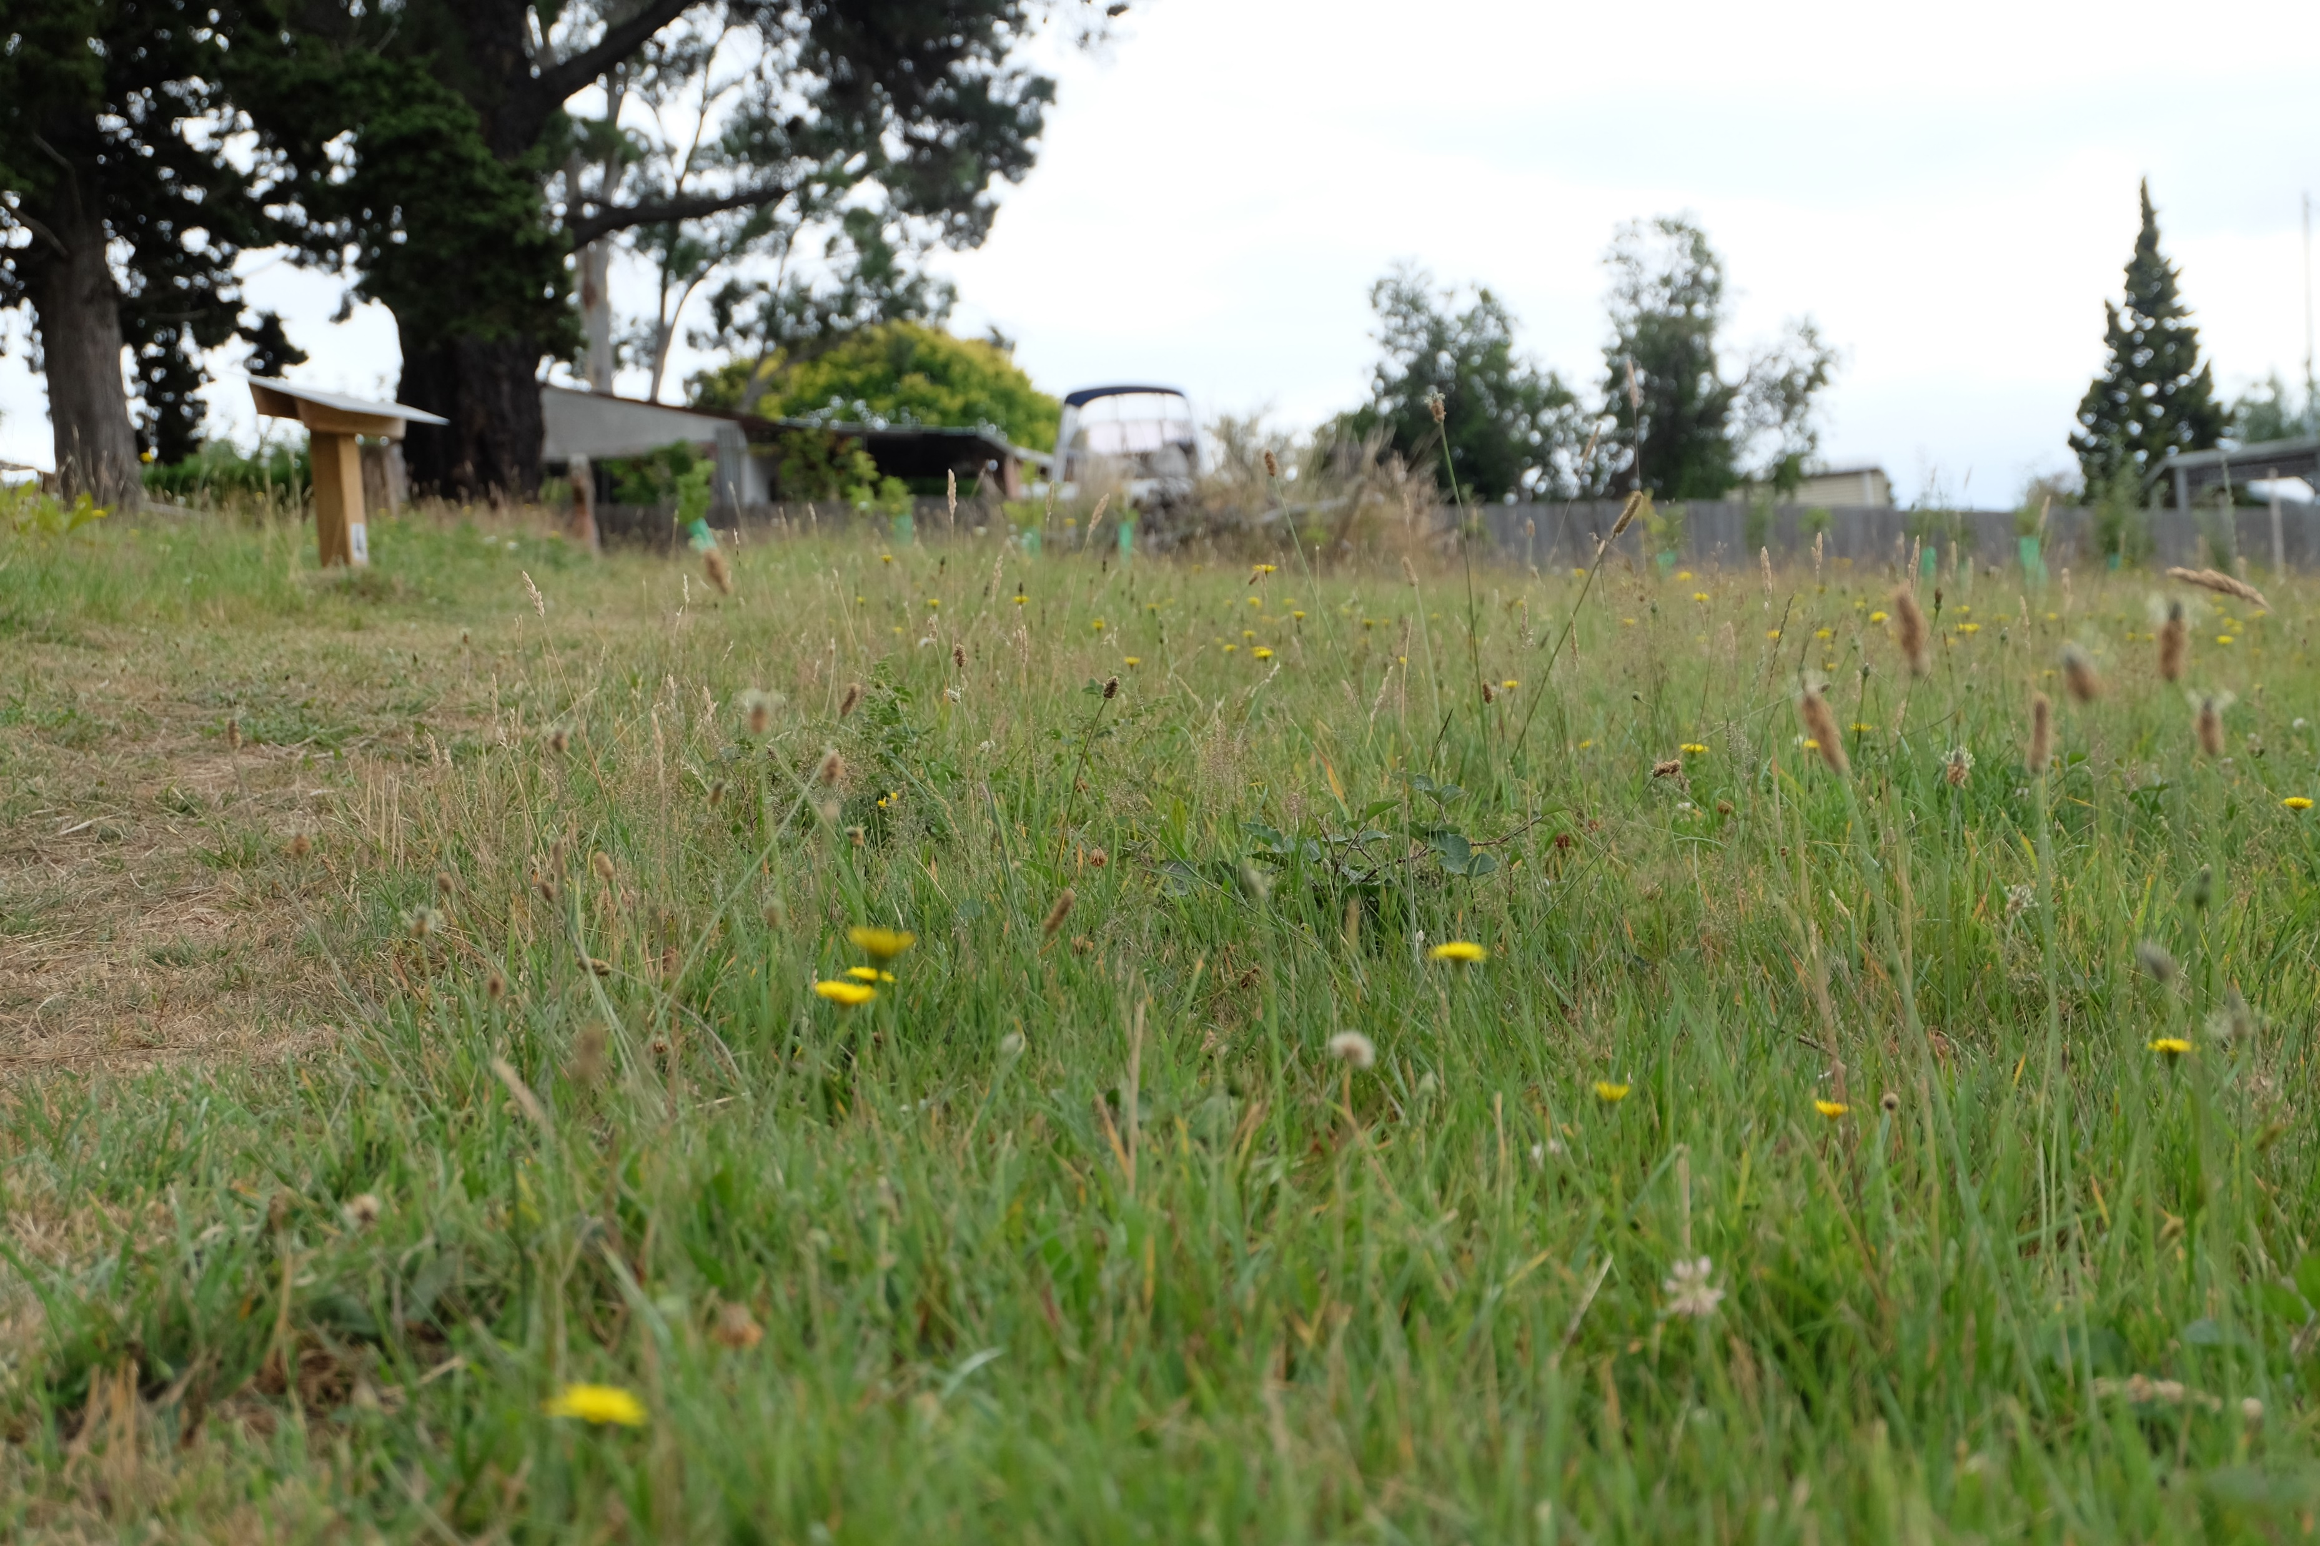

Slide 7
Contributing records
Portal website
One time upload
System integration

Slide 9
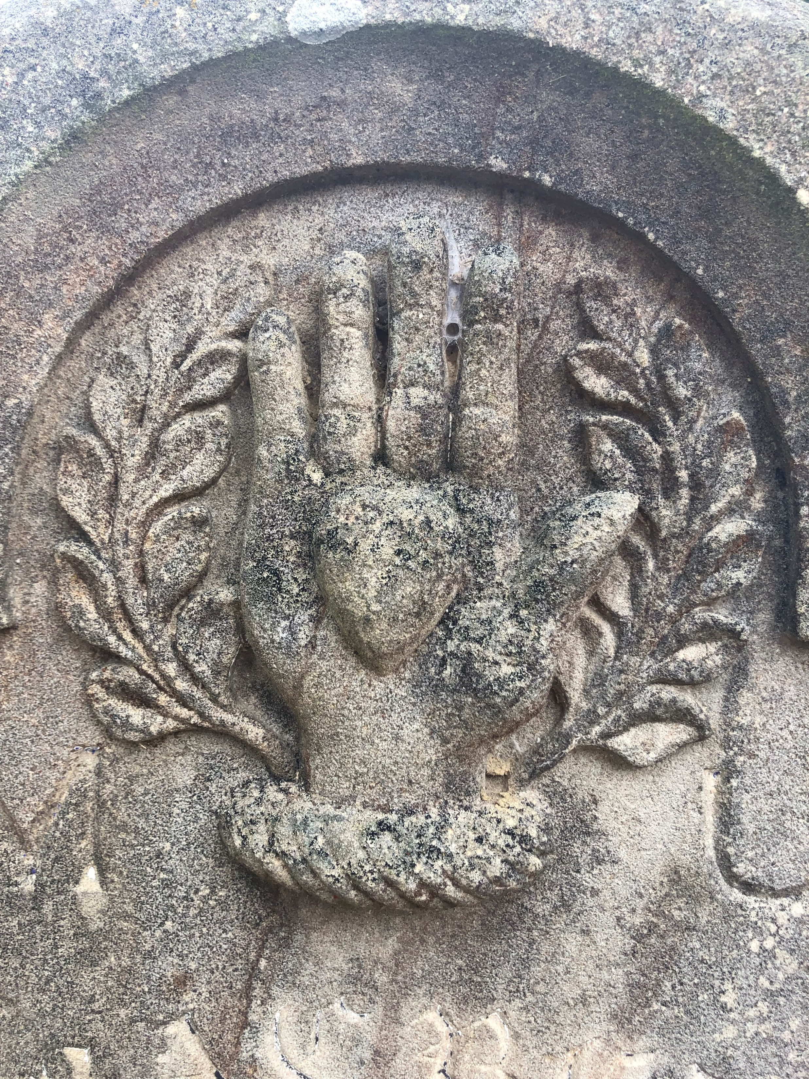

Slide 10
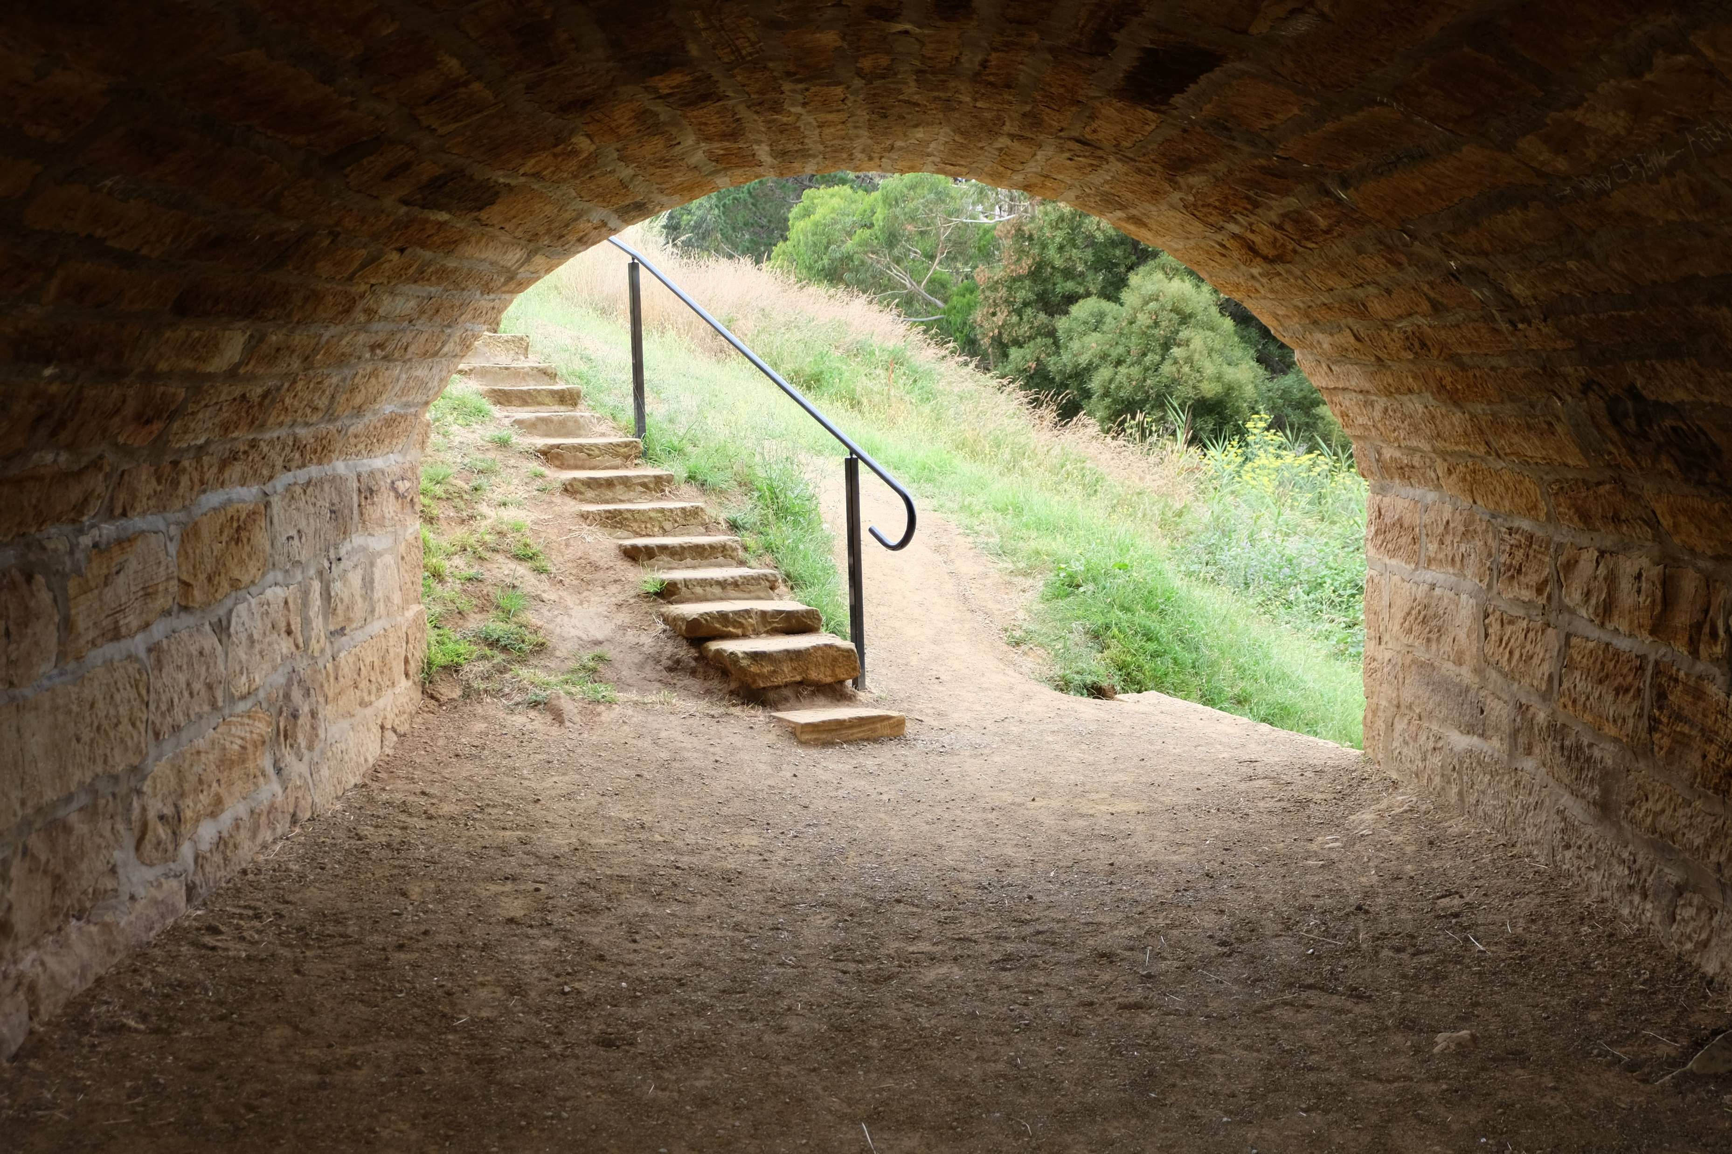
Contact
John Mundy
Manager Web Solutions
john.mundy@lga.sa.gov.au

