Slide 1
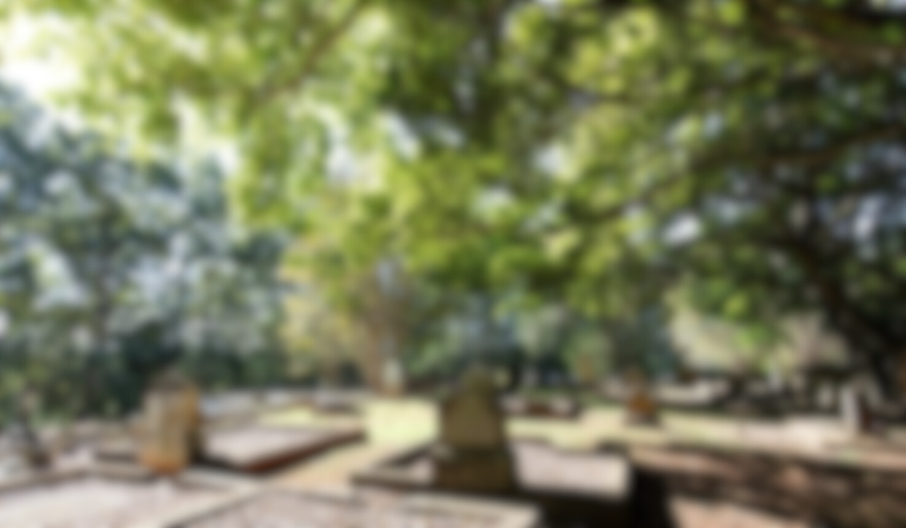


Product Showcase
"Our Latest Innovations and Commitment to Excellence"

Slide 2
About us
We offer a holistic design philosophy, crafting products and spaces that harmonise with communities, environment and architecture.
Our Services include:
  Consultation
  Product Design
  Placemaking
  Wayfinding
  Masterplanning

Slide 3


2023

Slide 4
Market Overview
More than 80% of people are cremated. Of that, less than 20% memorialise
Most cemeteries are lacking product variety
Cemeteries are struggling for space
Items placed around the memorial can damage it or be blown away in the wind.
Many memorials don’t consider accessibility and can have restricted access and interaction due to placements or levels.

Slide 5
Our Response...
Our latest release of products address these issues, each focusing on a different aspect and visual aesthetics.

Slide 6
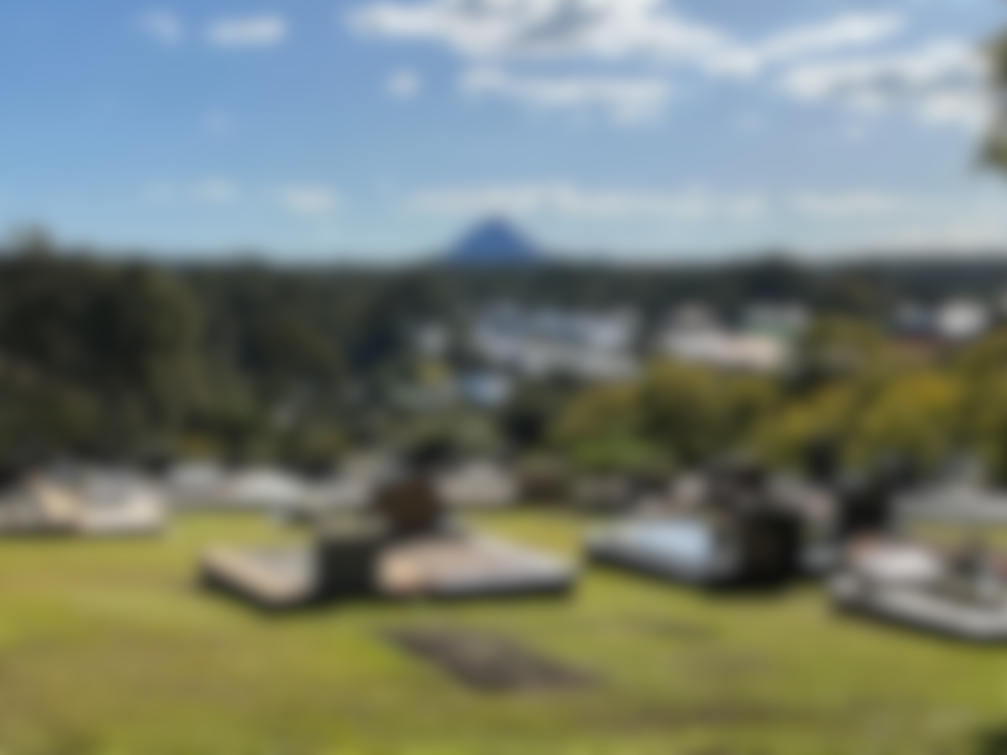
New Products
2023

Slide 7
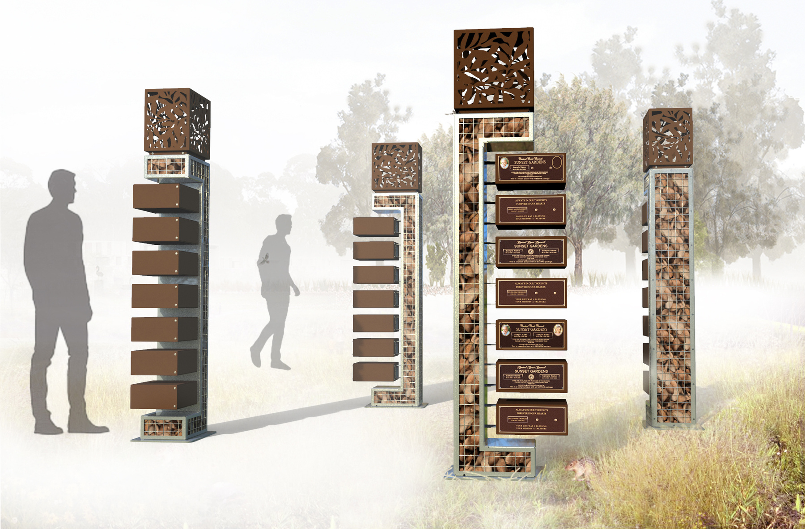
Eco Series
  Space Saving
  Cemetery Customisation
  Natural Aesthetic
Our Eco series is our first memorial featuring a unique vertical layout, that optimises space without compromising aesthetics.
We've seamlessly integrated river rocks and a corten steel look to craft a memorial that exudes rustic charm and a sense of the natural world.

Slide 8
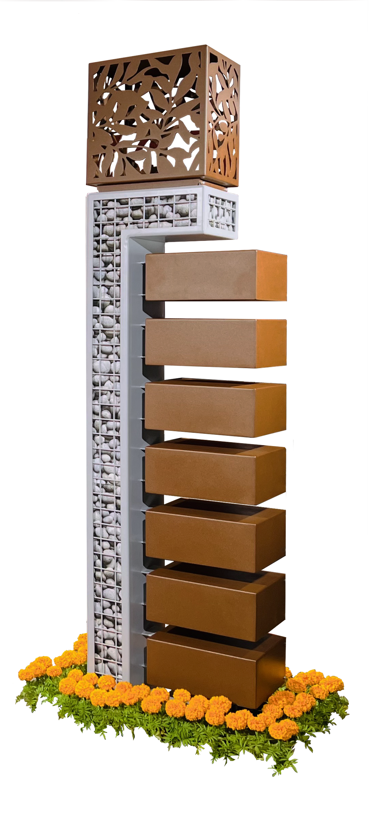
Design Cover
River-Rock Gabion
2 Ash Containers per position
Dulux Powder Coat

Slide 9
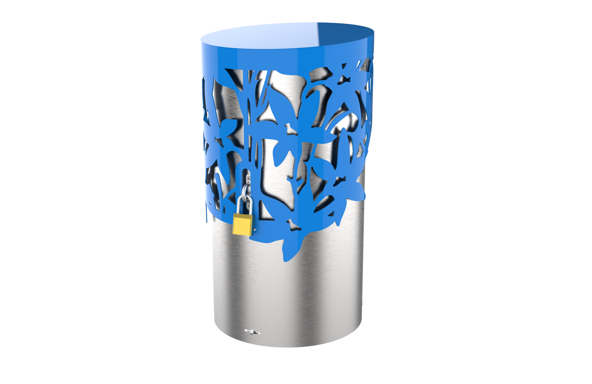
Keepsake
The Keepsake is an elegant product to help reduce the amount of items found around memorials. Families can keep these items safe and access them at any point in their visit.
  Locking function
  Can fit adult ash containers
  Uses screw pile installation
  Variety of designs
  3 sizes

Slide 10
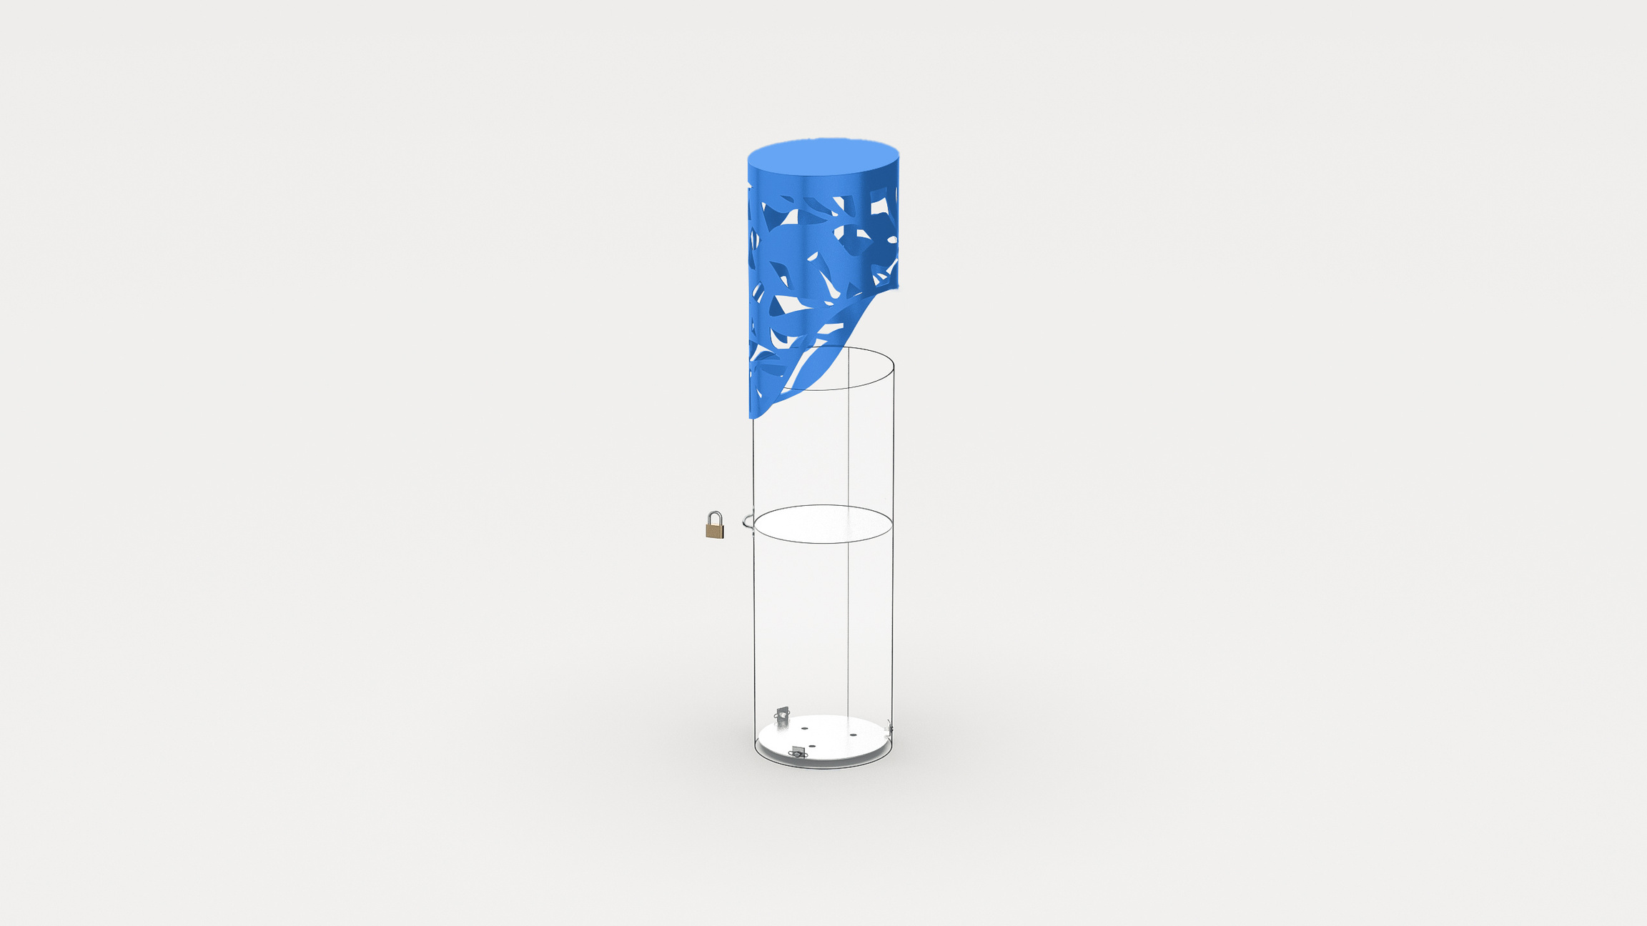
Design Cover
Keepsake Compartment
Lock
Ash Interment
Installation Fixing

Slide 11
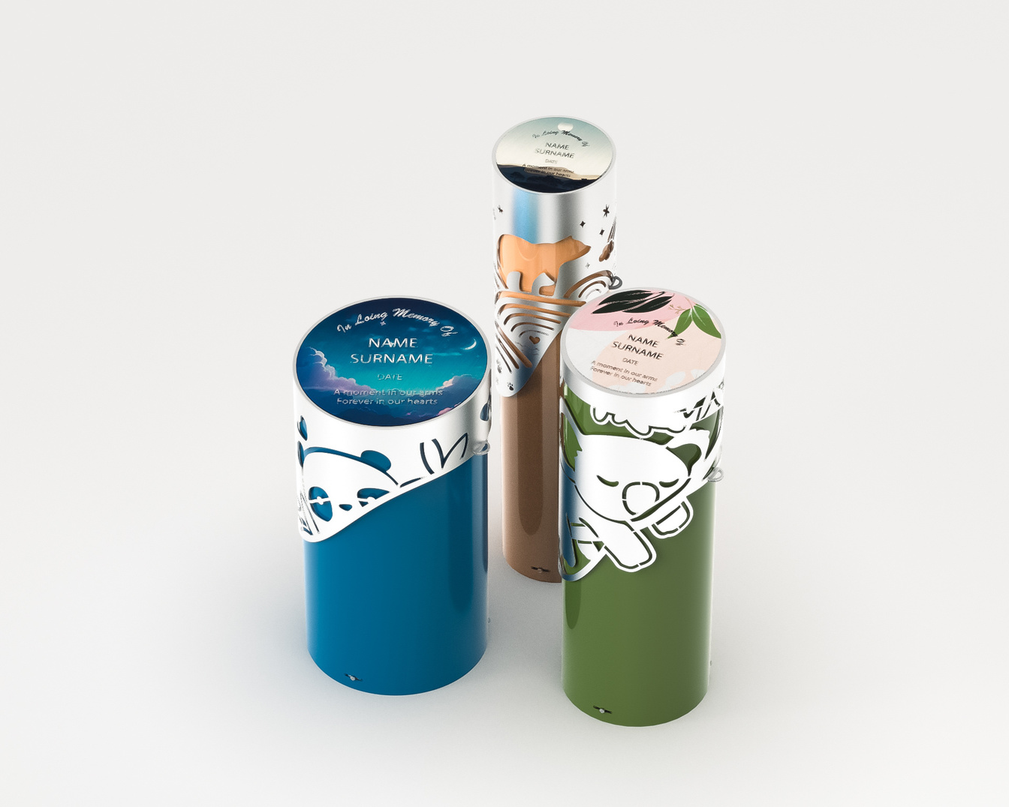
We have created a wide selection of unique designs for both children's and adult memorials.

Slide 12
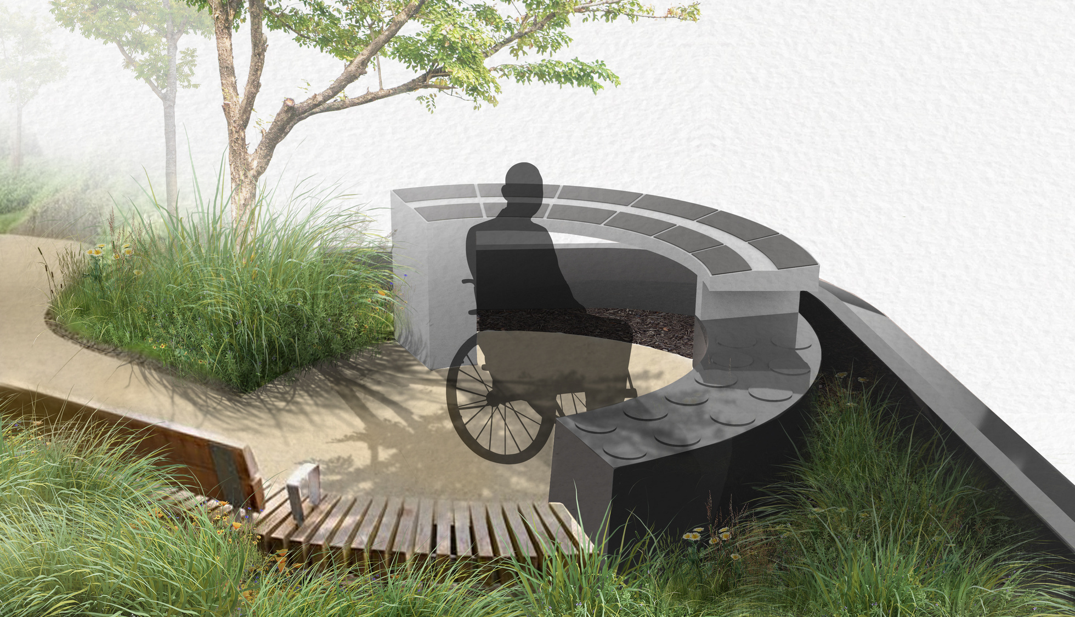
Accessibility Memorial
This innovative design allows individuals to effortlessly view plaques and interment spaces, as well as touch and arrange flowers, without the inconvenience of bending down to lower levels.
  2 ash containers per position
  Wheelchair accessible
  Made from granite

Slide 13
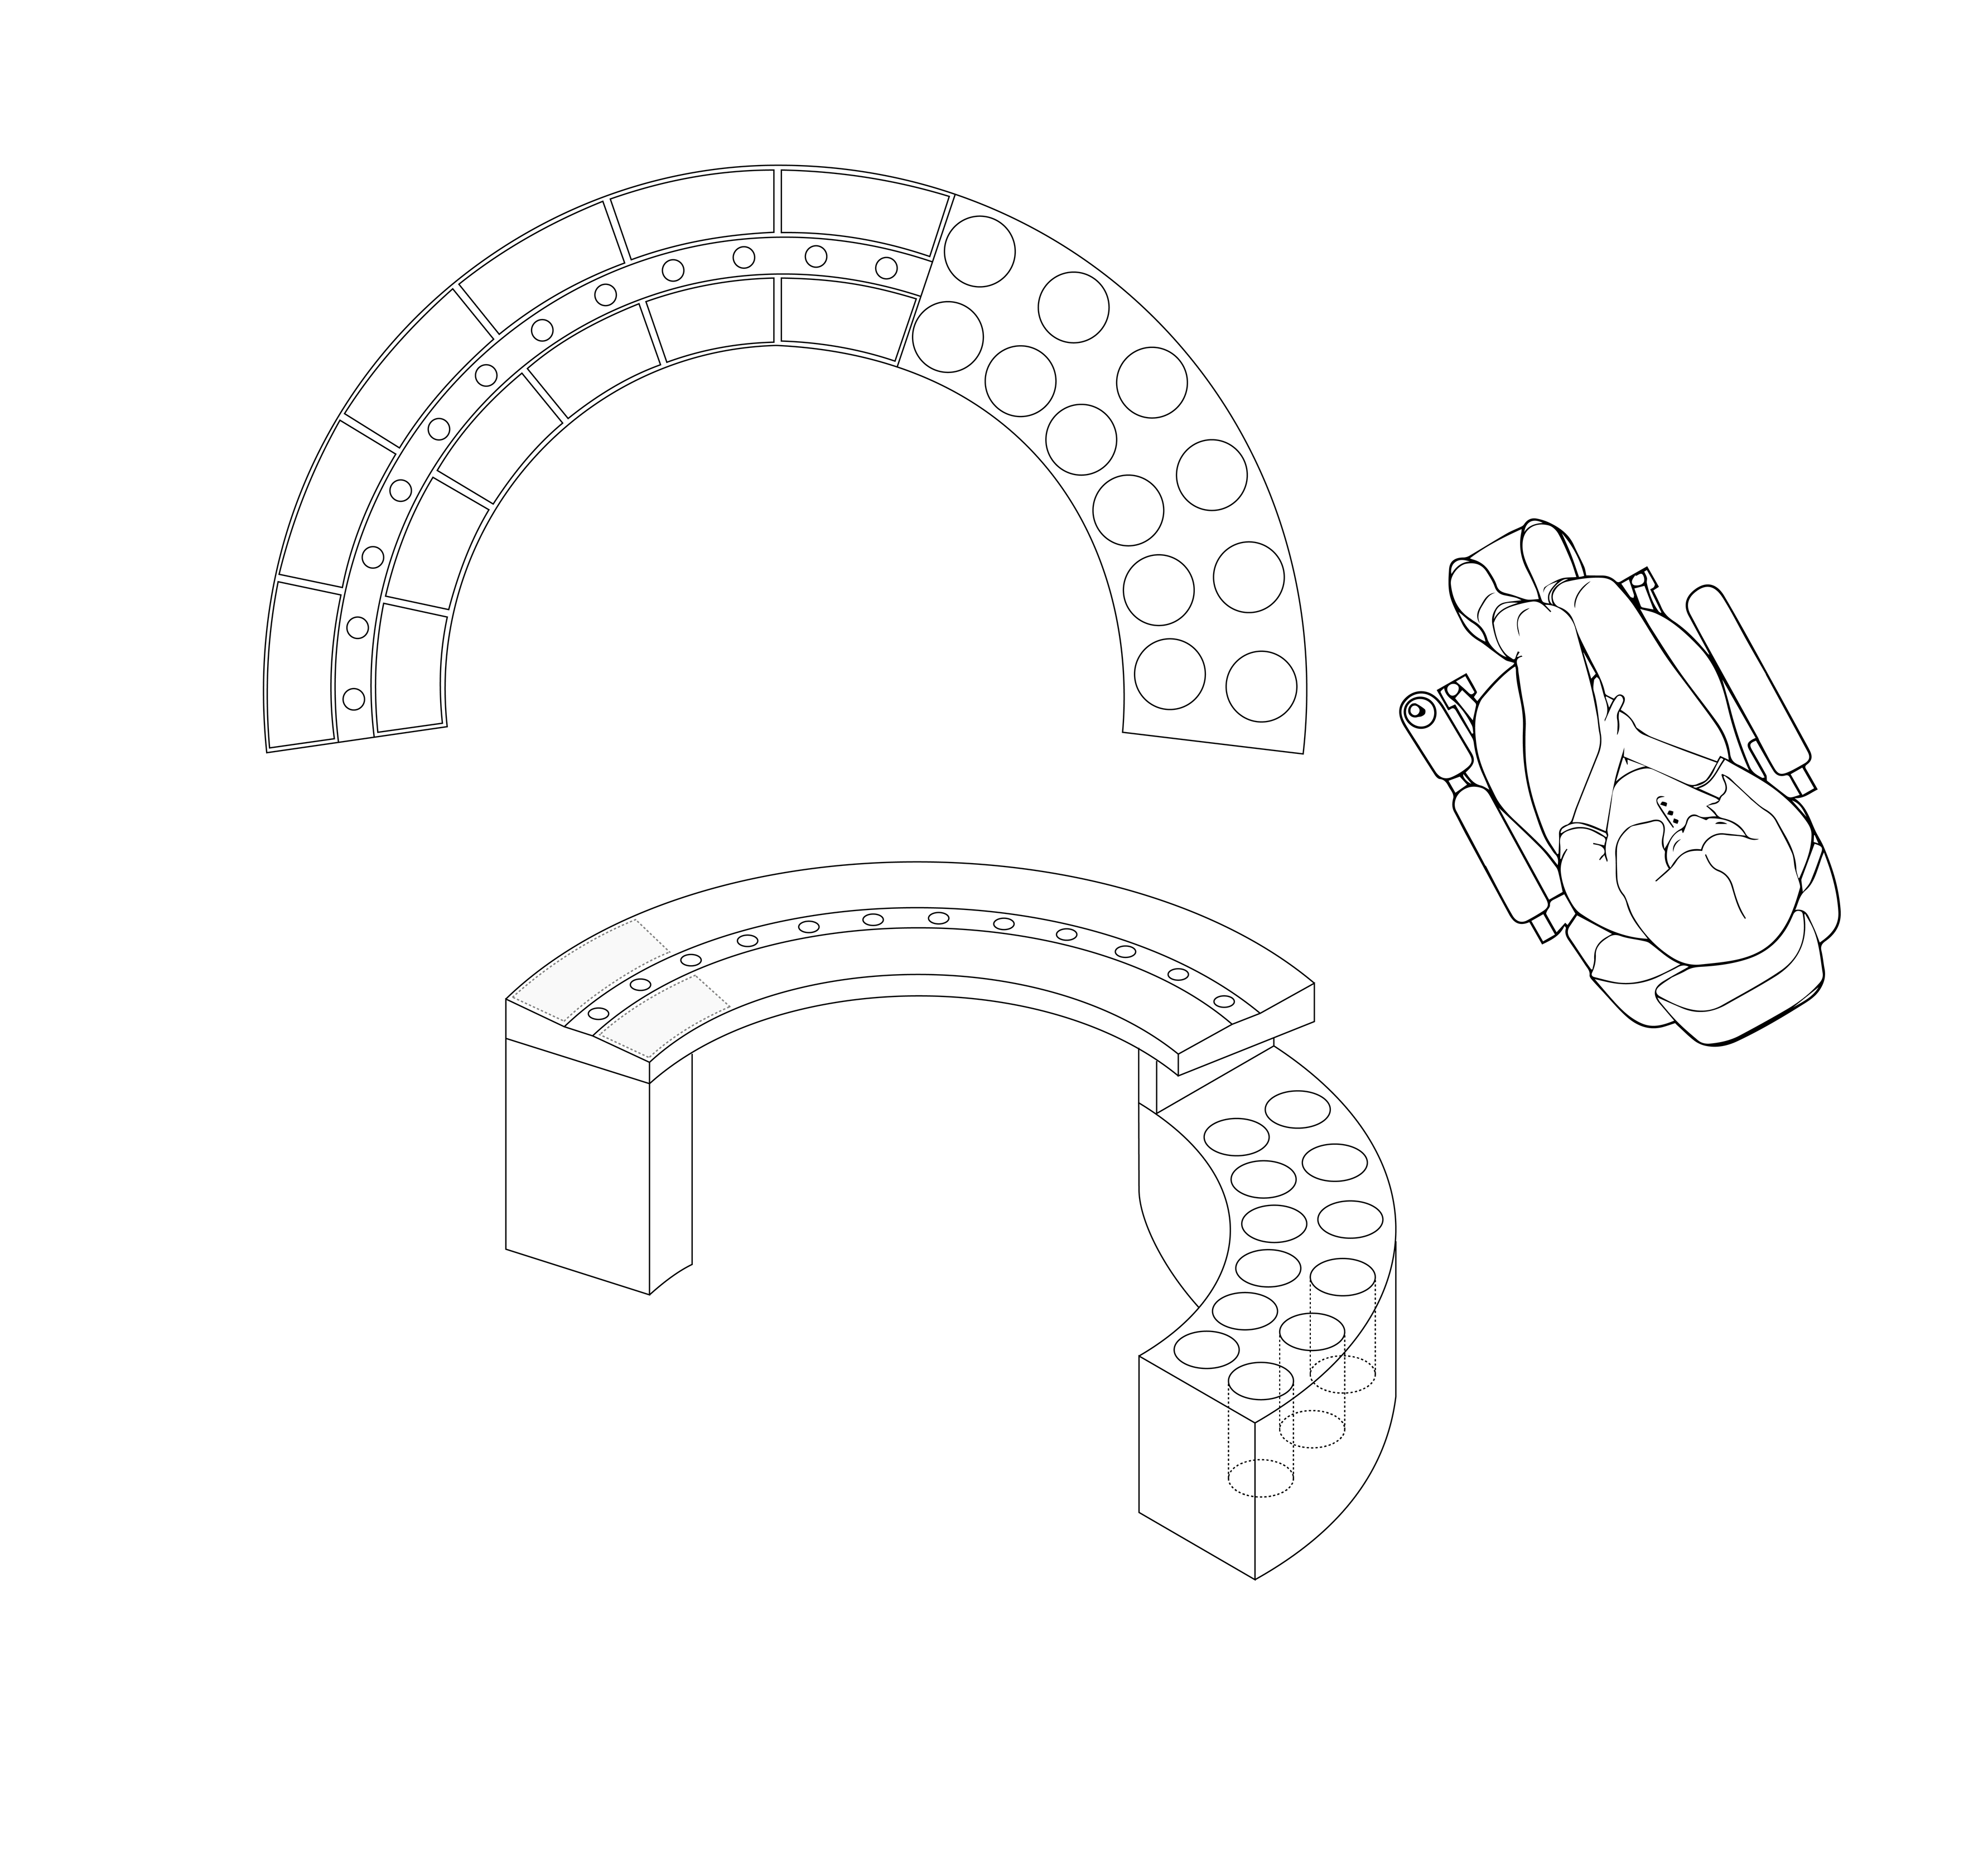
Vase Holder
Plaque
Ash Interment
Thoughtfully created with wheelchair users, walker users, and the elderly in mind.

Slide 14

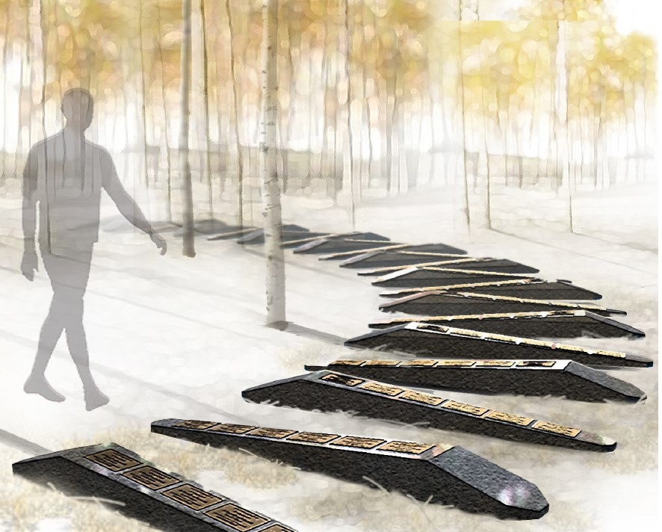
Family
Memorial
These low-lying structures serve as elegant transitional pieces. Thoughtfully designed to sit in front, or beside other medium to tall memorials, to utilize different eye-sight levels.
  Designed for lawns or rock gardens
  6 ash positions
  Positions buried in the ground
  Low lying for different levels

Slide 15
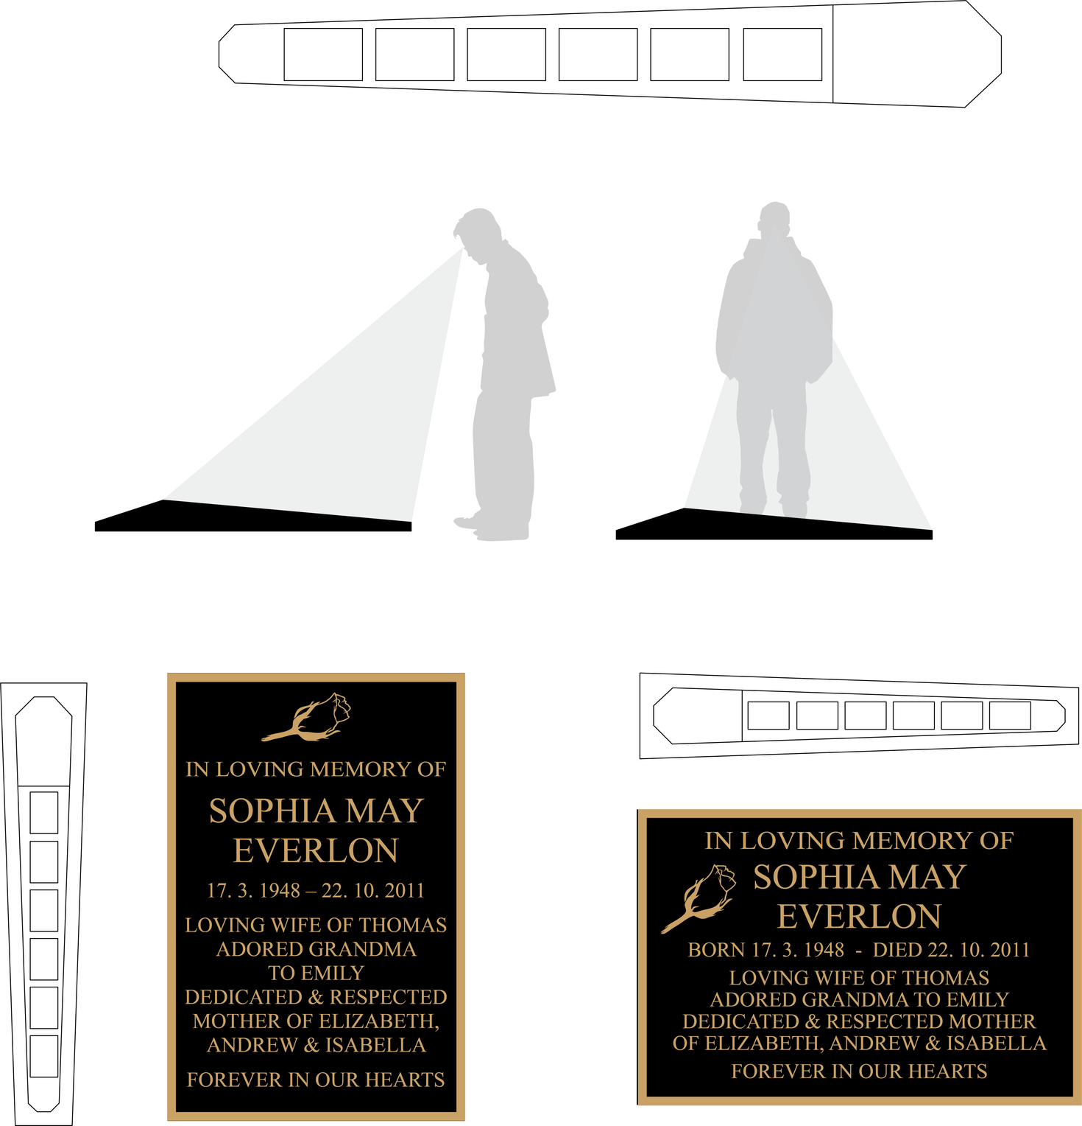

Two layouts for installation...
Vertical Positioning
Horizontal Positioning

Slide 16
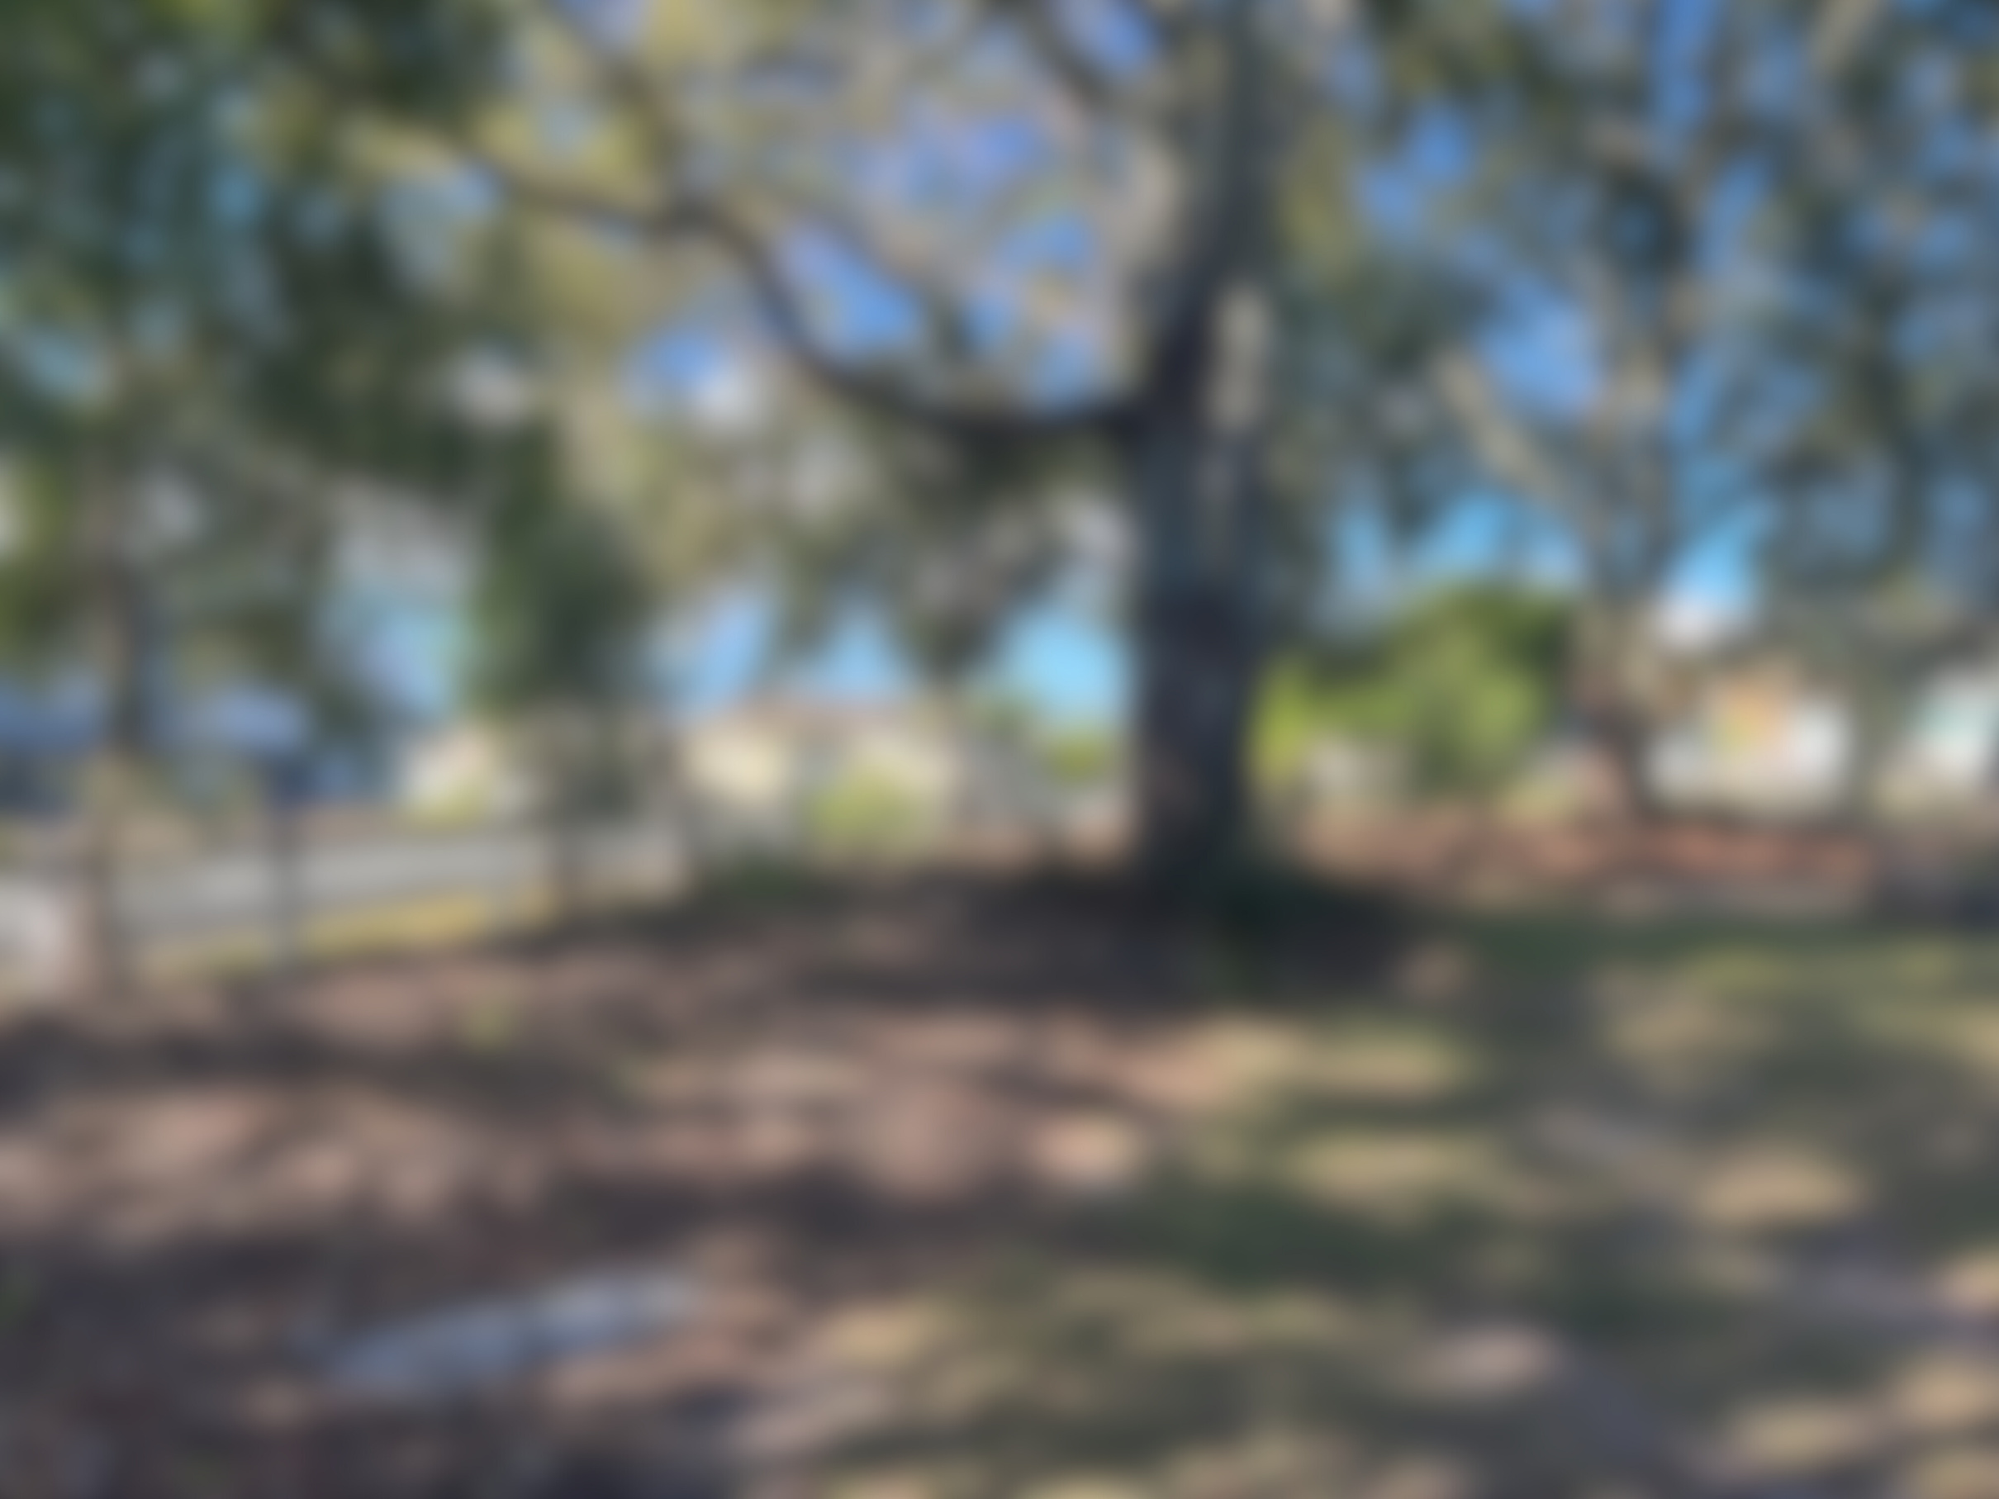
Other Products + Projects
2023

Slide 17
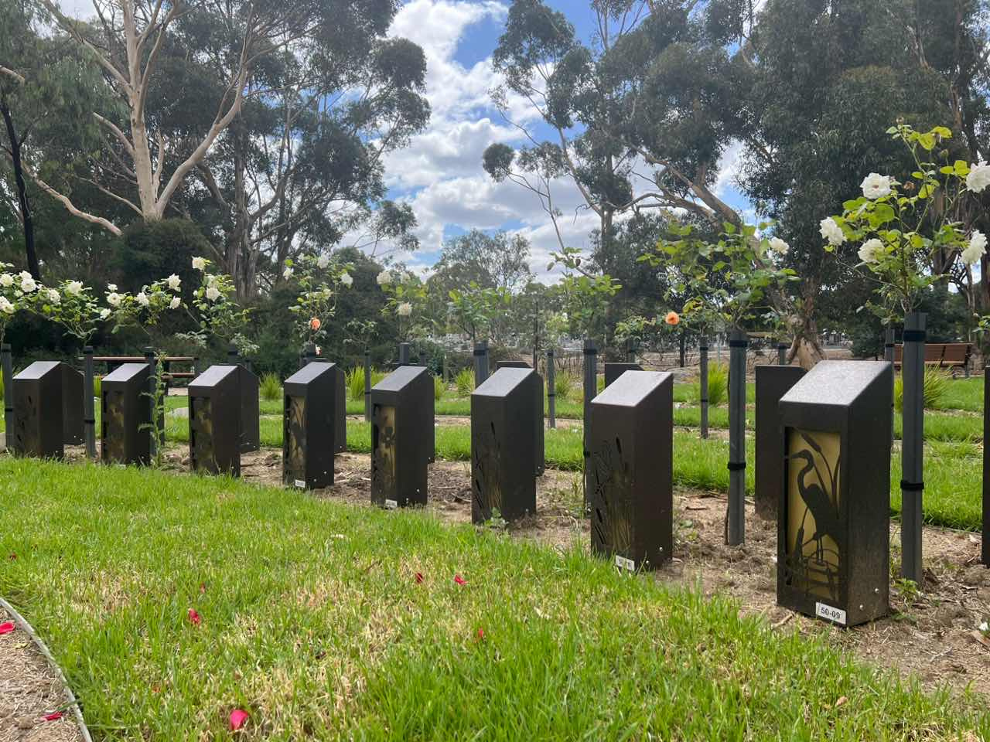
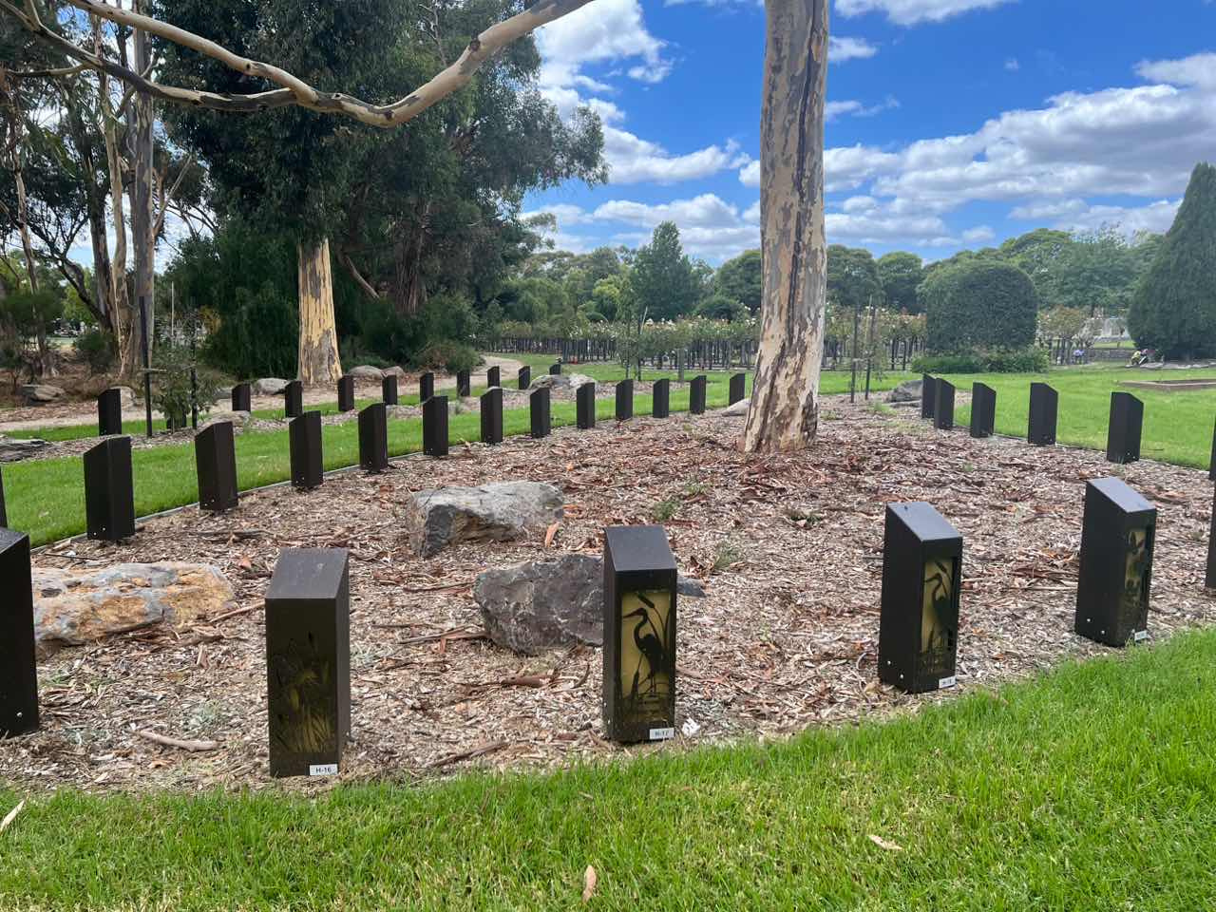
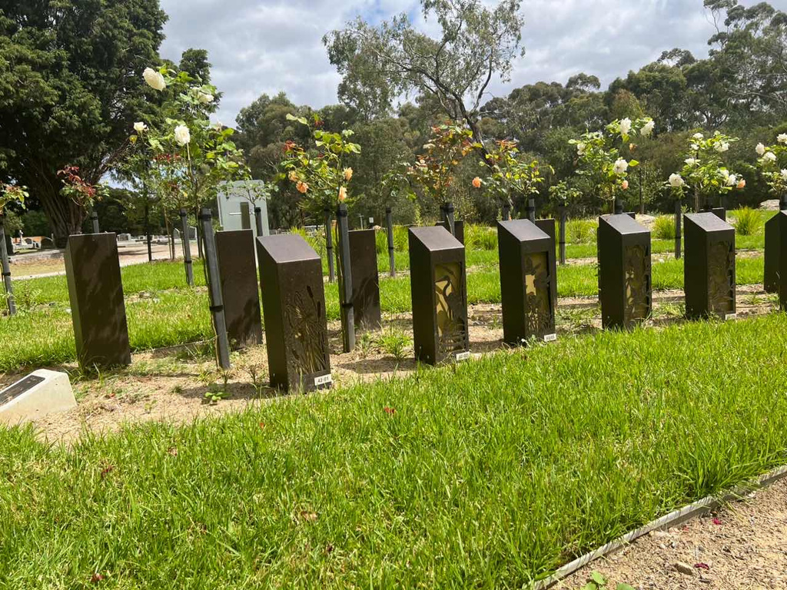
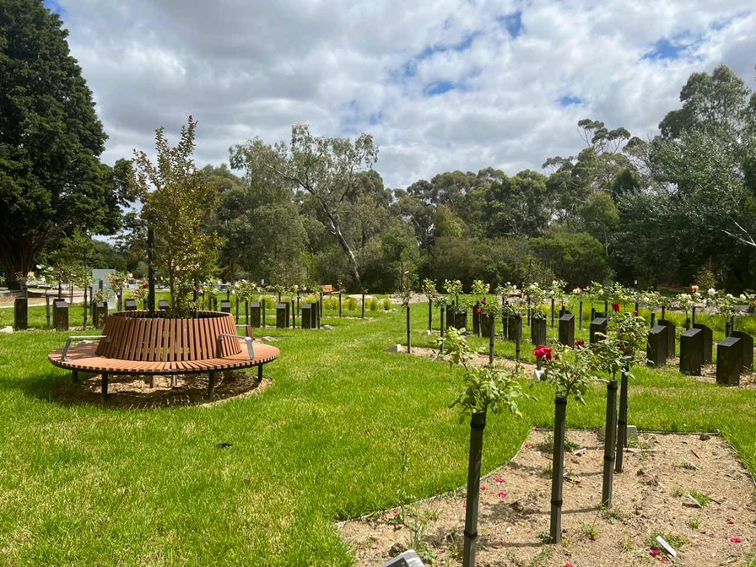
GMCT - PJ Rock
No Dig

Slide 18
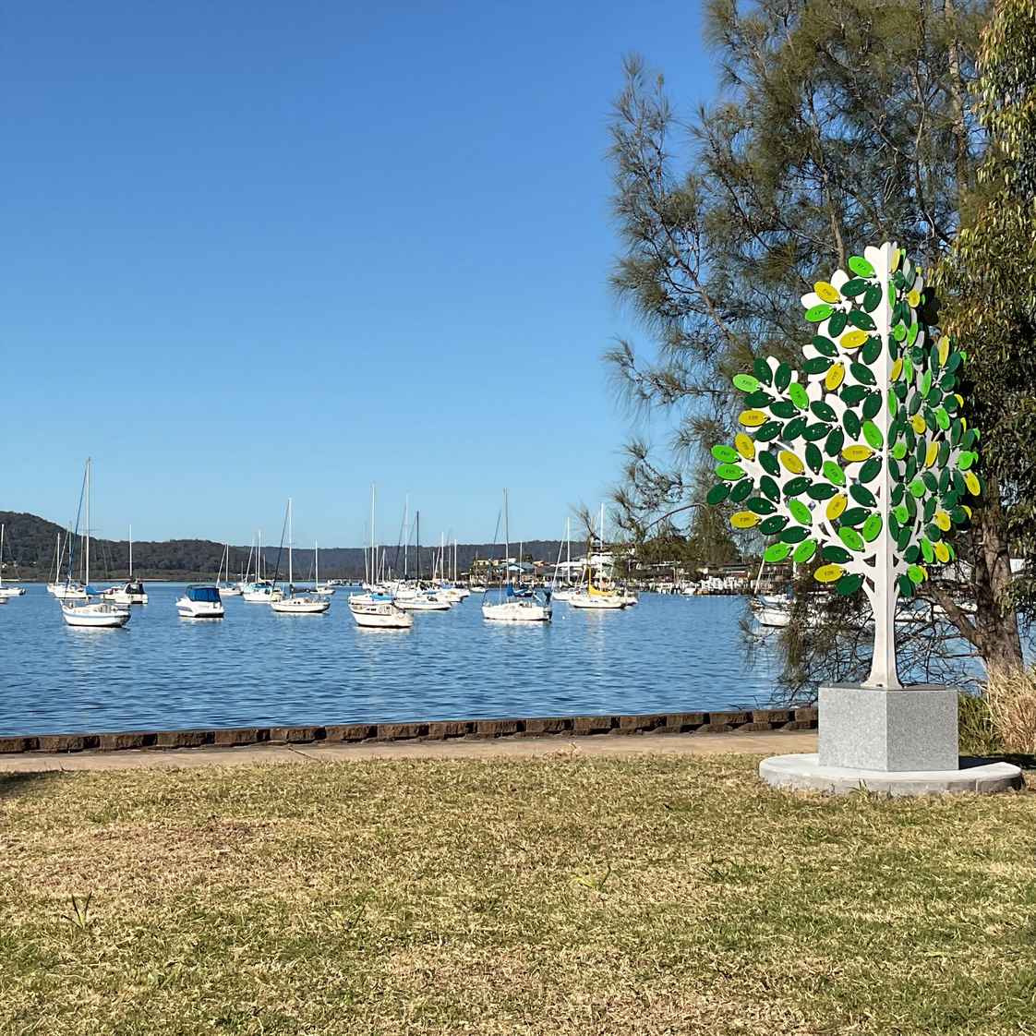
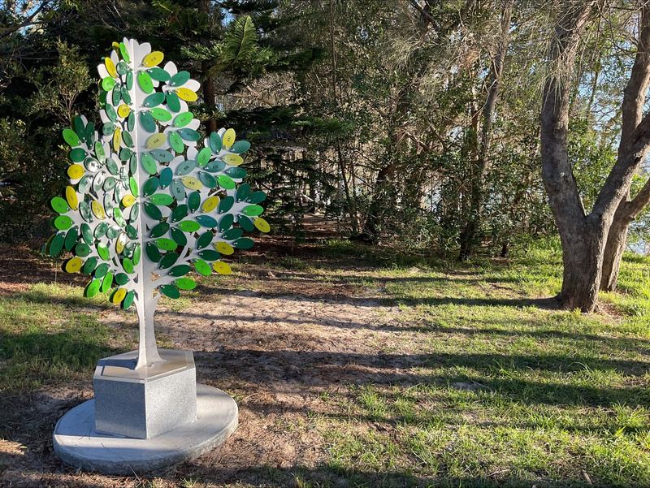
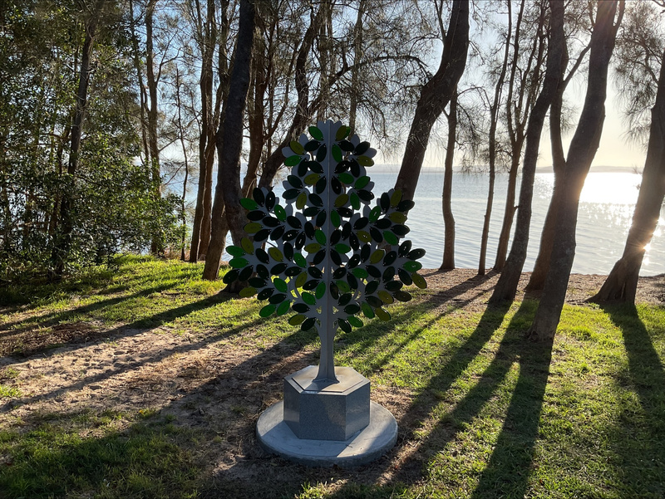
Central Coast Council
Memorial Trees

Slide 19
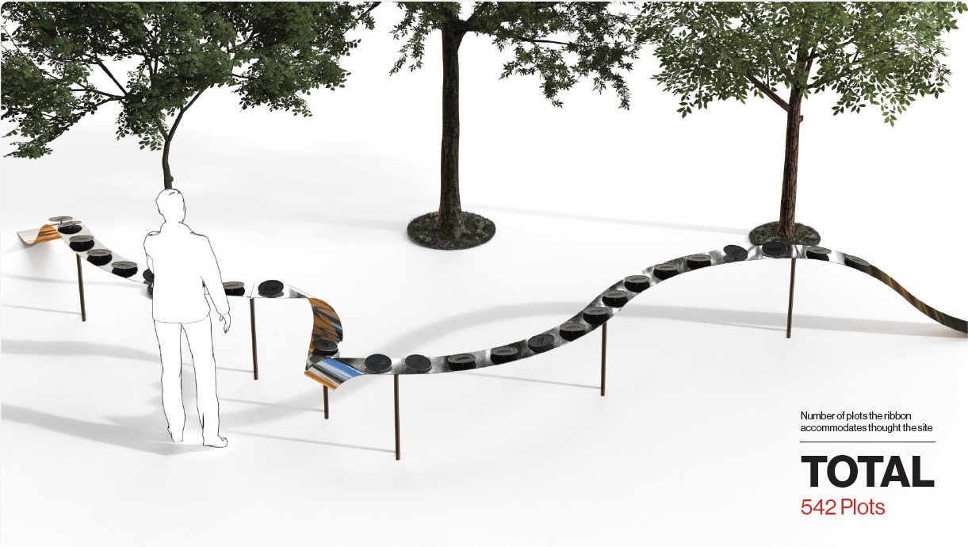
Canberra Memorial Parks
Ribbon Artwork

Slide 20
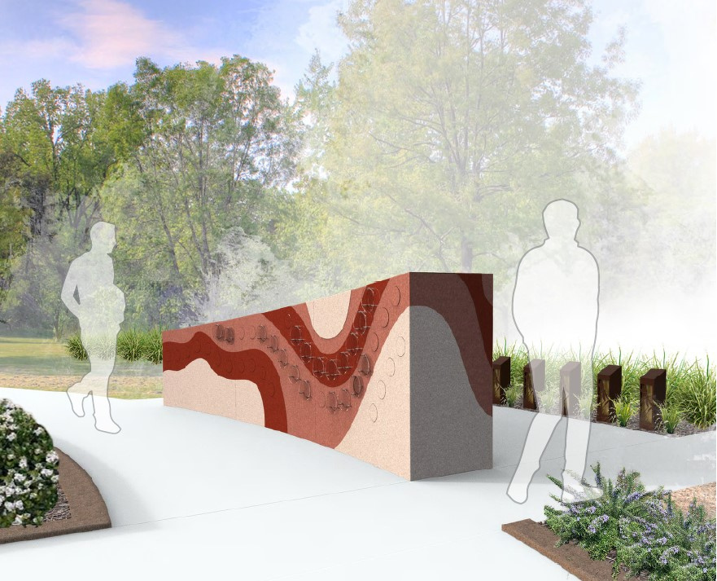
Canberra Memorial Parks
Niche Wall - Custom

Slide 21
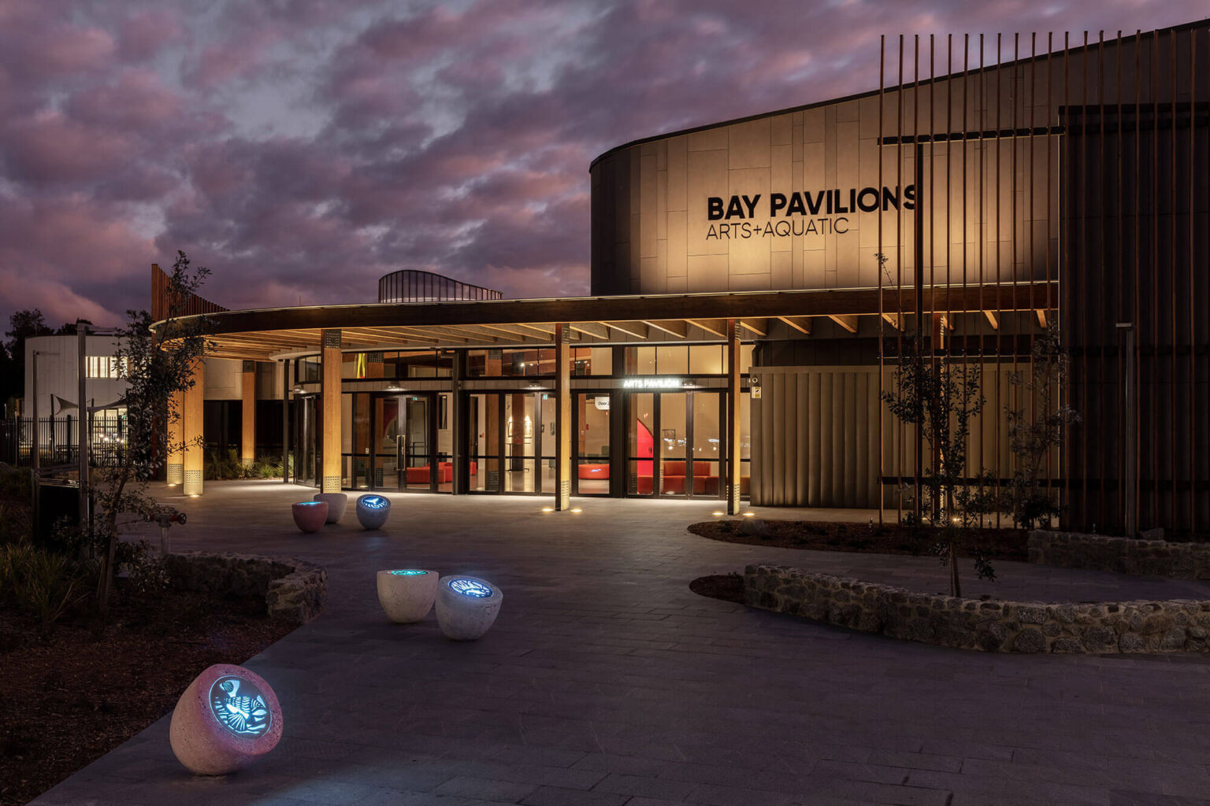
Batemans Bay
Emergence Artwork

Slide 22
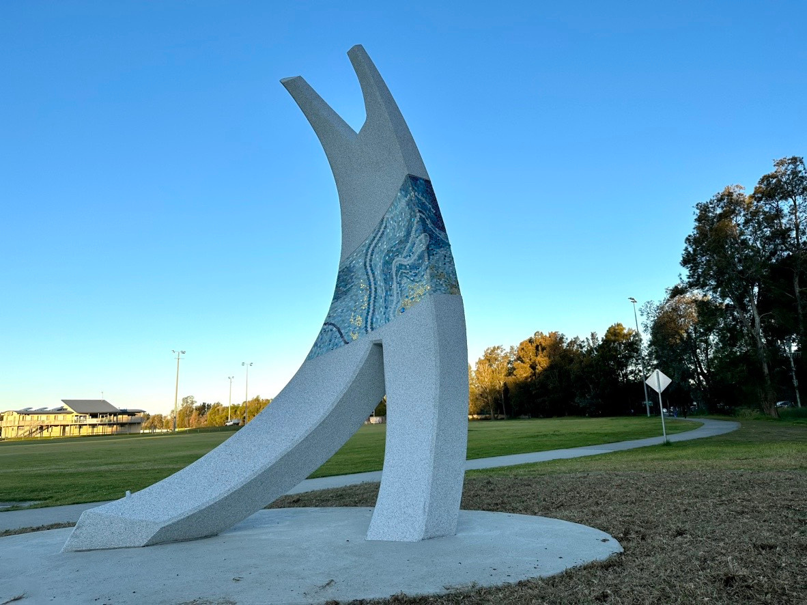
Batemans Bay
Soar Artwork

Slide 23
Future...
Everlon will continue to research, develop and innovate new methods and applications for memorialisation to continue to help cemeteries provide the best space and products for their families.

Slide 24

On behalf of Everlon
THANK YOU
Email: Info@everlon.com.au
Phone: (02) 9646 3886

